Slide 1
Mashpee Pond Water Quality And Low Impact Development (LID).
Mashpee Department of Natural Resources and Fuss & O’Neil

Slide 2
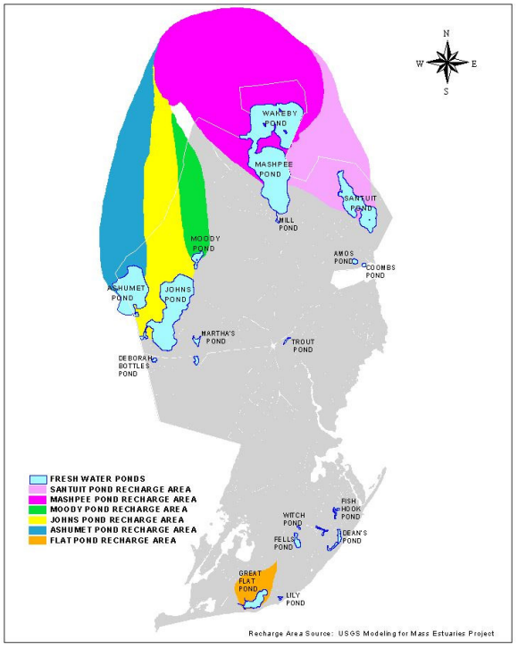
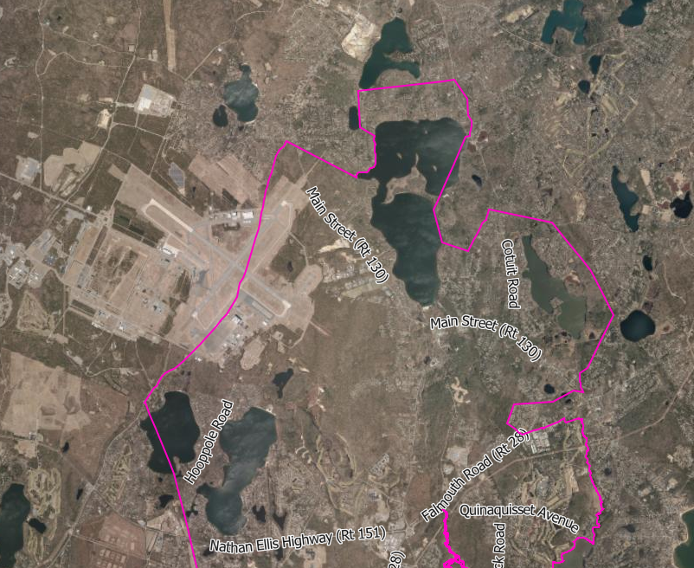

Slide 3
Ashumet Pond :
Description : Glacial “flow through” (groundwater fed) pond with a surface area of 215 acres. Total groundwater flux 454,741 – 474,081 cubic feet per day. Max Depth 69 ft. Average Depth 23 ft. 2.5 miles of heavily developed shoreline.
History : 1999-2001 Mass Military Reservation Plume Response Program : Ashumet Pond Phosphorous Management Plan completed to treat the Ashumet Valley sewage treatment plant plume that was discharging phosphorous into Ashumet pond.
Water Quality : Late 1990s and early 200s, decline in water quality evident due to the plume. Without action total pond eutrophication will escalate and cyanobacteria blooms will become the norm. Trophic status : STP Plume was contributing 19-45% of total annual phosphorus to the Pond. Anoxic conditions. Mesotrophic – Eutrophic.
Four remedial strategies were selected :
In-pond phosphorous inactivation by aluminum slats
In-pond phosphorous inactivation by iron-salts
Geochemical barrier at the plume pond interface
In-pond removal of phosphorous by hypolimnetic extraction.
Nutrient Inactivation Treatment: Ultimately a barrier and aluminum sulfate were chosen to eliminated input and inactivate the accumulated phosphorous within the pond.

Slide 4
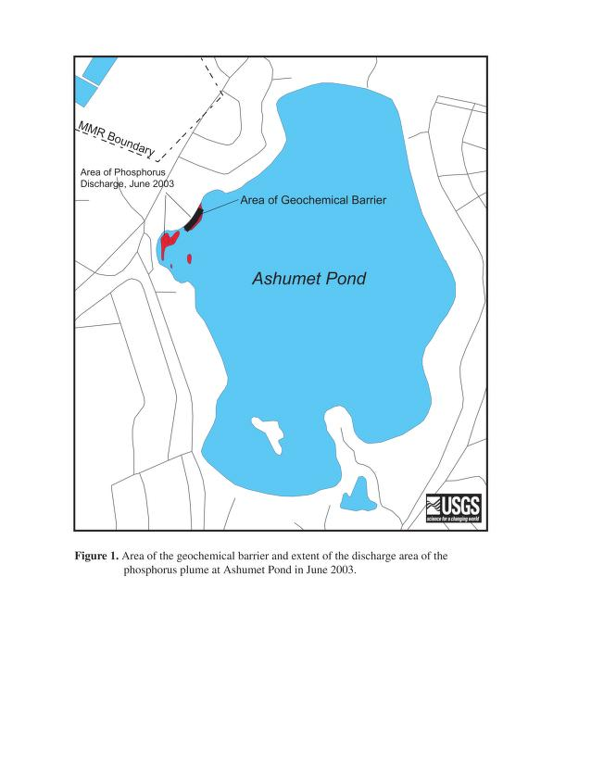
Ashumet Pond Treatments and Post-Treatment Conditions
2001 Ashumet Pond Phosphorous Inactivation project Mass Military Reservation.
Post treatment phosphorus decline seen throughout. Data seen in 2001 Report available from http:ar.afcec-cloud.af.mil/
2010 Ashumet Pond Phosphorous Inactivation project Mass Military Reservation.
Pre and Post Treatment Phosphorous Levels: Pre-treatment: highest concentrations seen 363µg/L Post-treatment : less than 20 µg/L throughout.
Mass Military Reservation barrier installation 2006: Installation of a geochemical barrier within the bloom discharge area: ferrous iron phase and/or mixed valent iron-based layered double hydroxide phase are used in phosphorous removal barriers.
Mass Military Treatment Upgrades ? External Loading from residential properties determined to be the cause of a rise in phosphorus levels form 2010-2022.

Slide 5
Ashumet Water Quality Data
 | Total Phosphorous | Chlorophyll | Secchi Depth | Dissolved Oxygen | Cyanobacteria Closure Y/N
2016 | Mid (9m) = 1.27µM | 3.50 µg/L | 4.35 m | 5.82 mg/L | N
2017 | Mid (9m) = 0.46µM Bottom (17m)=3.07µM | 3.50 µg/L 3.15 µg/L | 2.6 m | 7.30 mg/L 0.22 mg/L | N
2018 | Mid (9m) = 0.65 µM Bottom (17m)=6.31 µM | 11.39 µg/L 3.38 µg/L | 4.5 m | 2.7 mg/L 0.41 mg/L | N
2019 | Mid (9m) = 1.19 µM Bottom (17m)=7.68 µM | 28.50 µg/L 7.34 µg/L | 1.75 m | 3.20 mg/L 3.09 mg/L | Y
2020 | Mid (9m) = 0.73 µM Bottom (17m)=10.26 µM | 2.94 µg/L 2.64 µg/L | 3.5 m | 0.23 mg/L 0.01 mg/L | Y

Slide 6
Future Treatments:
The Mashpee Department of Natural Resources (DNR) will continue to monitor the pond for elevated phosphorus levels and cyanobacteria blooms.
Form May 1st to November 1st the Mashpee will conduct weekly water column cell counts for the presence of cyanoHABs and their density.
Visual inspections will also be conducted at the Northern and Southernmost sections of the pond to inspect for visible cyanobacteria scum layers.
Mass DPH recommends a minimum of a 1 week advisory notice if a scum layer is present and a minimum of 2 weeks for cyano cells counts exceeding the 70,000 cells / ml threshold.
In the occurrence of a high cell count, the DNR will send subsamples out form future toxin testing at a Mass DPH accredited laboratory.
Mass. Military Reservation has concluded their treatments. Further treatments would require Mashpee/Falmouth planning and implementation.

Slide 7
What is Aluminum Sulfate
Natural Resource Officer Christopher Avis

Slide 8
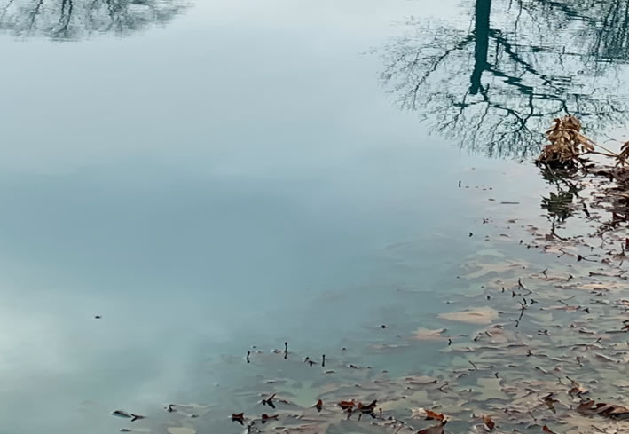
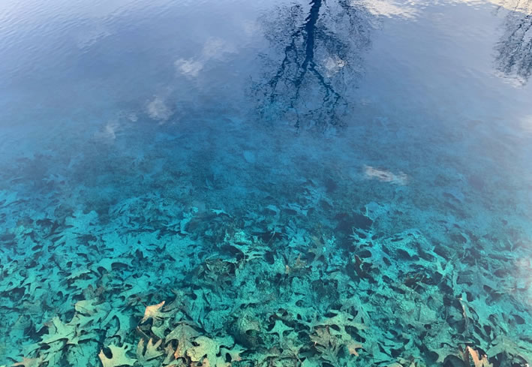
Aluminum Sulfate
Aluminium sulfate is a salt with the formula Al₂(SO₄)₃. It is soluble in water and is mainly used as a coagulating agent (promoting particle collision by neutralizing charge) in the purification of drinking water and wastewater treatment plants, and also in paper manufacturing.

Slide 9
The Problem
Water bodies like Santuit Pond, a kettle pond, will accumulate and store whatever flows into it from outside sources – Below are a list of just some of those nutrients:
Lawn fertilizer
Storm water runoff
Road water runoff
Nitrogen from septic/cesspools.
Waterfowl excrement, etc…
Overtime nutrient levels will become higher due to all the input with nothing balancing it out.
Inconveniently, phosphorus and nitrogen are the two nutrients that algae and rooted plants rely on the most for growth.
These abundant levels in the water column cause eutrophication, which cause harmful algal blooms.
This leads to closures of the pond to swimming and other forms of recreation, and is dangerous to humans, pets and other aquatic life.

Slide 10
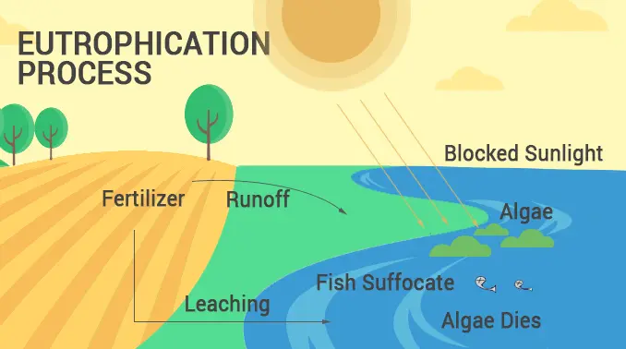
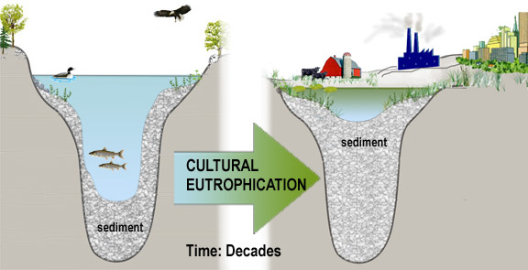

Slide 11
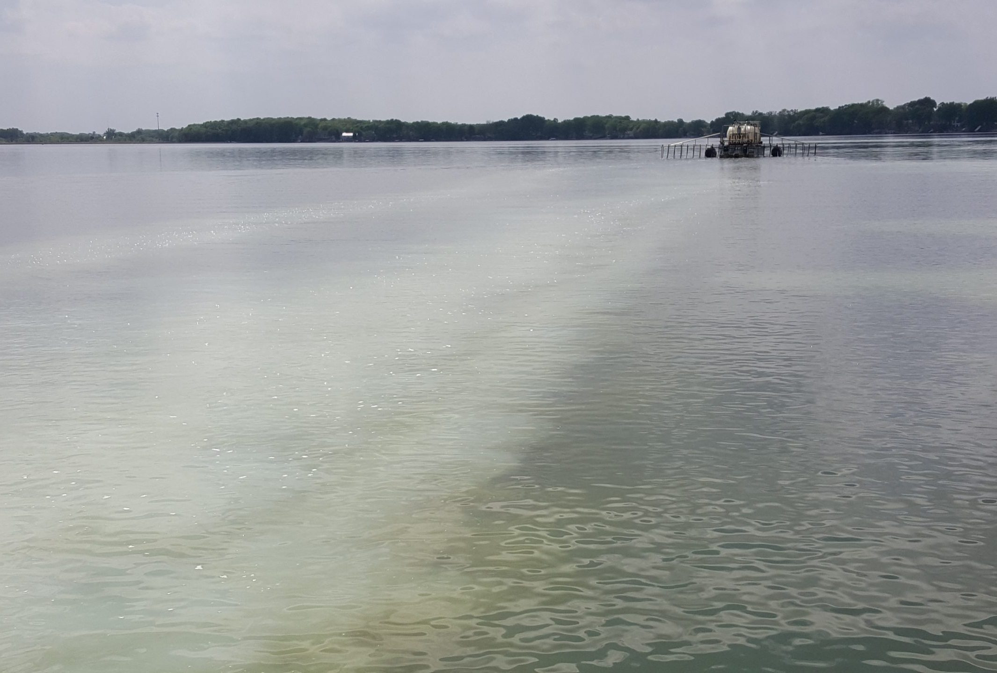
Why Aluminum Sulfate (ALUM)?
Due to the chemical makeup of alum, it will want to bind with a wide range of particles from clay and sand sediment to nutrients such as nitrogen and phosphorus.
When the alum binds with these nutrients, it renders them useless, and if done correctly can prevent plant growth before it happens.
Fortunately, this chemical property solves two of the biggest problems; eutrophication and clarity issues.

Slide 12
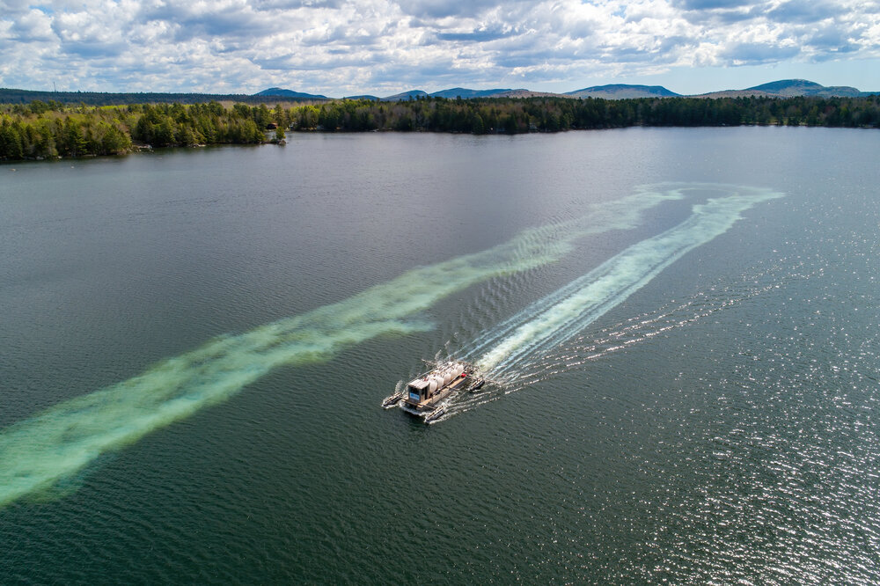
ALUM Treatment
The solid precipitate forms a flocculent material, referred to as a floc, that has a high capacity to adsorb phosphates. The aluminum hydroxide blanket, when applied appropriately, separates the sediment from the water column, which reduces internally supplied phosphorus.

Slide 13
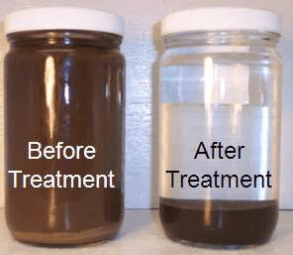
Sample of results before and after treatment

Slide 14
It’s Safe !
Alum is safe for swimming, recreational activities, aquatic life and pets.
Alum has been used in several Cape Cod ponds, including Ashumet Ponds, Mystic Lake, Hamblin Pond, Lovell's Pond, Long Pond, Cliff Pons, Lovers Lake, Stillwater Pond, Herring Pond and Great Pond.
Comparison of pre-treatment and post-treatment summer Phosphorous concentrations between surface or bottom sampling locations indicate a decrease in all cases.
Nickerson State Park / DCR – Ashley’s Experience
Hamblin Pond Barnstable – What went wrong?
Buffer and dosing not properly calculated for the waterbody.
Common Misconceptions-
Can cause Alzheimer's: “NO SOLID EVIDNECE”- Alzheimer’s Society
Kills Fish – pH differential not seen if pond is properly buffered
Does not work in shallow ponds- NO EVIDENCE in the literature
suggests this is true. Shallowness may reduce the life span of
the inactivation process if not properly managed – Bylaws.

Slide 15
Santuit Pond
Santuit is a shallow, fertile, enlarged great pond. Groundwater fed and forms the headwaters of the Santuit River. Max depth 11 feet. Average depth 6.5 feet. Shoreline is steep, moderately developed with homes and abandoned cranberry bogs.
History : Harmful algal blooms of cyanobacteria (cyanoHABs) have impacted water quality in Santuit Pond, limiting recreational access and impacting aquatic life. Santuit Pond water quality has been monitored by state, tribal, and local agencies, as well as academic groups and volunteer monitors. Like most ponds experiencing cyanoHABs, phosphorus sources are a mix of internal and external sources and addressing both is part of a long-term solution to improving water quality. Majority of the load of phosphorus comes from internal recycling of nutrients.
Water Quality : Poor. Santuit watershed ultimately enters into the Popponesset Bay system.
In Pond Treatment (Internal) -Nutrient Inactivation Treatment: Town of Mashpee and The Mashpee Wampanoag Tribe are currently investigating the possibility of an in pond nutrient inactivation treatment of Aluminum Sulfate.
In Pond Treatment (Internal) – Aeration systems or SolarBees: Oxygenating the bottom sediment prevents or limits internal cycling during anoxic events
Watershed Nutrient Treatment (External) - MVP / SNEP Projects : The Town of Mashpee and the Mashpee Wampanoag Tribe are also investigating and implementing stormwater control measures to reduce the external input load of phosphorus to Santuit Pond.
Watershed Nutrient Treatment (External) – Sewering : Santuit Pond watershed sewering moved from a later phase to phase 2.
Invasive Species Treatment: Santuit pond will be treated with the Herbacide Procellacor this spring to eradicate the invasive plant specie variable leaf milfoil
Cranberry Bog Restoration: Chopcaque Bog

Slide 16
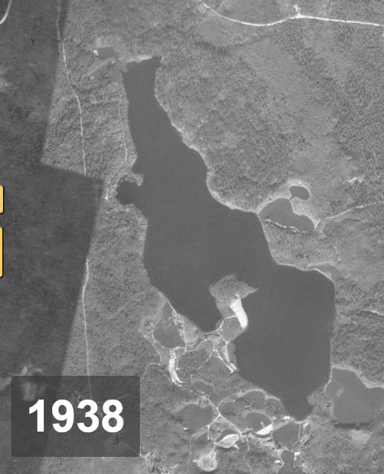
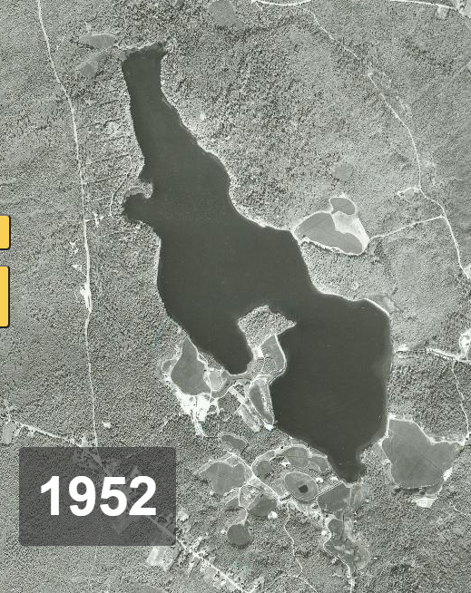
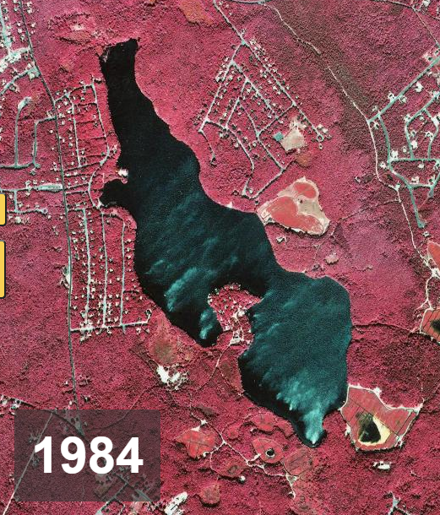
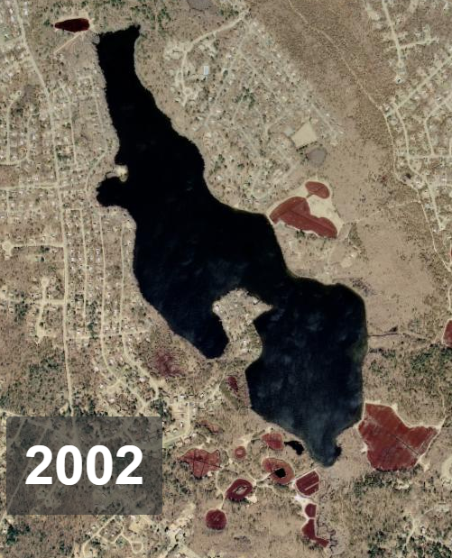
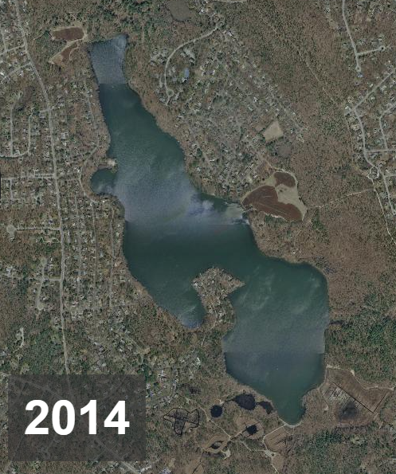
Santuit Development

Slide 17
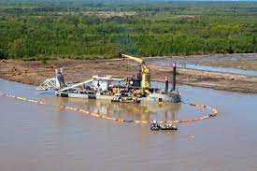
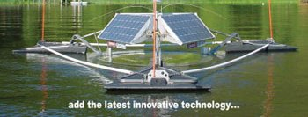
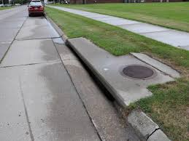
In Lake Treatment AND Control of External Sources :
Internal
Dredging
Aluminum Sulfate
Aeration
External
Stormwater
Yard use –LID / Green Infrastructure
Bylaw Review
Buffer Zones
Rain Gardens
Berms
Sewering

Slide 18
Santuit Pond
2019- Present - Tribe / Town Dredging Feasibility Study - Army Corps. Of Engineers : Original Proposal was to dredge nutrient latent sediments from the pond, but sediments were found to be rich is arsenic. The arsenic concentrations prohibited the Army Corps. from dredging the pond to reduce nutrients. The project then became solely for habitat restoration for the alewife herring. The U.S. Army Corps of Engineers, New England District (USACE) is proposing an Aquatic Ecosystem Restoration project for Santuit Pond to consider alternatives to restore aquatic habitat. The study is being conducted under Section 206 of the Water Resources Development Act of 1996 (WRDA), as amended, in cooperation with the Mashpee Wampanoag Tribe, the Non-Federal Sponsor, and the Town of Mashpee.
Arsenic accumulation is most likely from continual pesticide use within the Santuit Pond Watershed.
2021 – Order for Properties within 300’ of Santuit Pond- Mashpee Board of Health: Homeowners ordered to 1.) Conduct an Onsite Septic Inspection 2.) Pump Their System
Results Dec.2021 : Of the 118 properties, 90 are now considered fully compliant
10 properties have complied with the inspection component only
21 Failures were identified which included 7 cesspools
4 Properties have installed I/A Nutrient Reducing Systems
2021/2022 – Phase 2 Sewering?

Slide 19
SNEP Network Technical Assistance and Scope
Training (Town and Tribe) to develop conceptual design(s) for stormwater retrofits and green infrastructure solutions to address identified problems.
Contractor assistance to evaluate interim measures to address the phosphorus loading in Santuit Pond.
Santuit Pond Watershed Based Plan (WBP) using the MassDEP WBP Tool Kit.

Slide 20
Sources of Phosphorus:
#1 Internal Nutrient Cycling (78%)
#2 Stormwater Runoff (13%)
#3 Septic Systems (5%)
#4 Cranberry bogs ( 3%)
Source: Lake Diagnostic Feasibility Study, AECOM, 2010

Slide 21
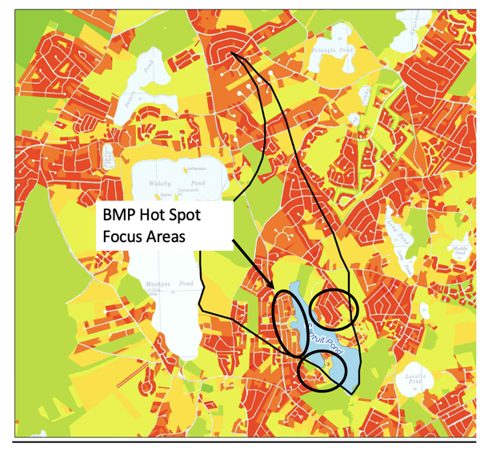
Santuit Pond Watershed Based Plan
Pull all activities into nine element plan
Stormwater retrofit 10-20 locations (bioretention, catch basin and roadway drainage retrofits, water quality swales, leaching catch basins, subsurface structures)
Alum Treatment
Implementation schedule and budget
Apply for funding for design and Implementation

Slide 22
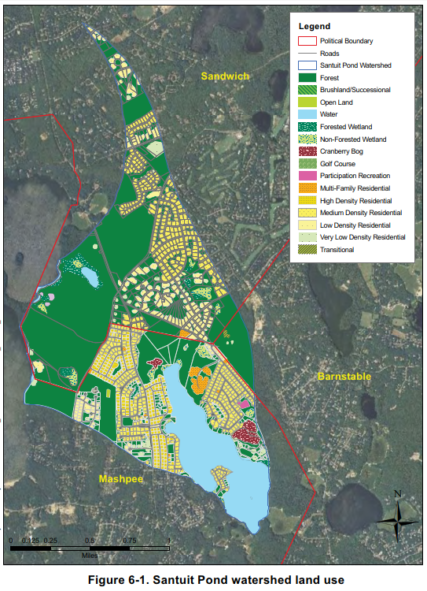
Santuit Pond Watershed
AECOM, 2010

Slide 23
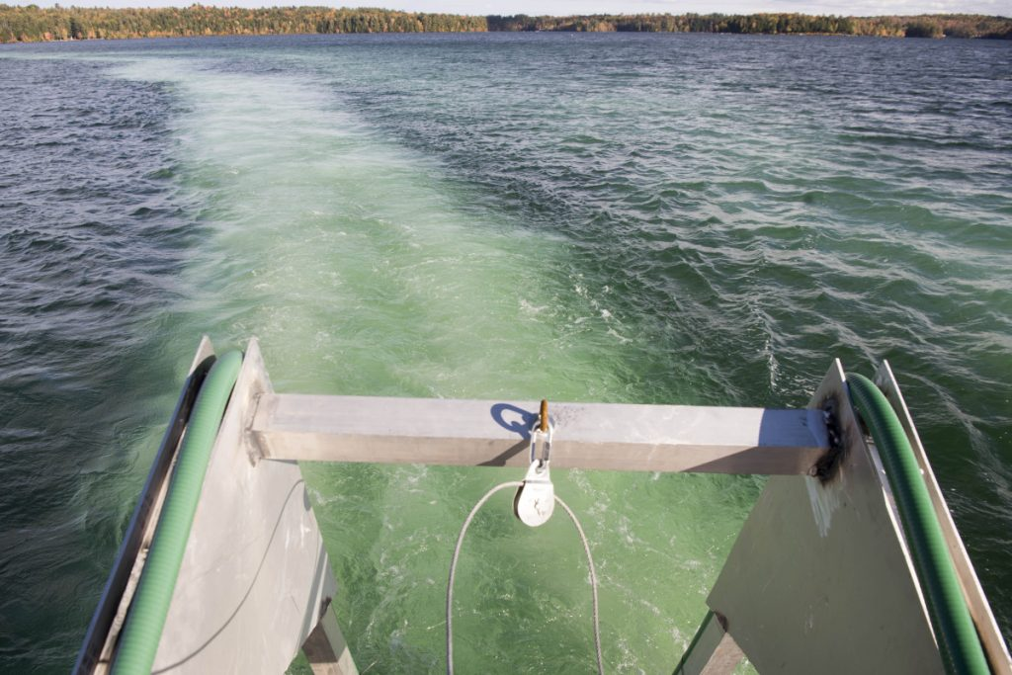
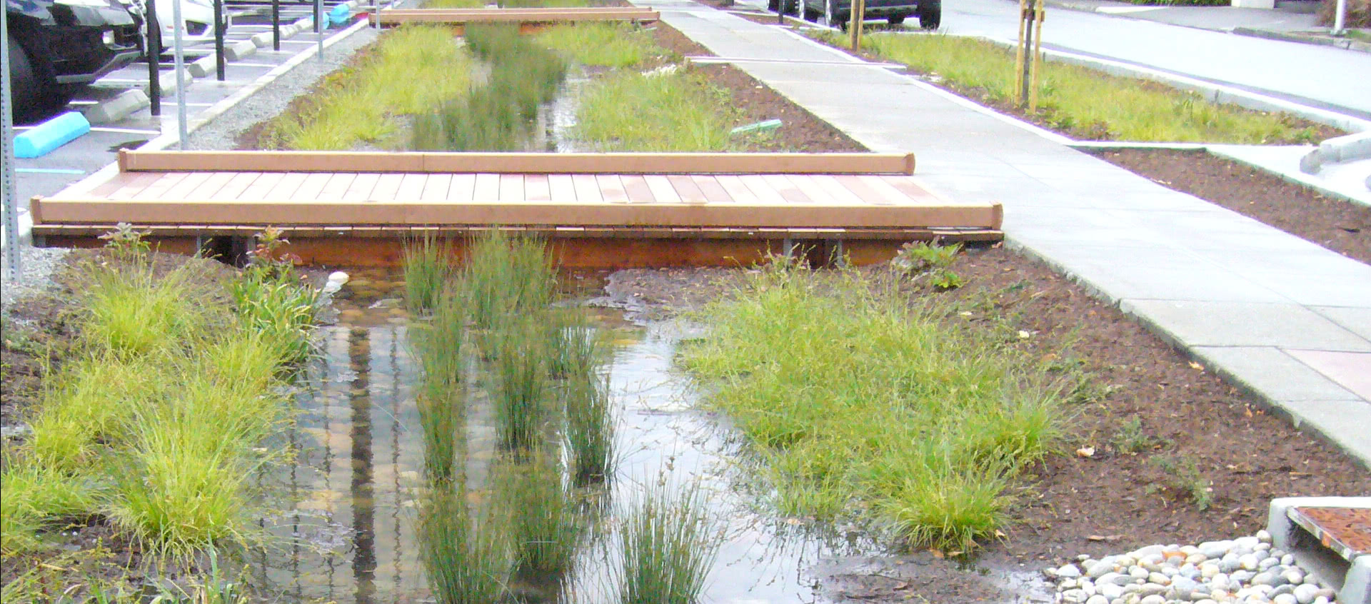
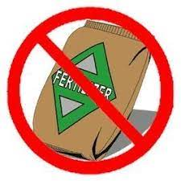
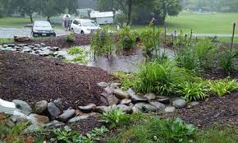
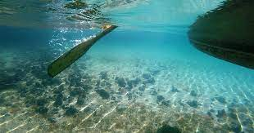
Santuit’ s Future:

Slide 24
Santuit Water Quality Data
 | Total Phosphorous | Chlorophyll | Secchi Depth | Dissolved Oxygen | Cyanobacteria Closure Y/N
2016 | Mid (1.5m) = 0.56 µM | 5.73 µg/L | 2.50 m | 9.52 mg/L | Y
2017 | Mid (1.5m) = 2.41 µM | 38.07 µg/L | 0.90 m | 9.18 mg/L | Y
2018 | Mid (1.5m) = 2.99 µM | 26.64 µg/L | 0.90 m | 4.40 mg/L | Y
2019 | Mid (1.5m) = 1.75 µM | 30.69 µg/L | 0.63 m | 6.00 mg/L | Y
2020 | Mid (1.5m) = 1.38 µM | 30.09 µg/L | 0.90 m | 9.18 mg/L | Y

Slide 25
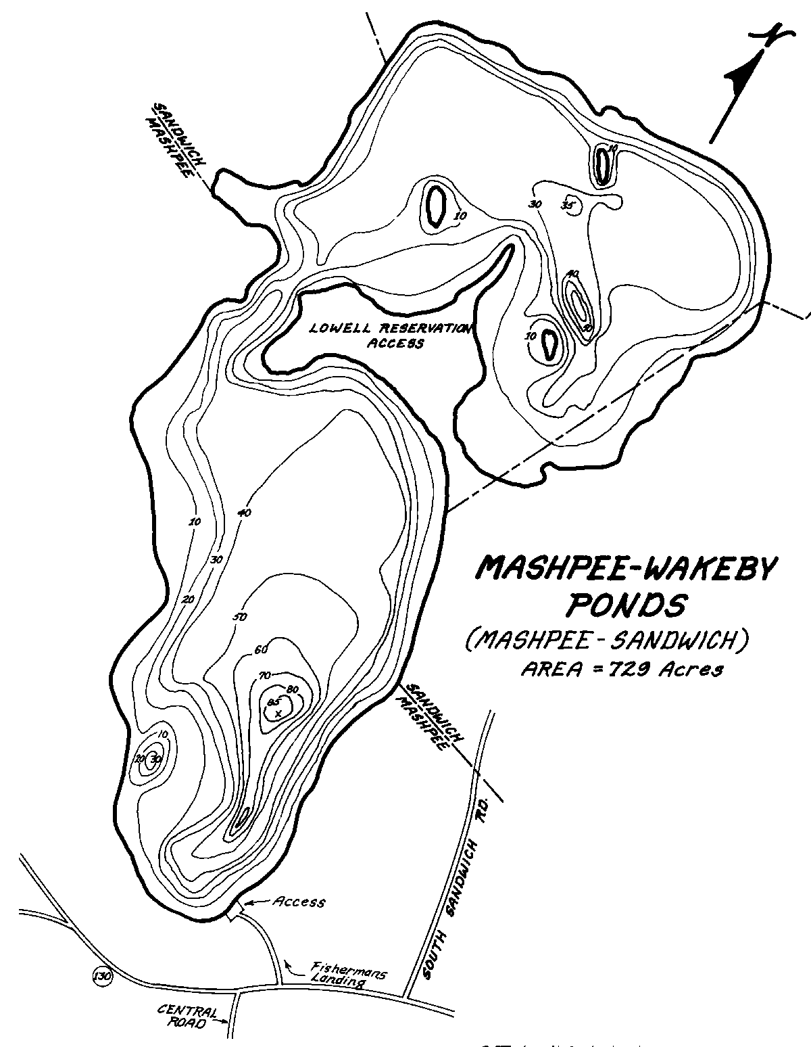
Mashpee Wakeby Pond
History : 729 Acres, Largest freshwater pond on Cape Cod. Mashpee and Sandwich abutting parcels. Deepest point is 90+ feet. Wakeby Pond is the northern basin and Mashpee Pond is the southern basin. The ponds are fed by groundwater and drain to the Mashpee River.
Three Islands: Keith, Jefferson, Cleveland.
Conservation Lands: Lowell Holly Reservation, Ryder Conservation Lands,
Pickerel Cove.
Water Quality : Moderate – Sub-embayments ultimately enter into the Popponesset Bay System.
Mashpee Side showing minor cyanobacteria elevations
Wakeby side consistent cyanobacteria elevations, and continued phosphorus increases from 2016-present
2021 advisory posted – evidence of a visible scum layer.

Slide 26
Mashpee Basin of Mashpee Wakeby Water Quality
 | Total Phosphorous | Chlorophyll | Secchi Depth | Dissolved Oxygen | Cyanobacteria Closure Y/N
2016 | Mid (9 m) = 1.24 µM Bottom (24 m) = 1.11 µM | 4.35 µg/L 3.83 µg/L | 2.75 m | 7.92 mg/L 0.12 mg/L | Y – High Algae Counts and High Bacterial Counts
2017 | Mid (9 m) = 0.65 µM Bottom(24 m)=10.40 µM | 2.32 µg/L 0.03 µg/L | ND | ND ND | N
2018 | Mid (9 m) = 0.99 µM Bottom(19 m) = 6.09 µM | 13.82 µg/L 0.03 µg/L | 5.20 m | 2.99 mg/L 0.39 mg/L | N
2019 | Mid ( 9 m) = 0.70 µM Bottom (22 m) = 8.80 µM | 9.59 µg/L 1.28 µg/L | 4.35 | 0.76 mg/L 0.28 mg/L | N
2020 | Mid (9m) = 0.80 µM Bottom (26 m) = 8.28 µM | 1.34 µg/L 0.73 µg/L | 0.90 m | 2.04 mg/L 0.00 mg/L | N

Slide 27
Wakeby Basin of Mashpee Wakeby Water Quality
 | Total Phosphorous | Chlorophyll | Secchi Depth | Dissolved Oxygen | Cyanobacteria Closure Y/N
2016 | Mid (9 m) = 1.27 µM Bottom (12 m) = 1.37 µM | 11.42 µg/L 13.96 µg/L | 1.75 | 7.49 mg/L 0.25 mg/L | Y – High Algae Counts and High Bacterial Counts
2017 | Mid (9 m) = 1.50 µM Bottom(12 m)=2.28 µM | 2.77 µg/L 3.25 µg/L | ND | ND ND | N
2018 | Mid (9 m) = 2.26 µM | 23.78 µg/L | 3.60 m | 1.45 mg/L | N
2019 | Mid ( 9 m) = 2.67 µM Bottom (12 m)=10.55 µM | 9.59 µg/L 8.77 µg/L | 3.20 m | 0.45 mg/L 0.29 mg/L | N
2020 | Mid (9m) = 2.65 µM Bottom (12 m)=11.37 µM | 2.86 µg/L 0.97 µg/L | 2.7 m | 0.11 mg/L 0.00 mg/L | Y- High Cyanobacteria Counts

Slide 28
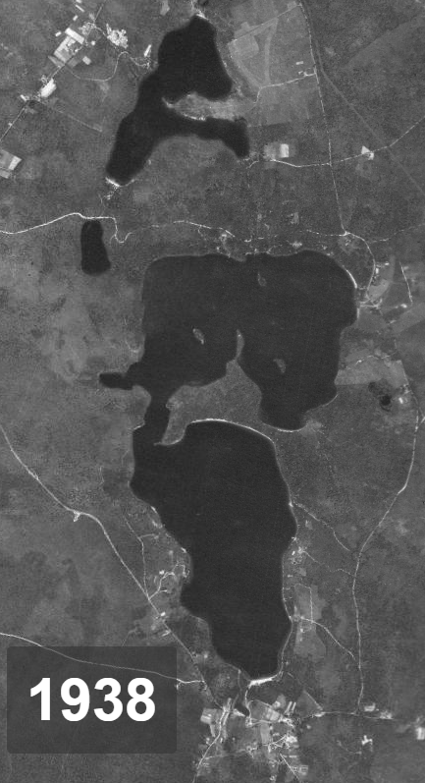
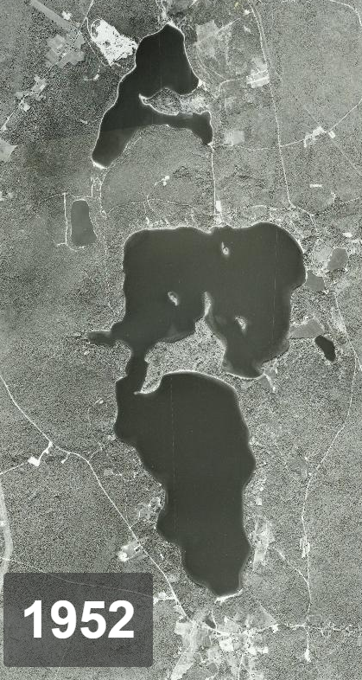
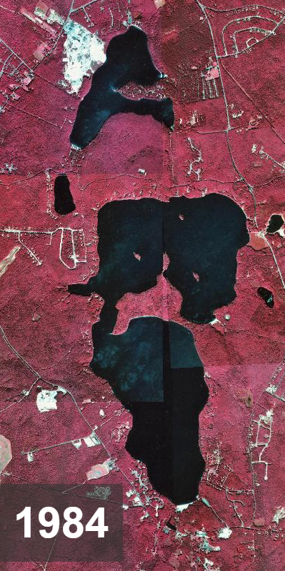
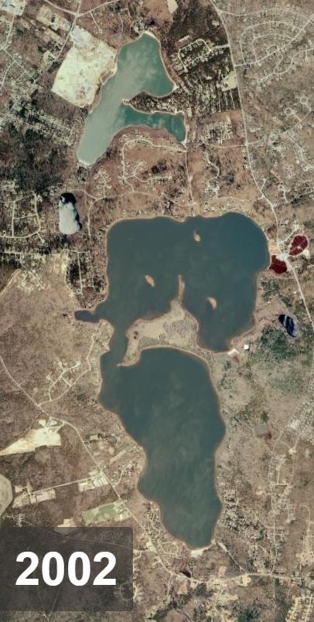
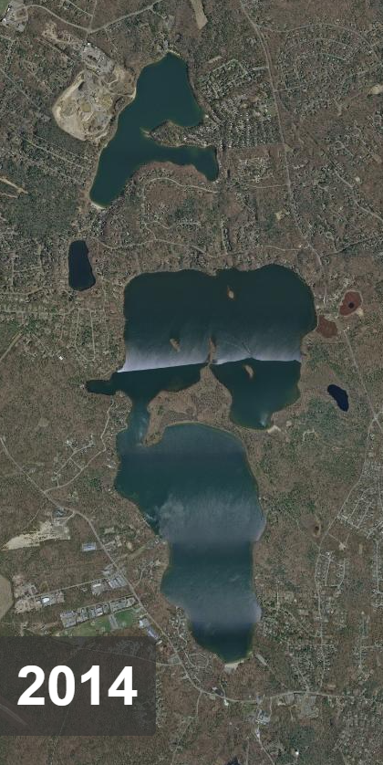
Mashpee Wakeby Development

Slide 29
Mashpee Wakeby Pond Diagnostic Study
A consultant for the Mashpee Wakeby Diagnostic Study has been chosen and work with begin this Summer. The scope of the diagnostic study will include:
Collection and review of pervious Mashpee-Wakeby Pond data : Data organization from the Pond and Lake Stewardship Program (data collected between 2001-2021), streamflow (flow and nutrient loads), water quality data, and watershed delineations collected / created for the Mass Estuaries Project, streamflow collected from the Mashpee River, and any historical data collected by other state and federal agencies. The consultant will also collect and review all fishery information from the Division of Marine Fisheries to asses the ponds fishery and to evaluate the Herring Run.
Pond Diagnostic Assessment: This will include the development of phosphorous, nitrogen, and water budgets based upon quantitative field data. The budgets will identify all sources of nutrients. The consultants will conduct 2 years of water column monitoring , sediment surveys, stream outflow surveys, rooted plant an mussel surveys, watershed assessment and development of watershed water, nitrogen, and phosphorous inputs and budgets, and stormwater surveys.
Mashpee-Wakeby Pond Management Plan : The consultant will use data and findings from the Diagnostic Assessment to develop a Mashpee-Wakeby Pond Management Plan. The plan will included the results from the DA, details of specific impairments, their causes, and a review of applicability of available pond management options to the identified water quality impairments and conditions of Mashpee Wakeby Pond.
Meetings and Outreach : The consultants will hold 4 public meetings to discuss the project, findings, and issues. They will also present the Diagnostic study and Management plan to the Mashpee Selectboard upon project completion.

Slide 30
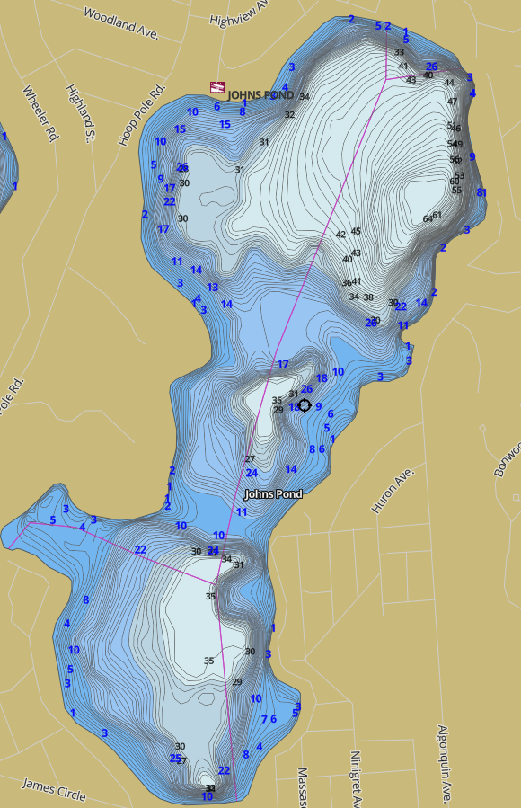
John’s Pond
History : 323 acres
1978- 1980 Diagnostic Study “Complaints of algal blooms and large masses of attached algae in shallow areas began in the early 1970s and continue today. A substantial decline in transparency from 4.6 m to 1.5 m was notice between 1972 and 1975.During the same time, aquatic vascular plant growths were increasing to nuisance levels and blue-green algal blooms occurred during the summer months.”
Common Complaints since the late 60s :
Pond Level
High-powered motorboats
Pollutants and algae blooms
Quoted in Study “a community designated as not requiring a sewage system”
Use : Forest, Recreation, and Agriculture until 1980s. Then
residential neighborhoods built:
Watershed : 33.8 % urban residential (1980) – Now?
Water Quality :
Catch an release ONLY
Septic Leaching found to be high in 1975- present due to soil type
PFAS elevations 2021 above 0.22 ppb

Slide 31
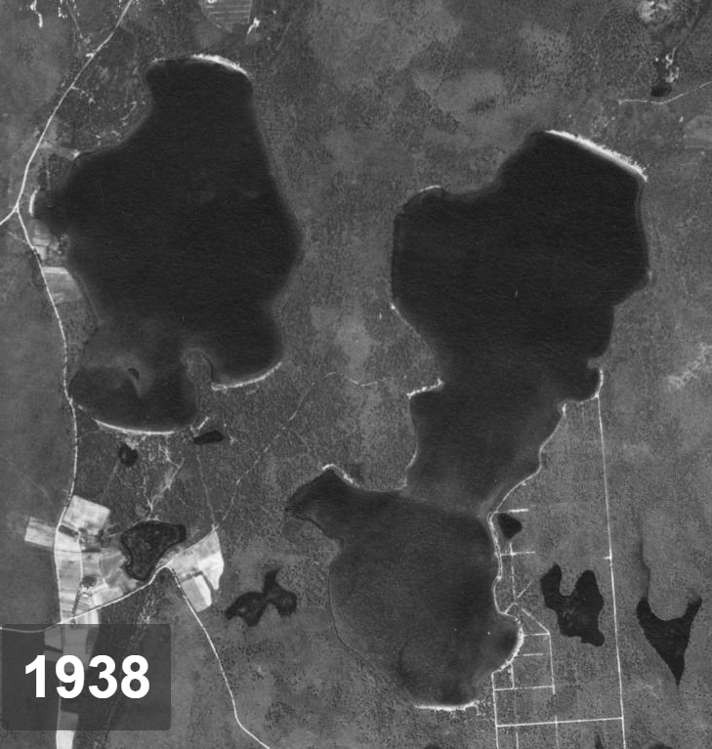
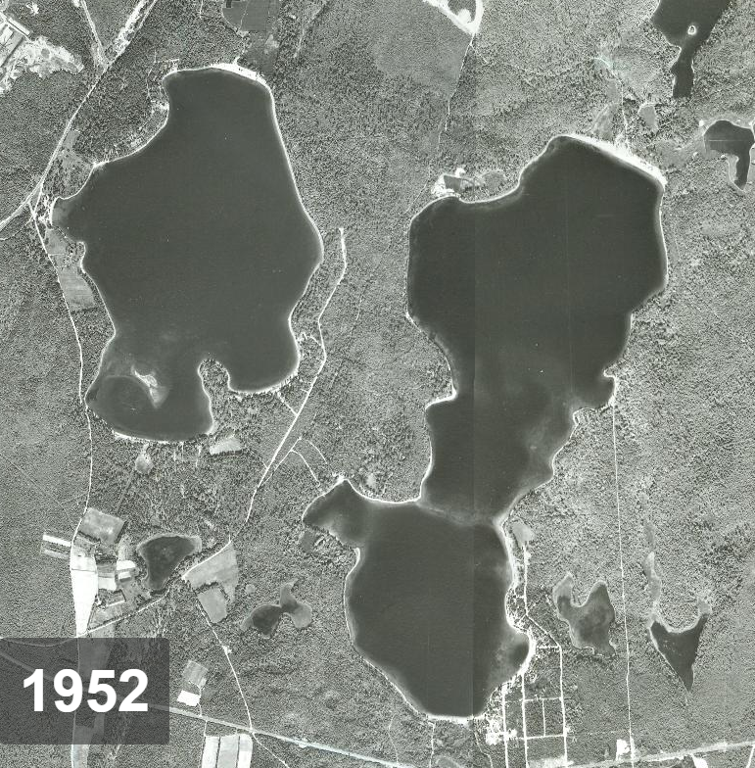
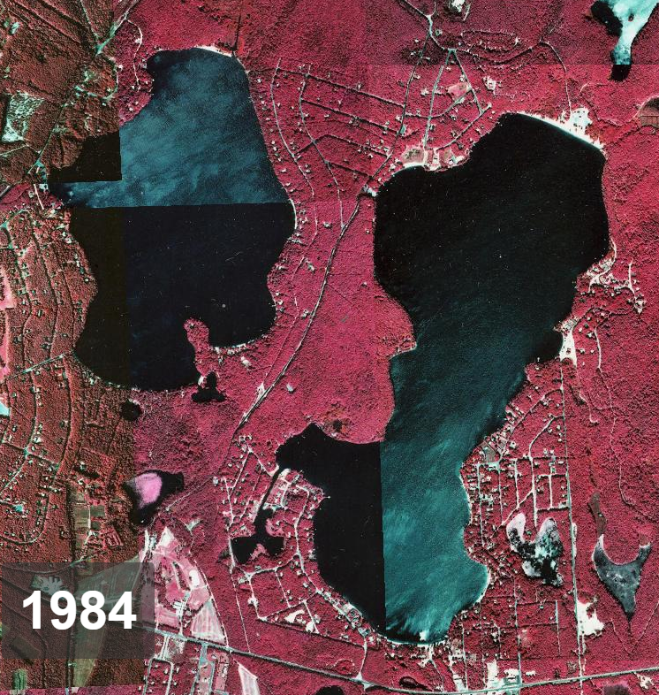
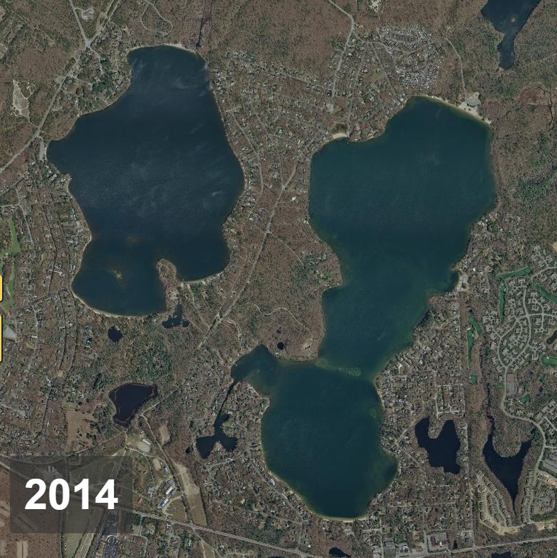
Ashumet and John’s Pond Development

Slide 32
John’s Pond Invasive Species
Invasive Species Treatment: In the late summer & early Fall of 2021, Johns Pond was surveyed and treated for invasive variable leafed milfoil, which was initially observed and reported to the town by pond front residents. The town hired a company specializing in eradicating invasive aquatic species to survey the pond and subsequently treat 8 acres of infested area (mostly in the southern portion of the pond and channel/lagoon area). An aquatic herbicide approved by the State was used to eradicate milfoil and public postings were put up all around the pond prior to treatment. The herbicide used (Procellacor) is target specific, dissipates rapidly and does not cause any human health issues in terms of recreational use of the pond. A follow up survey will be conducted this spring (2022) to check for any lingering areas of milfoil. If any are detected, follow up treatments will be done to ensure complete eradication.
Aquatic invasive species are typically introduced from boat usage between waterbodies. It is essential to make sure that ALL boats (motorized, kayaks, canoes, dinghies, etc) or any other objects placed in the water (floats, etc) are thoroughly inspected and cleaned prior to placement in the water. Clear and conspicuous educational signage at all town landings, beaches and ways to water advising the public to make sure their vessels and water dependent objects are clean prior to introduction into our water bodies is the best way to prevent aquatic invasive species from being introduced and spread

Slide 33
John’s Pond Water Quality
 | Total Phosphorous | Chlorophyll | Secchi Depth | Dissolved Oxygen | Cyanobacteria Closure Y/N
2016 | Mid (9 m) = 1.11 µM Bottom (17 m) = 0.74 µM | 7.67 µg/L 0.03 µg/L | 3.25 m | 8.18 mg/L 0.17 mg/L | N
2017 | Mid (9 m) = 1.17 µM Bottom(17 m)=0.72 µM | 4.34 µg/L 0.03 µg/L | ND | ND ND | N
2018 | Mid (9 m) = 0.65 µM Bottom(17 m) = 0.65 µM | 14.21 µg/L 4.62 µg/L | 5.20 m | 4.29 mg/L 0.59 mg/L | Y / Bacterial Closure
2019 | Mid ( 9 m) = 0.47 µM Bottom (17 m) = 0.89 µM | 9.59 µg/L 1.28 µg/L | 2.95 m | 3.09 mg/L 0.28 mg/L | N
2020 | Mid (9m) = 0.54 µM Bottom (16 m) = 1.02 µM | 2.58 µg/L 4.77 µg/L | 3.70 m | 4.54 mg/L 0.02 mg/L | N – Elevated cyanobacteria cell counts

Slide 34
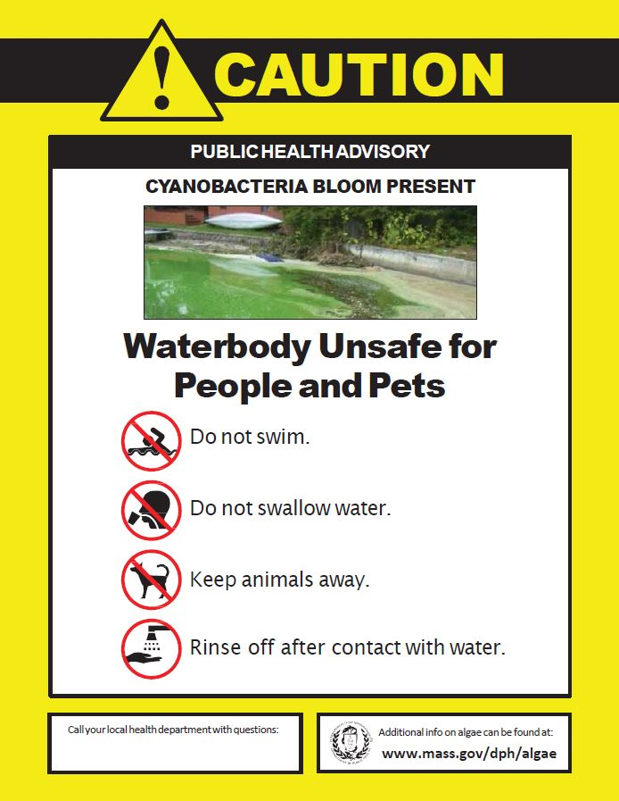
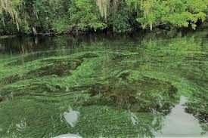
Cyanobacteria Advisories

Slide 35
What Can I Do?

Slide 36
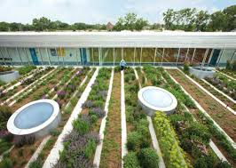
Low Impact Development
The term low impact development (LID) refers to systems and practices that use or mimic natural processes that result in the infiltration, evapotranspiration or use of stormwater in order to protect water quality and associated aquatic habitat.

Slide 37
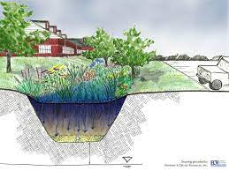
Low Impact Development
Rain Barrels
Rain Gardens
Rain gardens are shallow, constructed depressions that are planted with deep-rooted native plants and grasses. They are strategically located to capture runoff from hard surfaces such as a driveway, parking area, sidewalk or streets. Rain gardens fill with a few inches of water after a storm and then water filters into the surrounding soil, rather than running off to the street, entering a storm drain, or discharging directly to rivers, ponds, and coastal waters.
Rain barrels are specially designed containers that hold 40-75 gallons of water. Installing a rain barrel can reduce the amount of stormwater runoff and improve water quality in your community. Diverting runoff from your roof into a rain barrel for watering your garden or landscaping reduces the amount of stormwater discharged into storm sewers that empty into nearby rivers, ponds, and coastal waters.

Slide 38
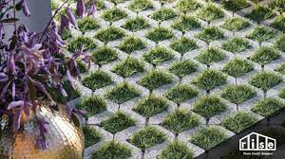
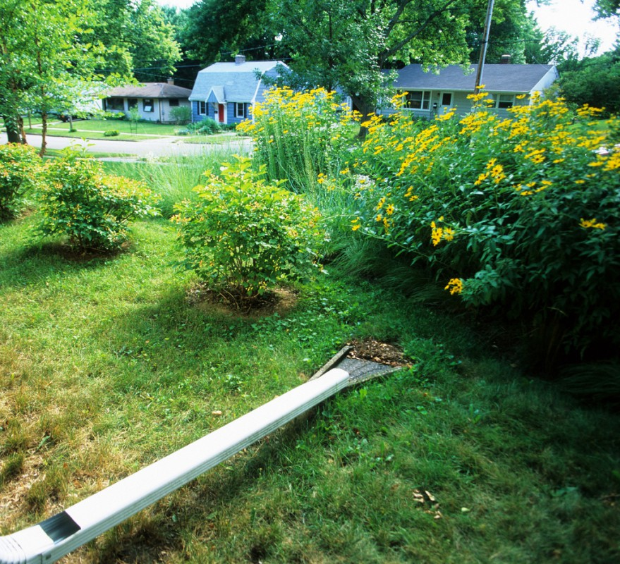
Low Impact Development
Permeable Pavement
Downspout Disconnection
Replace solid concrete and asphalt driveways, patios, and walkways with permeable pavers, cobble stones, brick and turf stone, all of which will slow down the flow of water and allow it to infiltrate into the ground. Solid concrete can also be divided with decorative and functional paver inlays.
Disconnecting a downspout redirects runoff to a vegetated area instead of a paved area, allowing it to soak into the ground. This technique can be used when roof downspouts drain to a driveway or sidewalk leading to the street or when connected directly to a storm drain or waterbody

Slide 39
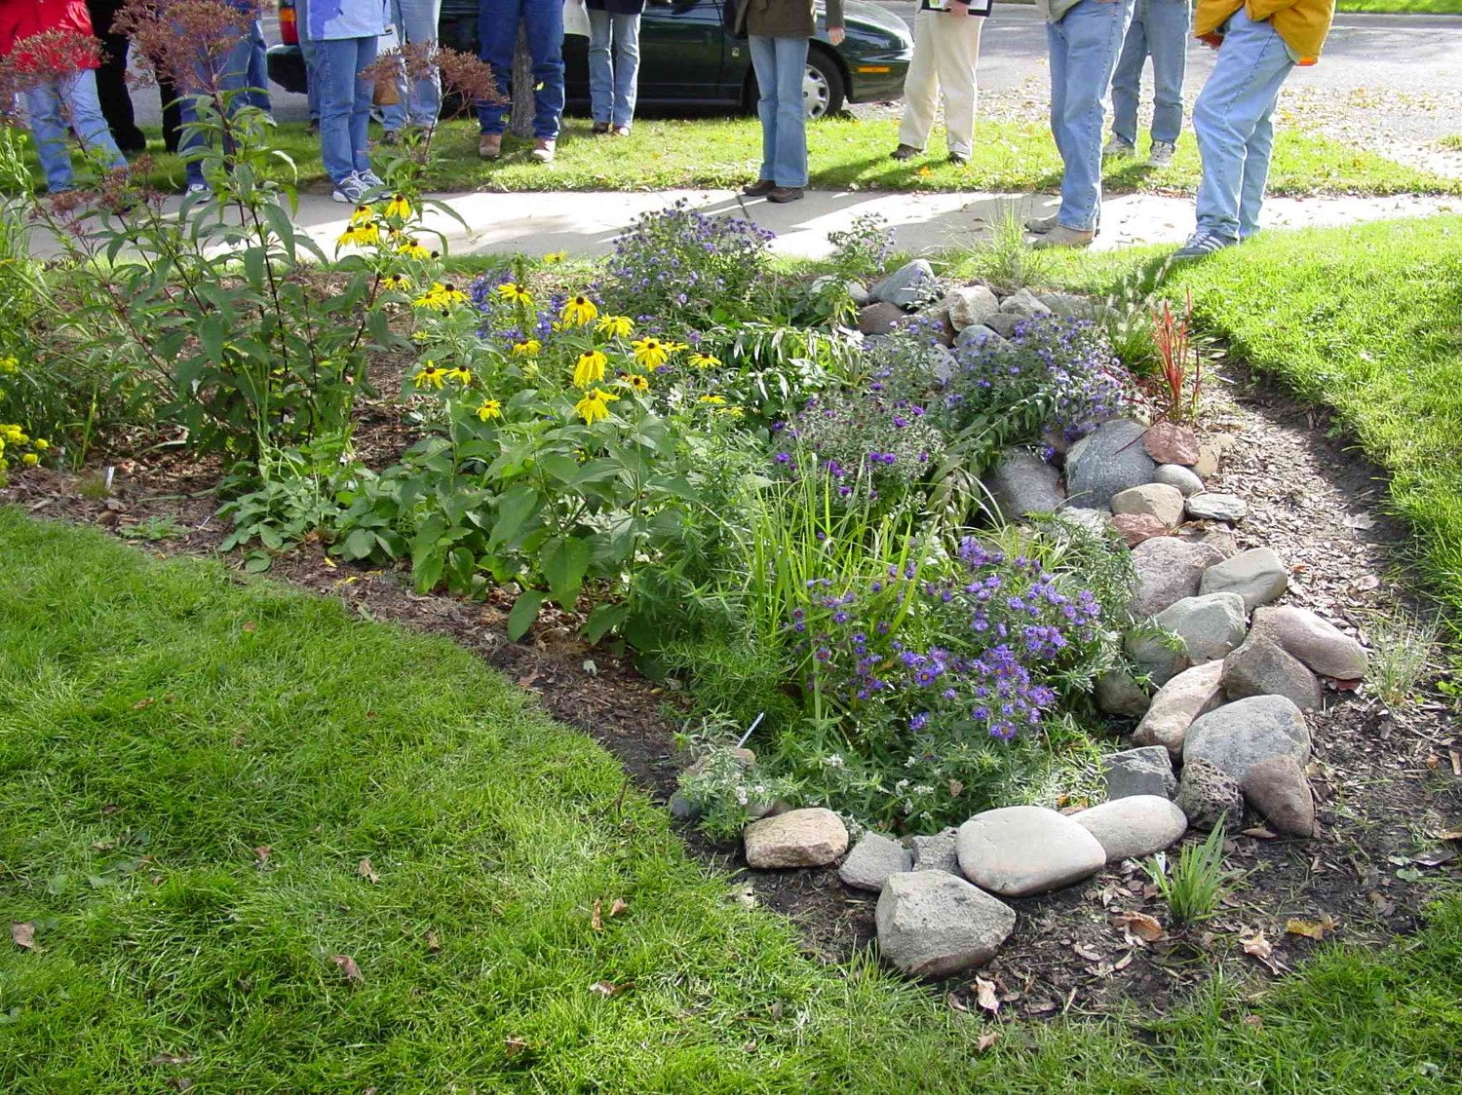
Rain Garden Design What the homeowner can do
Sydney Crook
Mashpee Natural Resources

Slide 40
What is a rain garden?
Shallow depression
Uses deep rooted native plants and grasses
Captures runoff water from roof or driveways
Rainwater that flows over hard (impervious) surfaces such as roofs and driveways, pick up pollutants that can easily infiltrate into our groundwater due to the sandy nature of Cape soils
Native plant roots extend up to 6ft which promote water infiltration and have a tolerance of drought

Slide 41
What can a rain garden do?
Collect water from gutter downspout
Address puddling in a certain area of property
Direct and/or capture water from an impervious surface

Slide 42
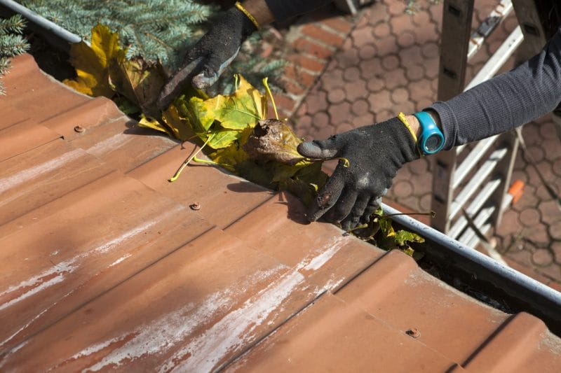
Catching Stormwater at the Source
Clean/check gutters every year
Keeping gutters clean is essential in dictating where your stormwater is directed
Homeowners can’t necessarily control the runoff in their street, but can catch stormwater from their home before it reaches their street

Slide 43
Rain Barrel
Great option for long term storage of water, especially during a drought
All rain water from this gutter will be stored in this barrel, mitigating any and all runoff from this downspout

Slide 44
Downspout Connection
Redirects rain water from sidewalk to garden
Place impermeable material under cobblestones so that all water is reaching the rain garden
Could improve this structure by using pebbles in stead of cobblestones in order to reduce flow rate to rain garden

Slide 45
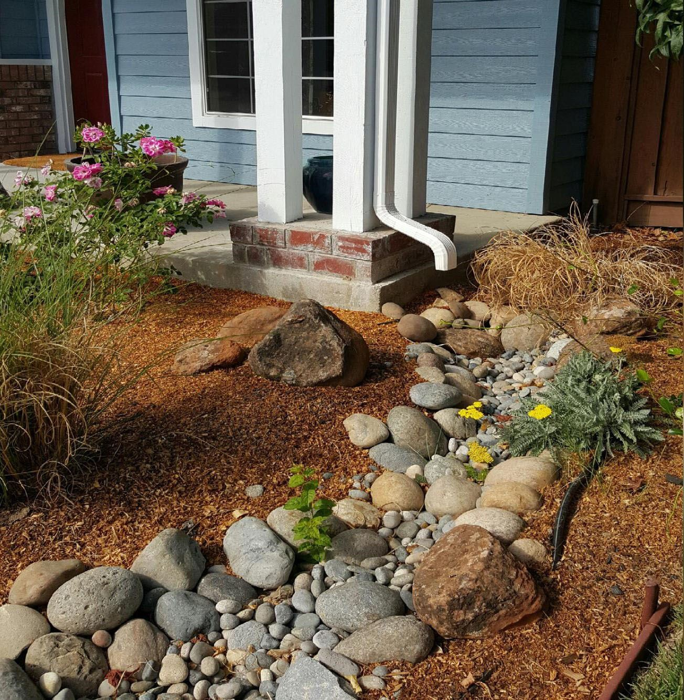
Downspout Connections
Integrates smaller stones to flow rate
Use of mulch to begin infiltration process
Use of native plants

Slide 46
Before you start landscaping…
Call DIGSAFE at 811
Locate your septic system -- DO NOT landscape your native rain garden above your septic system. Native plants have longer roots that can impact your infrastructure
Learn your soil! Dig a 24-inch deep hole to see the composition of your soil. If it’s sandy then your rain garden will function properly. If there is clay, then it’s best to look for another spot.
Try to find a suitable area 6-10ft away from your house foundation if possible
Determine how big you want your rain garden to be. If your property receives a lot of rain or pooling of water, you will need a larger rain garden

Slide 47
Picking Flora
Full/Partial shade
Plan!
Different species bloom at different times of the year. Plan for spring/summer/fall blooms in order to support pollinator pollutions!
Think about how tall and wide plants will get
Once established, you will not need to water or fertilize native plants
Remember:
Your garden is a bowl. The center of the bowl will be the wettest, and the edges the driest. Make sure the plants at the center of the garden can withstand being wet for longer periods of time than those around the edges

Slide 48
Native Garden Design

Slide 49
Native Garden Design

Slide 50
Native Garden Design

Slide 51
APCC – Native Plant Finder
WWW.CAPECODNATIVEPLANTS.ORG

Slide 52
I don’t have the means to build a rain garden… what else can I do to help?
Clean off storm drains in your neighborhood before a rain event
Don’t remove established plants from your yard unless they’re invasive
Educate others to build rain gardens or clear off storm drains in front of their house
Redirect gutter downspouts so they are not pointed towards impervious surfaces
DO NOT fertilize your lawn
Pump septic system regularly

Slide 53
What Can I do on the Waterfront
Conservation Agent : Andrew McManus

Slide 54
Be Informed Wetlands Jurisdiction
Mashpee Wetland Protection Bylaw: Chapter 172
MA State Wetlands Protection Act: MGL Ch. 131 Section 40
Mashpee Conservation Land Bylaw: Chapter 173
MA Waterways Licensing Agency: Chapter 91

Slide 55
What Are Wetlands?
Swamps
Marshes (fresh and saltwater)
Bogs
Wet Meadows
*Vernal Pools
Lakes/Ponds
Ocean/Estuaries
*Rivers/Creeks/Streams
*Banks (Inland and Coastal)
Beaches/Dunes
Lands Subject to Flooding (Bordering, Isolated and *Coastal)
Bordering Vegetated Wetlands
Jurisdiction
All areas within 100 feet of wetlands (known as the buffer zone).
All riverfront areas have a 200 ft zone of jurisdiction (no buffer zone).
Vernal pools are protected by a 100 ft zone of no disturbance)
All areas mapped as flood zones A, AE and V are jurisdictional but have no buffer zone.
Values Protected
Water quality
Public/private water supply
Groundwater
Flood Control
Erosion/Sedimentation Control
Storm Damage Prevention
Fisheries
Shellfish
Wildlife Habitat
Biodiversity/Rare Species
Recreation
Agriculture
Aquaculture

Slide 56
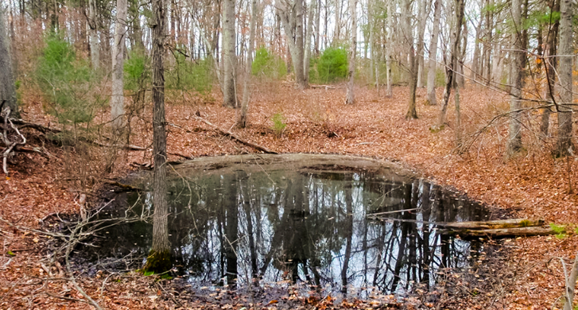
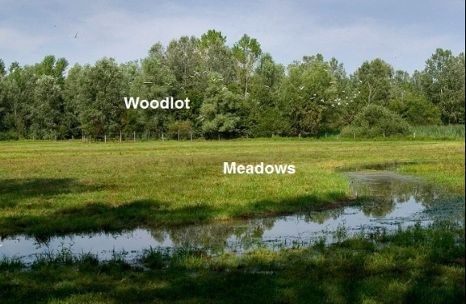
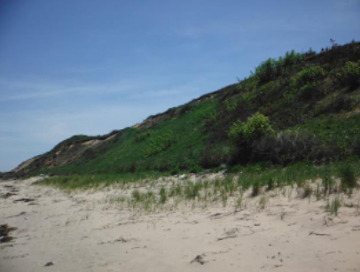
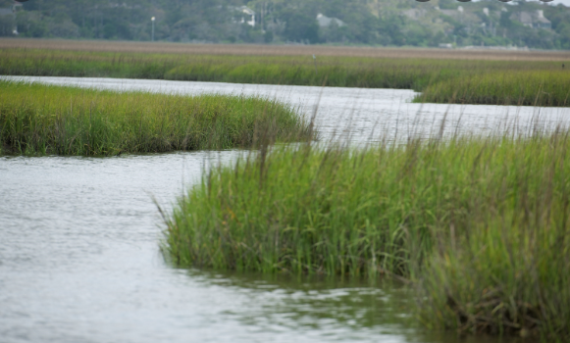
Vernal pool
Coastal bank/beach
Salt marsh

Slide 57
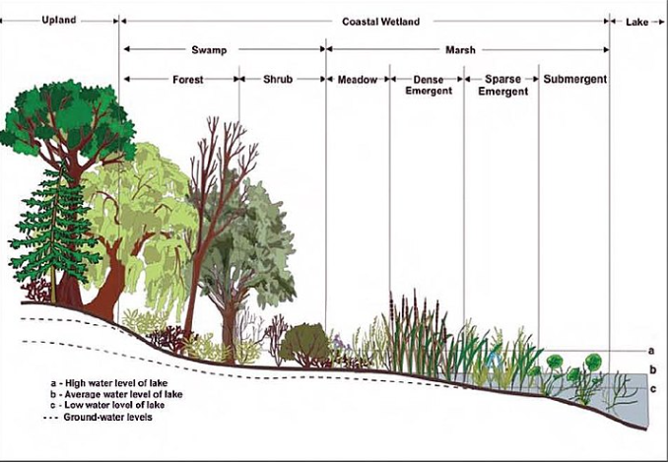

Slide 60
The Importance of Naturally Vegetated Buffer Zones (NVBS)
What are Naturally Vegetated Buffer Strips?
-Areas of continuous native vegetation adjacent to resource areas (wetlands, waterbodies, etc) that serve the purpose of minimizing erosion, siltation, loss of groundwater recharge, poor water quality and loss of habitat.
Ch. 172, Regulation 29: Buffer Zones & Naturally Vegetated Buffer Strips:
-Authorizes the commission to require a minimum of a 50 foot buffer zone of no disturbance for new development or creation/enhancement of buffer zones for pre-developed lots undergoing expansion.

Slide 61
Little to no vegetated buffers
Well vegetated buffer zones

Slide 62
What can you do to make environmental improvements on your property
If you have lawn that goes right to the edge of water or wetland, consider removing a minimum of 15 feet of turf width and replace with native material (groundcover, shrubs, trees or combination) to establish a naturally vegetated buffer strip. A minimum of three species is highly recommended
Reduce lawn areas and lawn maintenance as much as possible. Any existing lawn areas should be of a native rye/fescue variety which is adapted to the regional climate conditions and thus does not require fertilizers or irrigation. Native grasses go dormant in the offseason, they are not supposed to remain green year round. The saying that a green lawn is a healthy lawn is a myth.
Reduce impervious surfaces/hardscaping as much as possible. Too much impervious surface can lead to runoff and erosion as well as less area for groundwater recharge. We live in an area where drinking water is dependent on having enough ground water recharge to our aquifers.
Don’t dispose of landscape debris within wetlands or buffer zones thereof. This changes habitat characteristics and runoff patters, which can dramatically impact wetlands
Leave natural settings alone. There’s no need to “neaten up the woods” Dead and downed material provides essential habitat features and re-nourishes the soil through decomposition

Slide 63
Future Bylaws For Clean Water
Fuss & O’Neil

Slide 64
Fuss & O’Neill Bylaw Review- Part of the MVP Grant
Bylaws Reviewed :
Nitrogen Control Bylaw
Mashpee Water District Irrigation Policy
Erosion and Sediment Control
Illicit Connections and Discharges to the Municipal Storm Drain System
Stormwater Management
Wetlands Protection Bylaw
Wetlands Protection Regulations
Boating in Mashpee Rules and Regulations

Slide 65
Recommendations :
Nutrient Control Bylaw –
Specify an amount of nitrogen fertilizer required as slow release and annual rate in the Performance Standards.
Add language referencing that a subdivision plan shall comply with loading rates from lawn fertilizer as specified in the Zoning Bylaws
Require a Certified Fertilizer Applicator to submit soil test results, type and amount of fertilizer, and an irrigation plan for approval by the Enforcement Authority for fertilizer application to lawn greater than a specified area.
Prohibit application of fertilizer containing nitrogen and/or phosphorous within 100 – 150 feet of the Groundwater Protection District and areas within Wetland Jurisdiction.
Change the name of the “Nitrogen Control Bylaw” to more broadly reflect nutrient control, including phosphorous”
Re-add exemptions to the most current bylaw
Add Performance Standards

Slide 66
Recommendations :
Mashpee Water District Irrigation Policy
Water Conservation –
Consider Adopting an Outdoor Water Use Bylaw
Require the Submission of Irrigation Managements plans with Proposed Development
Illicit Connections and Discharge to the Municipal Storm Drain Systems
Nutrient Source Control-
Include improper disposal of pet waste in prohibited actives section.
Stormwater Management
Consider adopting stand-alone stormwater regulations to provide greater clarity and flexibility in implementing the Town’s existing Stormwater Management Plan
For projects which employ bio-retention or similar filtering best management practices (rain gardens, tree filters, sand/organic filters, and dry water quality swales) for treatment prior to infiltration, the designs should incorporate filter media and/or an internal water storage zone to optimize nitrogen and phosphorous removal.
Require that the design of new stormwater quantity control BMPs and other drainage system components consider projected increases in precipitation intensity and frequency.

Slide 67
Recommendations :
Wetlands Bylaw and Regulations
Consider increasing the existing 100-foot Buffer Zone to between 100 and 300 feet
Consider increasing naturally vegetated buffer strips (NVBS) from a minimum of 50 feet to at least 50% of the Buffer Zone width.
Specify tree-replacement requirements within the Buffer Zones
Require a bases fee to replace a tree within the Buffer Zone if the site conditions do not allow for mitigation tree planting.
Limit impervious area allowed within Land Subject to Coastal Storm Flowage
Boating in Mashpee Rules and Regulations
Santuit ONLY - Prohibit the use of motorboats or limit the speed of motorboats (less than 5 mph) except for vessels owned by an agency of the United State Government or by a State, County, City, or Town.
This provision aims to limit potential disturbance and resuspension of phosphorous latent sediment into the water column resulting from the use of motorized boats.
Total prohibition, limiting speed to less than 5 mph, limiting the areas of motorboat use based on water body depth are options – relationship between mixing depth and horsepower

Slide 68
Effective Missing Depth by Engine Size
Horsepower | Mixing Depth
10 | 6 feet
28 | 10 feet
50 | 15 feet
100 | 18 feet

