Slide 1
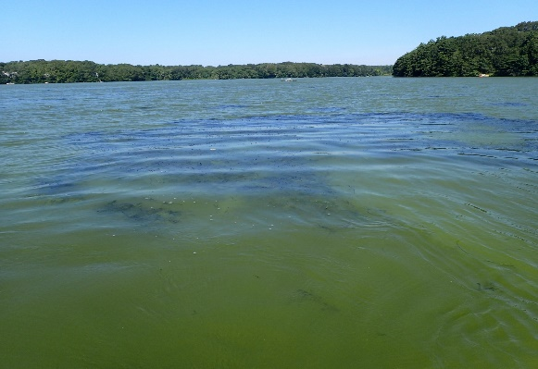
Watershed-based Solutions to Increase Resilience to Harmful Algal Blooms in Santuit Pond in a Warmer and Wetter Climate
MVP Action Grant
Core Team Project Initiation Meeting
September 28, 2021

Slide 2
Agenda
Welcome
MVP Action Grant
Project Purpose
Core Team & Contacts
Background – Cyanobacteria, Climate Change, Watershed Practices
Tasks & Timeline
Opportunities for Input
Outcomes
Questions/Discussion

Slide 3
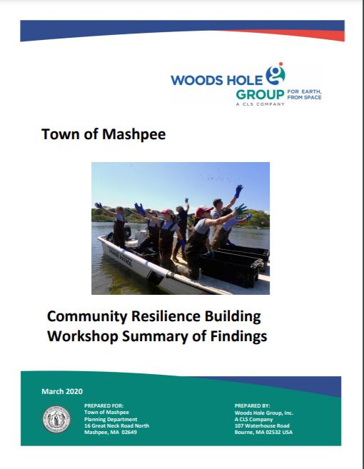
MVP Action Grant
Municipal Vulnerability Preparedness (MVP) Program
Planning for climate change resiliency
Implementing priority projects
Mashpee MVP Planning Grant – March 2020
https://www.mass.gov/doc/mashpee-report/download
Top Priorities
Coastal Green Infrastructure
Water Quality
Stormwater Infrastructure
Vulnerability for Municipal Facilities & Infrastructure
Emergency Management Planning & Communication
Low-lying Roadways & Culverts

Slide 4
Project Purpose
Santuit Pond – chronic cyanobacteria blooms
Changing climate favors cyanobacteria
Nutrients (internal and external) drive blooms
Focus on watershed (external) to reduce nutrient inputs
Green Stormwater Infrastructure
Residential Low Impact Development (LID) Practices

Slide 5
Project Team Primary Contacts
Town of Mashpee
Ashley Fisher, Director of Natural Resources, afisher@mashpeema.gov, 508-539-1410
Mashpee Wampanoag Tribe
Jason Steiding, Natural Resources Dept. Director, Jason.Steiding@mwtribe-nsn.gov
Mashpee TV
Christopher Ball, chris@mashpeetv.com
Fuss & O’Neill
Diane Mas, Project Manager, dmas@fando.com, 800-286-2469 x4406

Slide 6
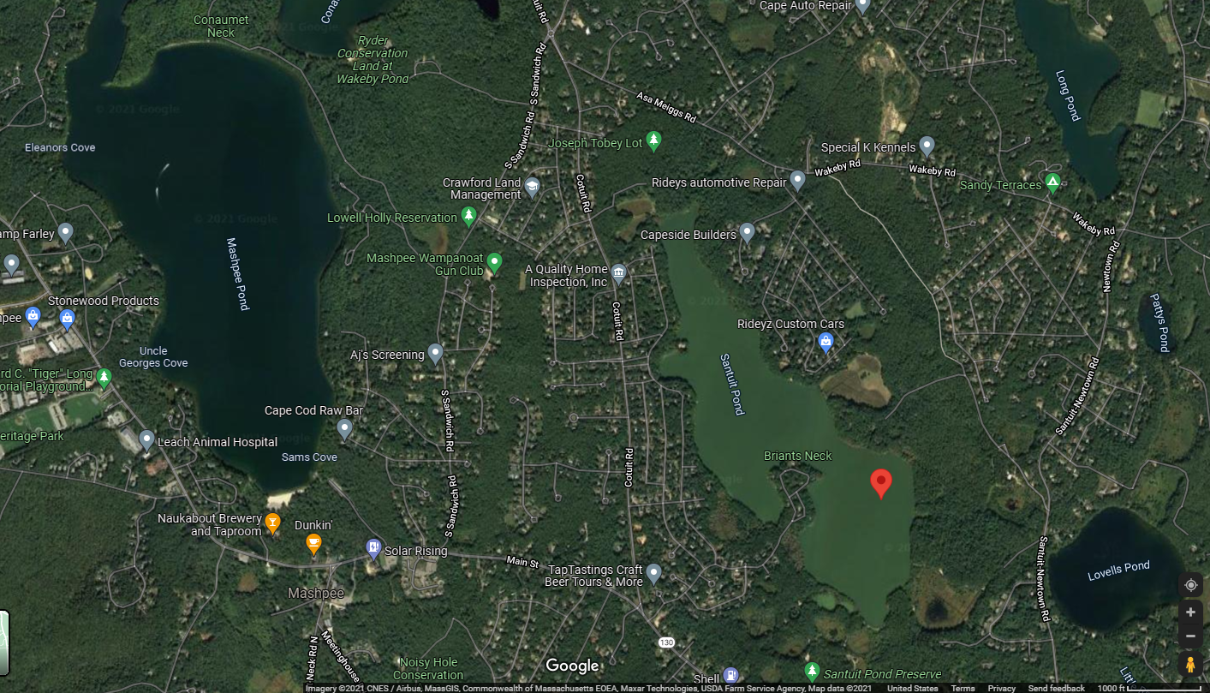
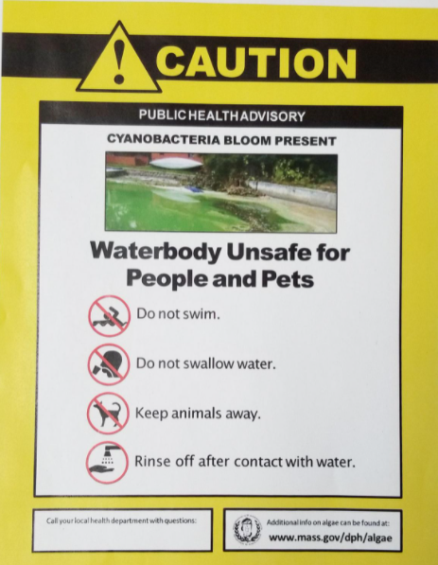
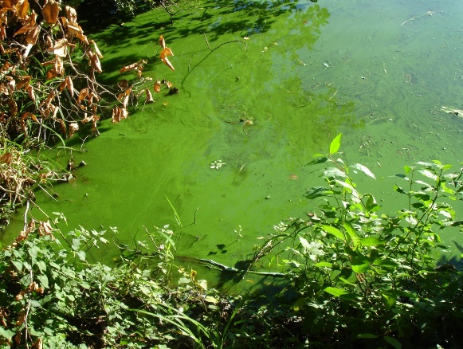
Cyanobacteria
Cyanobacteria
Bacteria (not a true algae) that photosynthesize
Produce toxins harmful to people and animals
Harmful Algal Bloom (HAB or CyanoHAB)
Deplete oxygen in water
Aesthetics (sight & smell)

Slide 7
Cyanobacteria & Changing Climate
Nutrients (phosphorus) + warm water + still water = CyanoHABs
Summer temperatures >> total phytoplankton
Length of summer >> cyanobacteria abundance
New England is anticipated to experience an increase in number of days with blooms sooner than other areas of the U.S.
Average summer temperatures 3-5 degrees by mid-century, 5-9 degrees higher by the end of the century
Growing degree days 26% under moderate emissions by mid-century
Sources: Chapra et al. (2017); Ho and Michalack (2019); Northeast Climate Science Center at the University of Massachusetts Amherst (https://www.resilientma.org/)

Slide 8
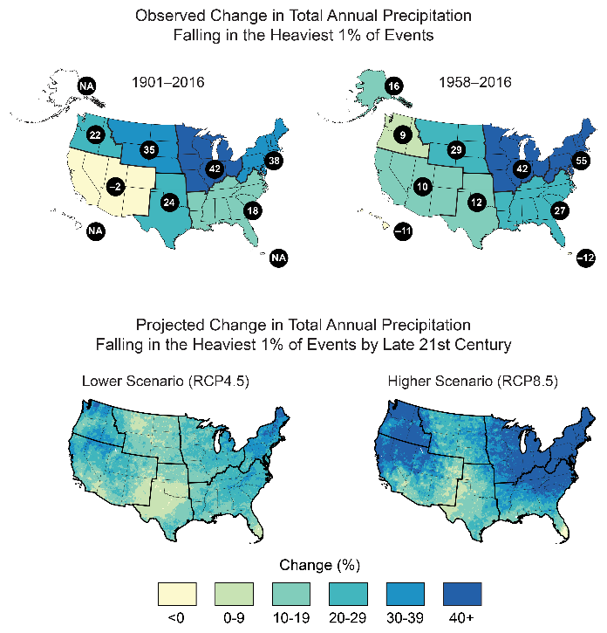
Cyanobacteria & Changing Climate
Nutrients (phosphorus) + warm water + still water = CyanoHABs
Total precipitation and precipitation intensity >> runoff generation & transport of sediment and nutrients
+2 inches of total annual rainfall
Number of days of precipitation over 1 inch
Total amount of precipitation falling in the heaviest 1% of rainfall events
While temperature change cannot be controlled, the secondary impacts of increased rainfall and rainfall intensity can be mitigated through stormwater controls, offering an adaptation measure to provide resilience to anticipated climate change
Sources: 4th National Climate Assessment (2018); Northeast Climate Science Center at the University of Massachusetts Amherst (https://www.resilientma.org/)

Slide 9
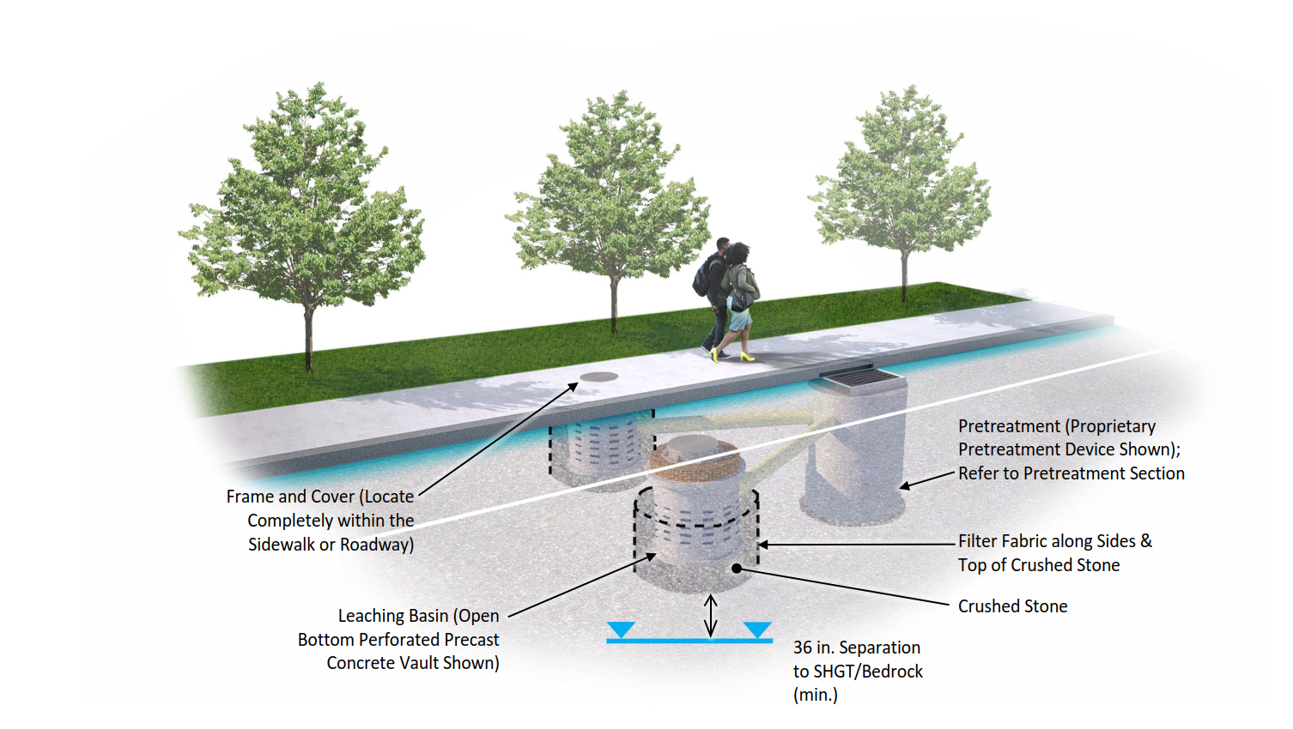
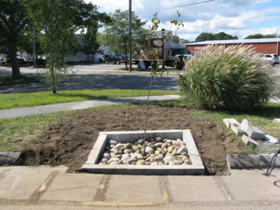
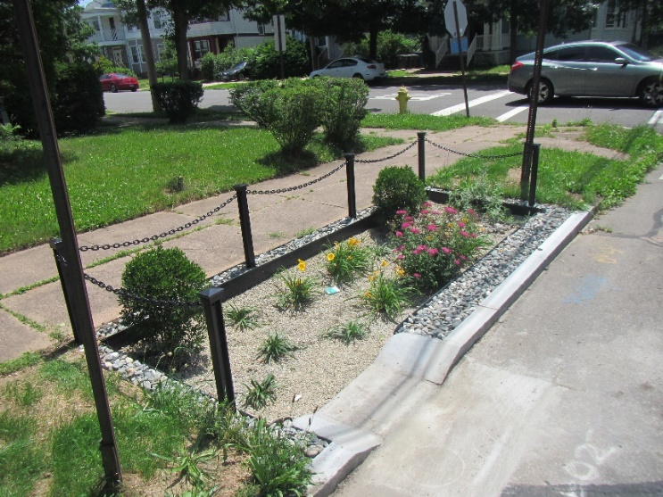
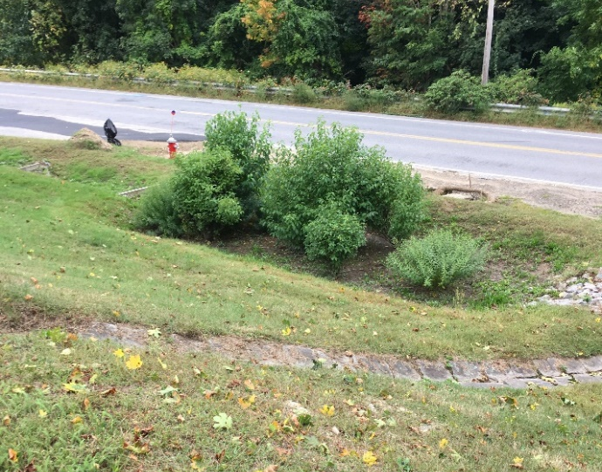
Green Stormwater Infrastructure
Target Pollutants – Nutrients & Sediment
Use Low-cost Controls Whenever Possible
Design for Low Maintenance
Adapt Designs to Maximize Pollutant Load Reduction
Phosphorus – Bioretention Soil Mix (No Compost!)
Nitrogen – Internal Storage Reservoir
Leaching Catch Basin, RIDOT Linear Stormwater Manual
Tree Well, Niantic River Watershed
Bioswale, New Haven, CT
Roadside Biofilter, Central MA

Slide 10
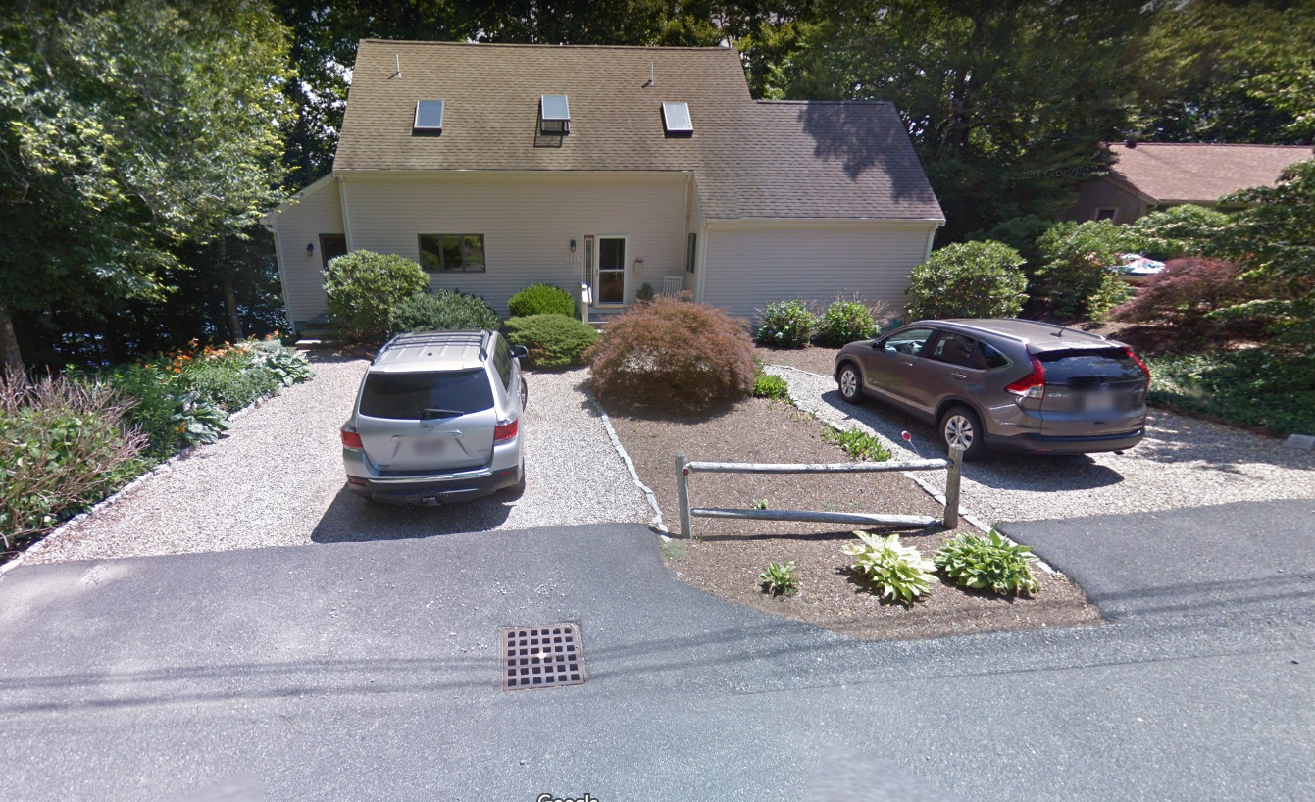
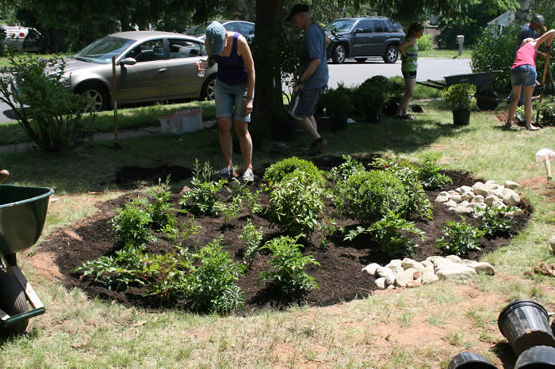
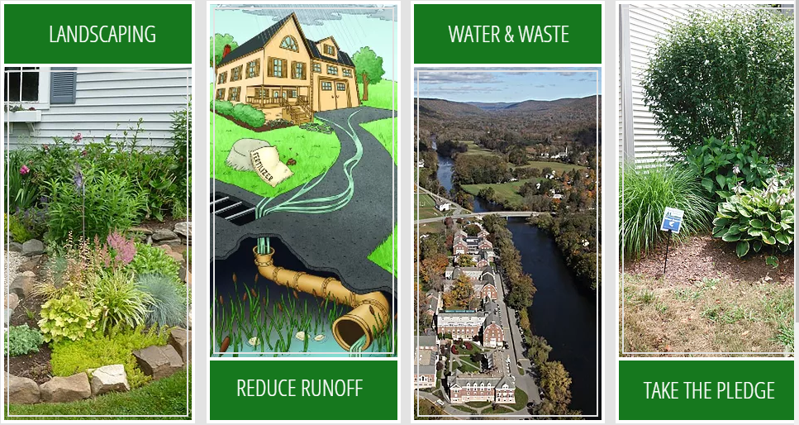
Residential LID Practices
Disconnect driveways and roofs
Redirect stormwater to lawns, dry wells, rain barrels, or rain gardens
Maintain natural buffers
Reduce lawn size, water usage, and fertilizer

Slide 11
Elements of the Project
Resource Mapping
2010 Diagnostic Study
Monitoring data
Known/suspected sources
Compile and Review Data
Characterize Watershed Pollutant Sources
Develop Green Infrastructure Retrofit Concepts – Design/Permit (1)
Residential and Watershed-Wide Practices
Municipal Bylaw Review and Recommendations
Nitrogen Control
Wetlands
Stormwater
Zoning
Public Involvement
and
Community Engagement
Summarize data
Field inventories
Resilience Trail Signage
Mashpee TV – documentary and PSAs
Digital Media – Storymap and webpage
Meetings – listening session, walkshop
Outreach materials
Low impact development
Lawn care
Non-structural source controls
Conceptual designs for 5 sites
Size for future precipitation
Estimates of pollutant removal
Estimates of cost
Carry one (1) concept to permitting

Slide 12
Schedule
GI Retrofit Concepts
LID & Watershed Practices
Data Review
2021
2022
S
O
N
D
J
F
M
A
M
J
Project Initiation
Watershed Pollutant Source Characterization
Bylaw
Review
Design/Permitting
Outreach & Engagement

Slide 13
Outcomes
Watershed Characterization Report
Five (5) Stormwater Green Infrastructure Retrofit Concepts
Design & Permitting for One (1) Retrofit Concept
Recommendations for Bylaws
Outreach Materials
Resilience Trail Signage
Storymap – Residential “makeover”
Digital information
Video (documentary & 3 PSAs)

Slide 14
Questions & Discussion

Slide 15
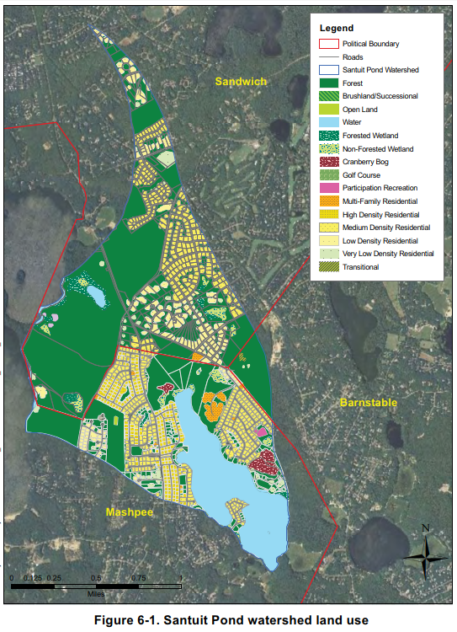
Santuit Pond Watershed
AECOM, 2010

