Slide 1
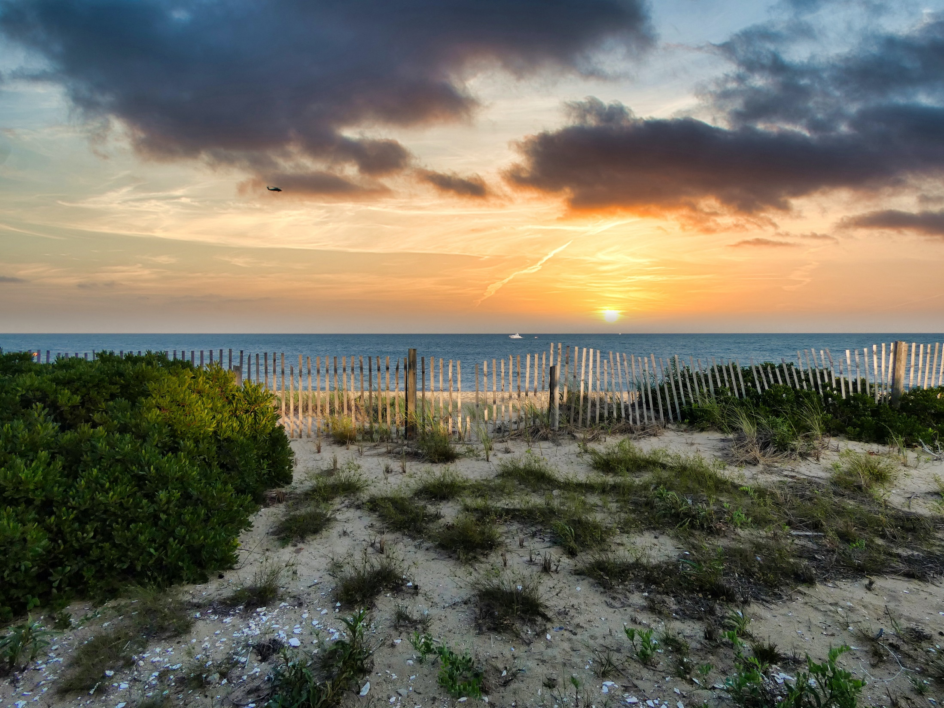
MASHPEE LOCAL COMPREHENSIVE PLAN Planning Board Meeting
January 25, 2023
Photo by Christopher Ryan on Unsplash

Slide 2
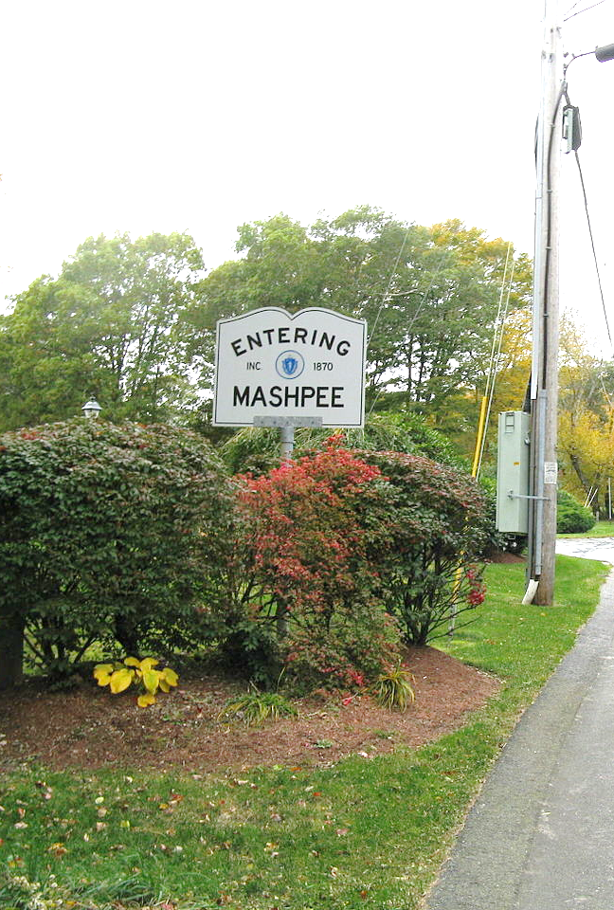
Agenda
Project Update
Goals, Policies, and Actions
Chapter Review of Goals, Policies, and Actions
Survey Results
Next Steps
Photo by John Phelan - Own work, CC BY-SA 3.0, Wikimedia Commons

Slide 3
Project Update
Existing Conditions
Chapters have been updated based on comments received
Issues and Opportunities sections added
Other Sections
Public Engagement Summary
Introduction Chapter
Implementation Table

Slide 4
Goals, Policies, and Actions
GOALS:
Desired outcomes. Simple, broad, high-reaching.
POLICIES:
Statements that guide municipal decision makers so that decisions help to achieve the goals.
ACTIONS:
Specific, measurable acts whose implementation will bring the municipality closer to achievement of its goals.

Slide 5
Goals, Policies, and Actions
Responsible Party
The lead responsible party is identified by bold text with supporting roles by those listed in regular text.
Timeframe
Short-term is typically considered for action items that will be initiated within 0-3 years
Medium-term is typically considered for action items that will be initiated within 4-7 years
Long-term is typically considered for action items that will be imitated within 8 years or more
Ongoing is typically used to identify items that are continuous and do not have a defined end and beginning timeframe
The timeframes can be adjusted and are defined in an introductory paragraph within the implementation chapter
Example
Goal
Protect terrestrial and aquatic habitats for long-term environmental and social benefits.
Policy
Identify areas for coastal and habitat restoration to enhance water quality and improve overall habitat conditions.
Actions | Responsible Party | Timeframe
Continue to maintain navigational channels for not only navigation but for adequate stream and tidal flow. | DCR Select Board Conservation Commission | Ongoing

Slide 6
Goals, Policies, and Actions
Homework
Review the draft word document
Provide updates and edits in a written format
Evan will review comments and consolidate similar responses
Significant changes will be reviewed by the Planning Board as a group to vet suggestions/edits/additions

Slide 7
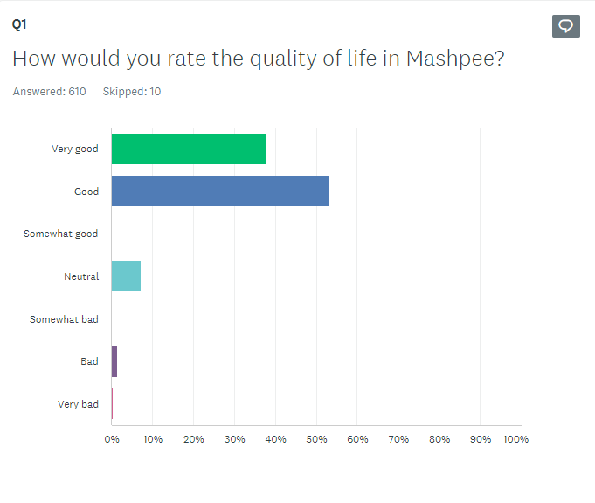
Survey Results
49 Questions
620 Responses
Open for approximately 6 weeks

Slide 8
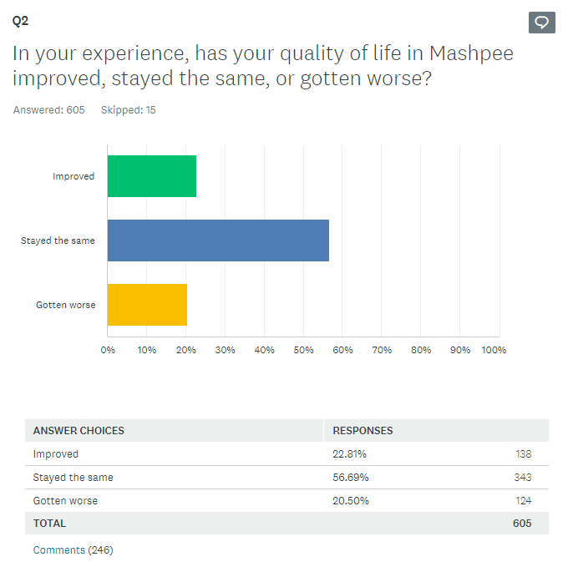
Survey Results

Slide 9
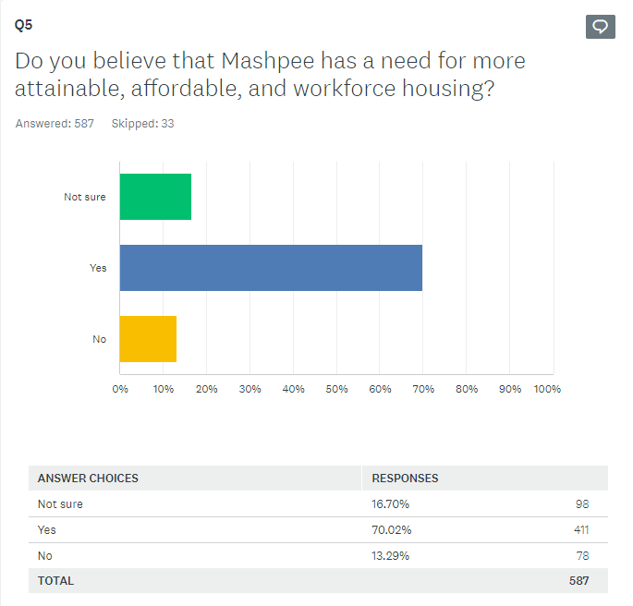
Survey Results

Slide 10
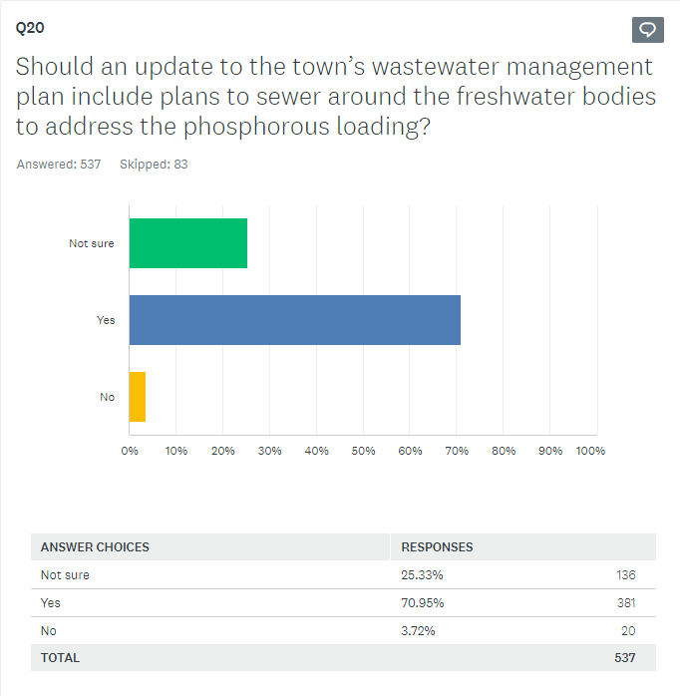
Survey Results

Slide 11
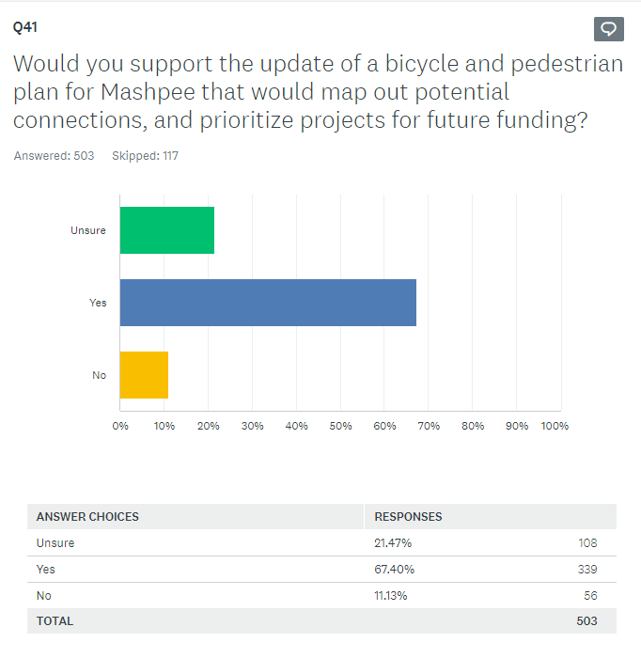
Survey Results

Slide 12
Next Steps
Finalize chapters
Review and edit goals, policies, and actions
Finalize Implementation Table
Provide draft maps for review

Slide 13
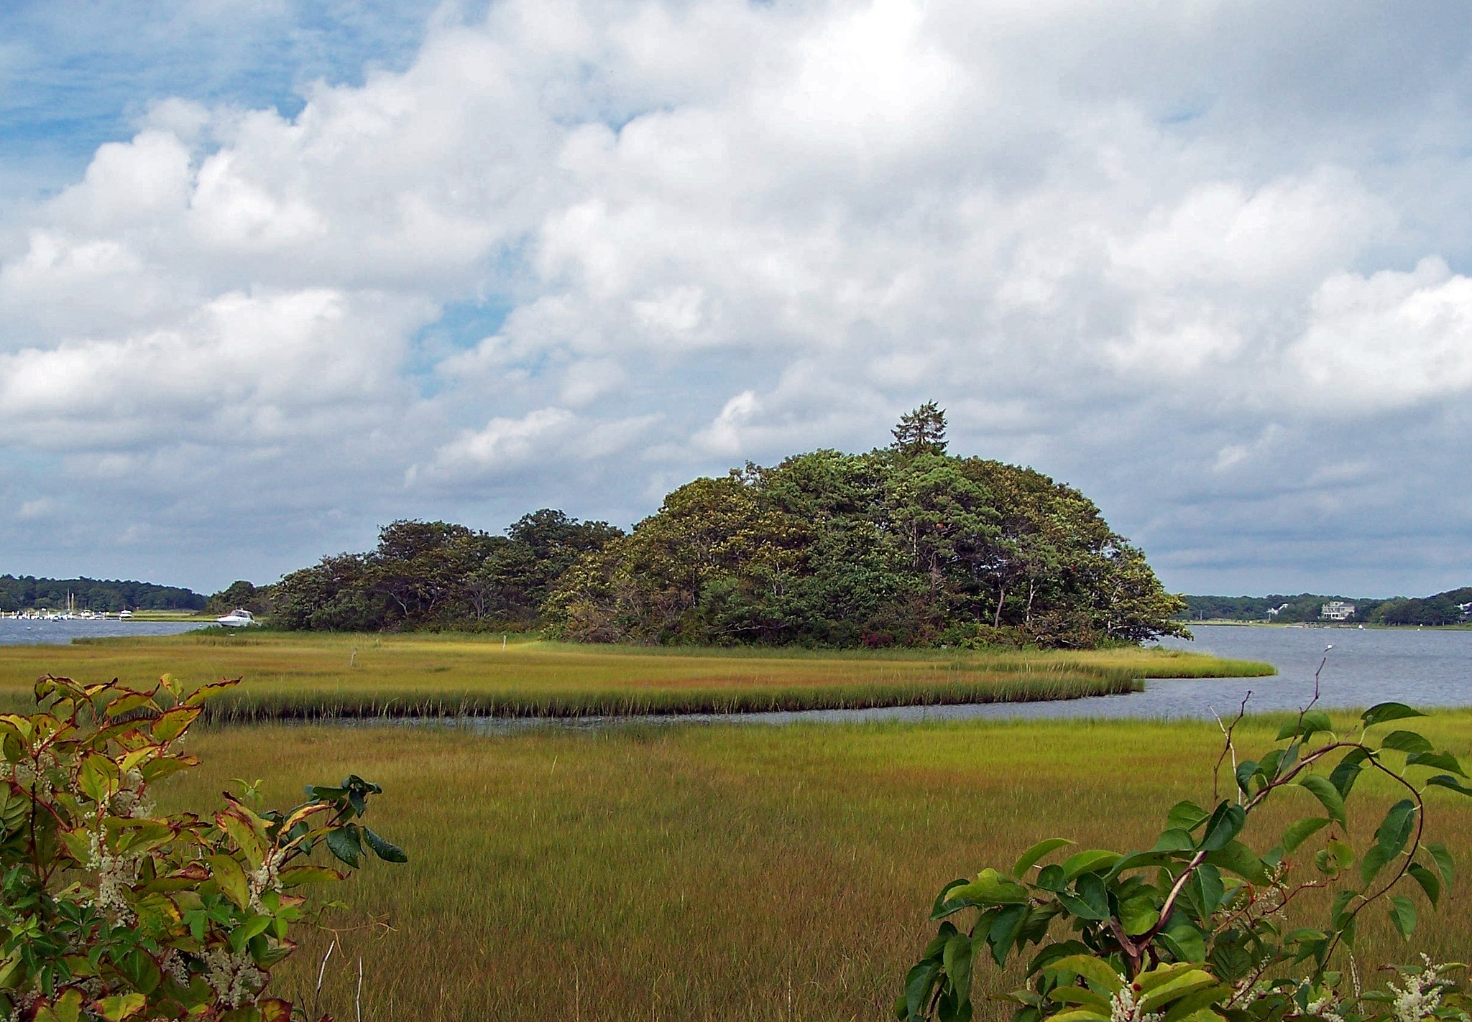
thank you
Photo by U.S. Fish and Wildlife Service.

