Slide 1
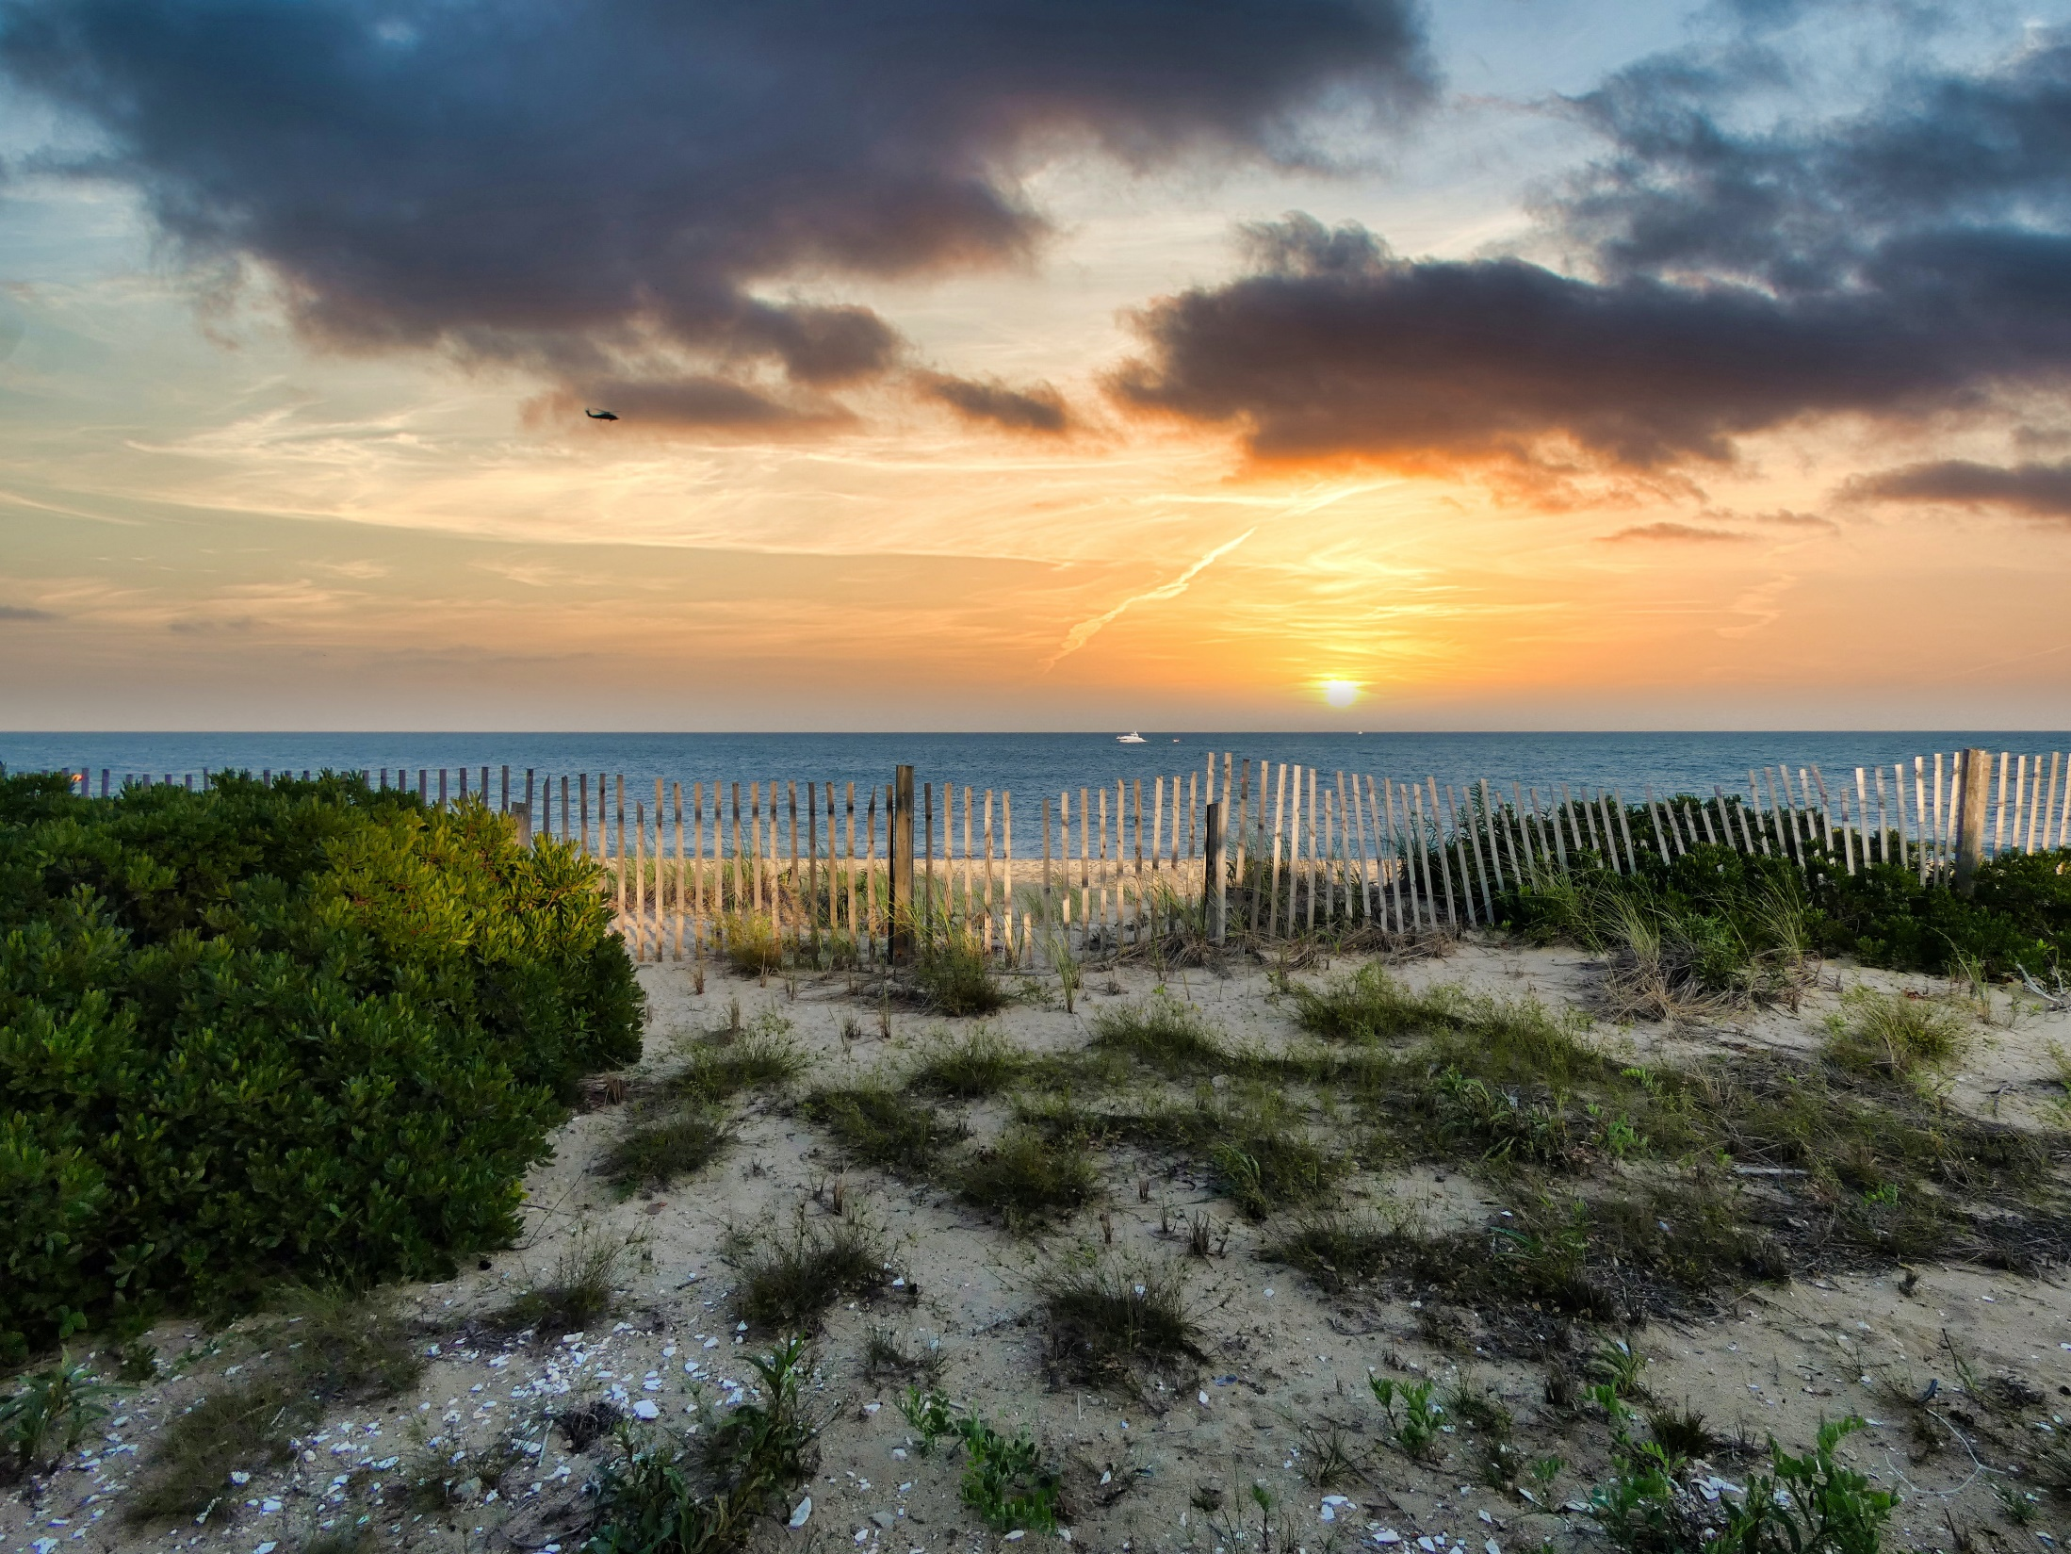
MASHPEE LOCAL COMPREHENSIVE PLAN Planning Board Meeting
June 1, 2022
Photo by Christopher Ryan on Unsplash

Slide 2
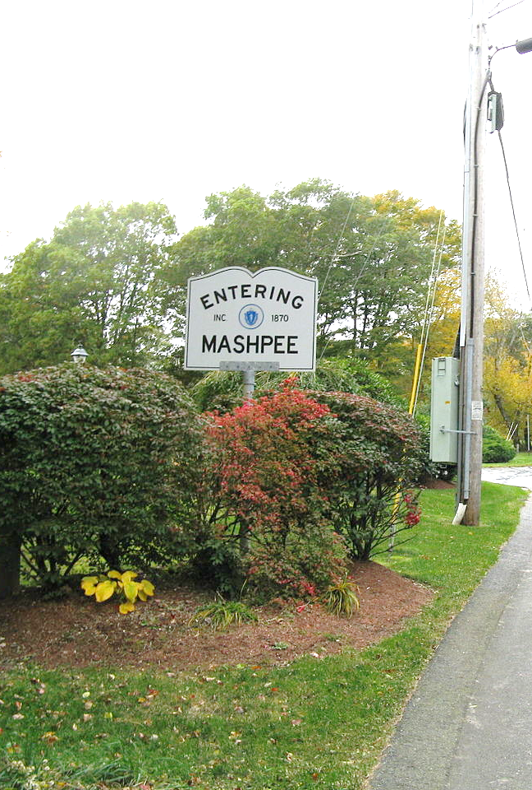
Agenda
Comprehensive Plan Framework
Project Approach
Examples
Photo by John Phelan - Own work, CC BY-SA 3.0, Wikimedia Commons

Slide 3
Comprehensive Plans and Planning Process
Traditional
Chapter oriented
Text heavy
Technical writing approach
Data driven (as opposed to public opinion)
Limited public participation
Lack specific direction for implementation
Difficulty transcending jurisdictional borders

Slide 4
Comprehensive Plans and Planning Process
Modern
System oriented
Visual
Easy to read
Easy to understand
Policy and action driven (data in the background)
Focus on public participation
Scalable
Visionary and anticipating of change

Slide 5
How to Accomplish this in Mashpee
Review existing chapters and update facts and figures
Reorganize in a more readable and user-friendly manner
Highlight public participation and link the results to actionable items (both previous and new)
Include appropriate and relevant links to the Cape Cod Commission
Include new and emerging topics (climate change, resiliency, energy, etc.)
Notes:
The Town is in the process of contracting with CitizenLab. While that is occurring, we are working on creating some graphics and maps that will be able to be displayed on the site when it is first launched. We anticipate that more information will become available as public engagement really gets underway in the spring. Initially the website will be useful for introducing the project and putting up some basic project information. We will begin to work on a generalized online survey that will be posted on the website in mid April as an initial engagement and information gathering tool. As soon as the Town has signed the contract we will work with CitizenLab to secure a date by when the website will be ready.

Slide 6
Existing Conditions
Housing
Economic Development
Sustainability
Natural Resources
Land Use and Growth Management
Heritage and Preservation
Open Space and Recreation
Municipal Buildings, Facilities, and Services
Transportation and Circulation
Notes:
We are in the process of drafting existing conditions. This slide represents the initial chapters of the plan that we are working on. We plan to have a draft chapter for each of these by March 4th. At that point the chapters will……These chapters will not be fully complete. As we draft, we identify information that is still outstanding, and we create a punch list from that. We then use that punch list to formulate questions that we will use to interview relevant town staff to help us fill in that information. The EC chapters will continue to evolve as we gather this information and other feedback from the public as the public engagement begins to ramp up.

Slide 7
Existing Conditions Approach
Review existing chapters
Reuse and reorganize relevant information
Update existing information based on the most recent data available
Notes:
The Town is in the process of contracting with CitizenLab. While that is occurring, we are working on creating some graphics and maps that will be able to be displayed on the site when it is first launched. We anticipate that more information will become available as public engagement really gets underway in the spring. Initially the website will be useful for introducing the project and putting up some basic project information. We will begin to work on a generalized online survey that will be posted on the website in mid April as an initial engagement and information gathering tool. As soon as the Town has signed the contract we will work with CitizenLab to secure a date by when the website will be ready.

Slide 8
Policy and Actions Approach
Gather public feedback through public engagement tools.
Gather staff and board and commission feedback through interviews and meetings.
Review existing policies and actions through the lens of feedback and information collected.
Move forward relevant publicly supported policies and actions.
Formulate new policies and actions based on feedback and information collected.
Notes:
The Town is in the process of contracting with CitizenLab. While that is occurring, we are working on creating some graphics and maps that will be able to be displayed on the site when it is first launched. We anticipate that more information will become available as public engagement really gets underway in the spring. Initially the website will be useful for introducing the project and putting up some basic project information. We will begin to work on a generalized online survey that will be posted on the website in mid April as an initial engagement and information gathering tool. As soon as the Town has signed the contract we will work with CitizenLab to secure a date by when the website will be ready.

Slide 9
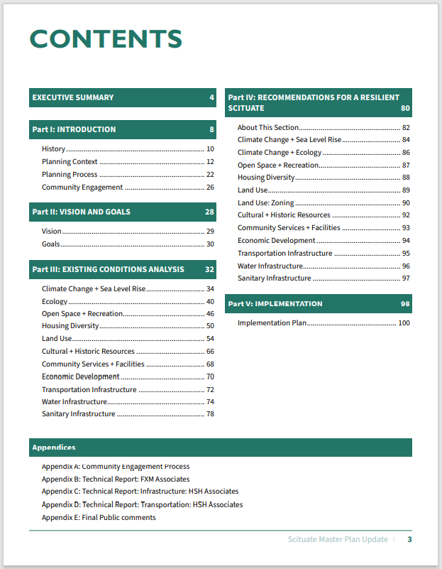
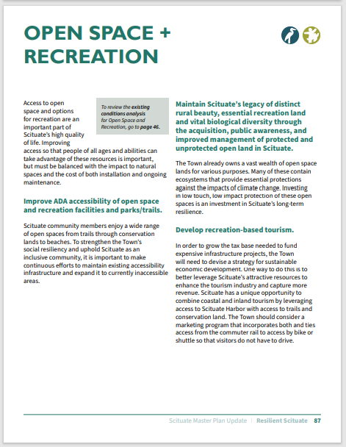
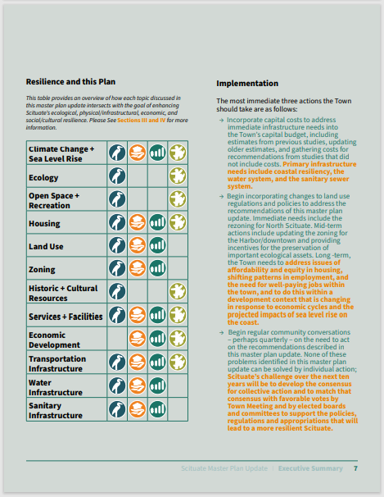
Example Layouts Scituate, MA
Notes:
The Town is in the process of contracting with CitizenLab. While that is occurring, we are working on creating some graphics and maps that will be able to be displayed on the site when it is first launched. We anticipate that more information will become available as public engagement really gets underway in the spring. Initially the website will be useful for introducing the project and putting up some basic project information. We will begin to work on a generalized online survey that will be posted on the website in mid April as an initial engagement and information gathering tool. As soon as the Town has signed the contract we will work with CitizenLab to secure a date by when the website will be ready.

Slide 10
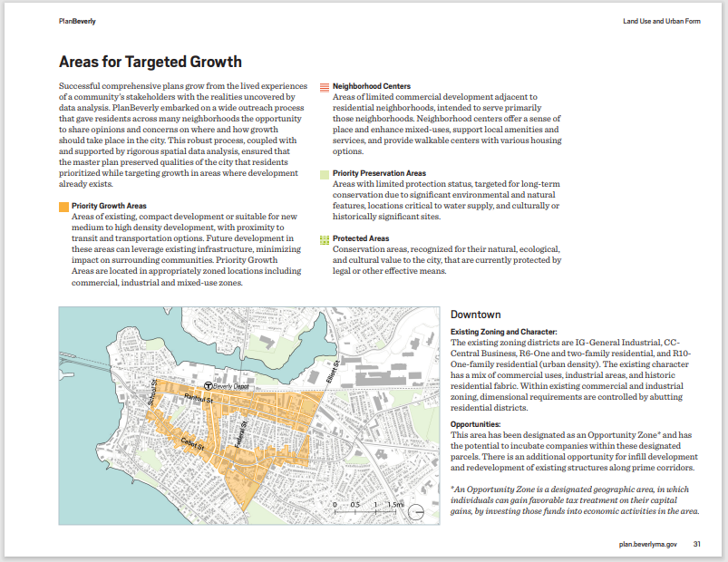
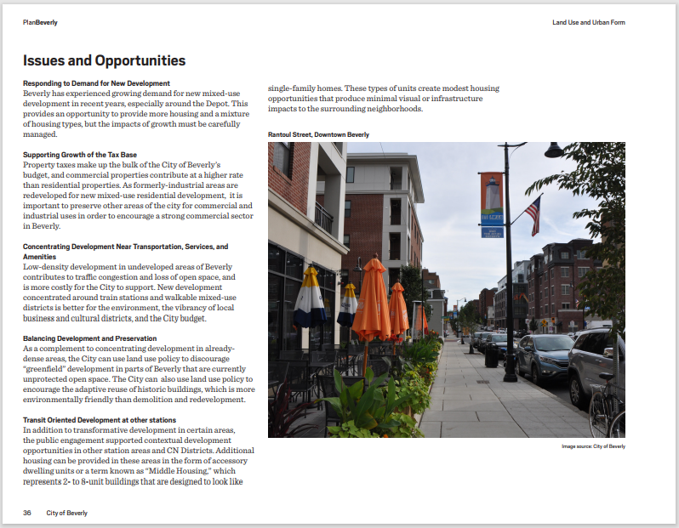
Example Layouts Beverly, MA
Notes:
The Town is in the process of contracting with CitizenLab. While that is occurring, we are working on creating some graphics and maps that will be able to be displayed on the site when it is first launched. We anticipate that more information will become available as public engagement really gets underway in the spring. Initially the website will be useful for introducing the project and putting up some basic project information. We will begin to work on a generalized online survey that will be posted on the website in mid April as an initial engagement and information gathering tool. As soon as the Town has signed the contract we will work with CitizenLab to secure a date by when the website will be ready.

Slide 11
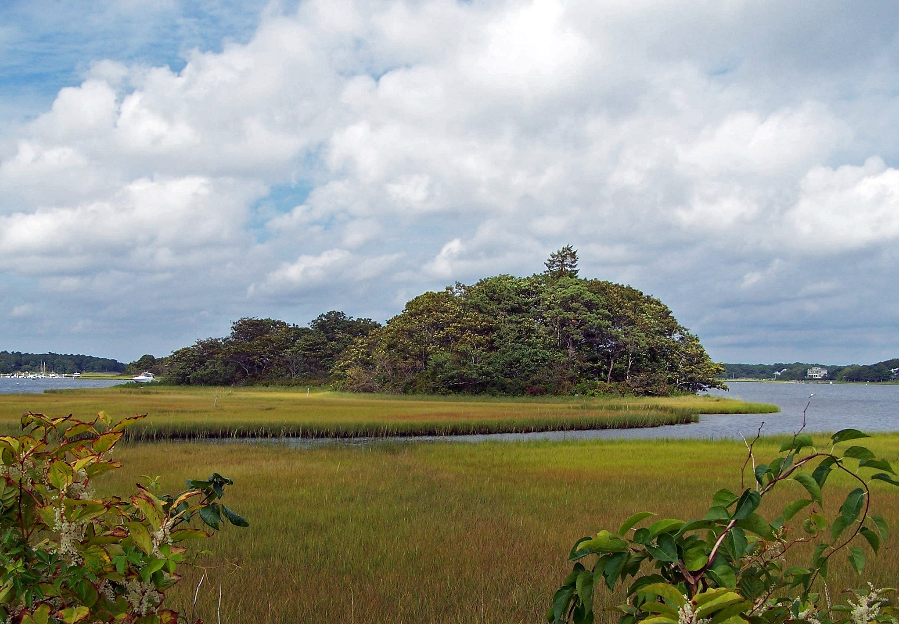
thank you
Photo by U.S. Fish and Wildlife Service.

