Slide 1
MASHPEE COMPREHENSIVE PLAN SURVEY RESULTS
May 17th, 2023
Photo by Susan Dangel

Slide 2
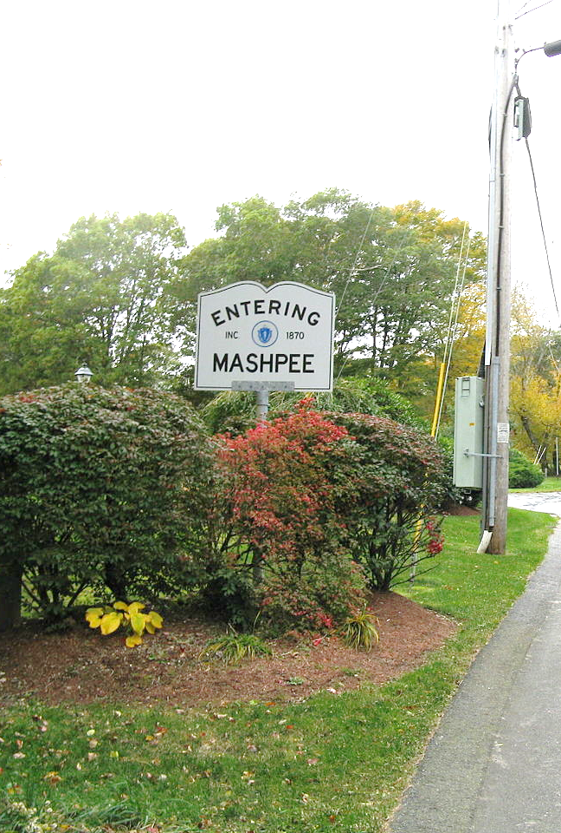
Agenda
Survey Results
Implementation
Photo by John Phelan - Own work, CC BY-SA 3.0, Wikimedia Commons

Slide 3
Participant Demographics By the Numbers
620
1/3
responses to
online survey
of participants have lived in Mashpee for 20+ years
62%
70%
84
of participants are
aged 60 or older
of participants live in
single-family homes
participants live on
waterfront property

Slide 4
Quality of Life
91% of participants responded that their quality of life is “good” or “very good”
What drew people to Mashpee?
High quality public services, access to nature, and overall Town character
An equal number of participants (~20%) reported that their quality of life has improved, as said it has worsened, since they started living in Mashpee
Over 60% of participants cited air and water quality as “very important” factors in their decision to live or buy property in Mashpee

Slide 5
Government Communication
More than 70% of participants use the Town website as a source of receiving government information
How do residents stay updated?
Social Media, Emails, Mashpee TV, Government Website, Public Meetings
1 in 5 participants say they attend meetings for new and general information about the Town
Over 50% of participants expressed a desire for more public meetings to be broadcast on Mashpee TV
Nearly 45% of participants voted that collaboration between the Town and Mashpee-Wampanoag Tribe on projects and grant funding was most important for what they hope to see coming from future joint meetings

Slide 6
Housing
70% of participants agree that Mashpee has a need for more attainable affordable and workforce housing
Residents overwhelmingly agree that new housing is necessary
Almost 77% of participants support redevelopment of existing buildings/properties into housing
23% of participants strongly support donating Town-owned lands to non-profit organizations for the construction of affordable housing projects

Slide 7
Economic Development
12% of participants- view hotels and full-service resorts as “very undesirable”
Consider how to encourage tourism while discouraging larger resorts
Over 75% of participants claimed that they purchase most of their dining, groceries, and medication within Mashpee
1/3 participants felt a strong desire to incorporate technology, blue economy, and cultural/nature-based tourism

Slide 8
Climate, Natural Hazards, and Natural Resources
Climate Change
Nearly 55% of participants voted that they were “very concerned” about climate change and related impacts
Water Resources
Forestry
62% of participants would support the town budgeting for a street tree program
Of 552, 541 participants voted that “ensuring clean and reliable drinking water” is somewhat or very important
Other
Over 50% of participants would support the adoption of a town-wide tree bylaw
1. Construction in the flood zone
2. Pesticide
3. Chemical fertilizer
Between 38% and 54% of participants voted that they strongly support prohibitions on:
However, almost 10% of participants believed education on climate change and sustainability was “totally unimportant”
About 60% of participants were also concerned with improving stormwater management and reducing landfill waste
Only 2%-5% of participants responded with strong opposition to each of these statements

Slide 9
Facilities and Services
Water and Wastewater
Over 2/3 of participants say there should be an update to the Town’s wastewater management plan
Recreation
Participants agreed that ocean beaches and parks meet their needs (~60%)
Other Government Services
Roughly 75% of participants are at least satisfied with first responder services (fire, police, ambulance services)
Over 1/2 of participants support expanding the Town sewer system and addressing PFAS issues
Almost 1/2 of all participants expressed interest in an indoor swimming pool and Town marina
More than 3/4 of participants were strongly supportive of improving Town beach facilities including concessions and restrooms
The library is viewed as the most satisfactory public facility, with almost 84% of participants voting that they are “very satisfied” with it
Between 15% and 20% of participants were unsatisfied with beaches and parking lots, road conditions, and public housing
Roughly 40% of bike trails fail to meet participant expectations
Public Access to Water is the highest recreational priority for Mashpee residents

Slide 10
Transportation
TOP TRANSPORTATION ISSUES
Traffic congestion
Lack of use of public transportation
Pedestrian and bicycle safety
Vehicles
Over 50% of participants claimed that they are
Public Transportation
More than 50% of participants agreed that
Active Transportation
Other
Over 80% of participants are neutral or
Over 98% of participants claimed to “rarely” or
2/3 of participants said they would support
“never” take the local bus
unsatisfied with traffic congestion between
Memorial Day and Labor Day
Roughly 3/4 of participants are neutral or
The “Bus to Boston” was the only form of
sidewalks, crosswalks, and walking trails were
“very important” to Mashpee
satisfied with road conditions, traffic safety,
and wayfinding (street and directional signage)
for Mashpee
an update of the bicycle and pedestrian plan
satisfied with off-season traffic congestion
public transportation that received more than
1% of participants claiming they use it “very
often”
Why Don’t Mashpee Residents Use Public Transit?
Prefer my car
Does not take me where I want to go
Infrequency of service

Slide 11
Implementation
Program for achieving the plan’s goals
Detailed list of the public actions that are proposed
Action
Responsible party
Timeframe
Theme

Slide 12
Goals, Policies, and Actions
GOALS:
Desired outcomes. Simple, broad, high-reaching.
POLICIES:
Statements that guide municipal decision makers so that decisions help to achieve the goals.
ACTIONS:
Specific, measurable acts whose implementation will bring the municipality closer to achievement of its goals.

Slide 13
Goals, Policies, and Actions
Example
Responsible Party
The lead responsible party is identified by bold text with supporting roles by those listed in regular text.
Timeframe
Short-term is typically considered for action items that will be initiated within 0-3 years
Medium-term is typically considered for action items that will be initiated within 4-7 years
Long-term is typically considered for action items that will be imitated within 8 years or more
Ongoing is typically used to identify items that are continuous and do not have a defined end and beginning timeframe
The timeframes can be adjusted and are defined in an introductory paragraph within the implementation chapter
Goal
Protect terrestrial and aquatic habitats for long-term environmental and social benefits.
Policy
Identify areas for coastal and habitat restoration to enhance water quality and improve overall habitat conditions.
Actions | Responsible Party | Timeframe
Continue to maintain navigational channels for not only navigation but for adequate stream and tidal flow. | DCR Select Board Conservation Commission | Ongoing

Slide 14
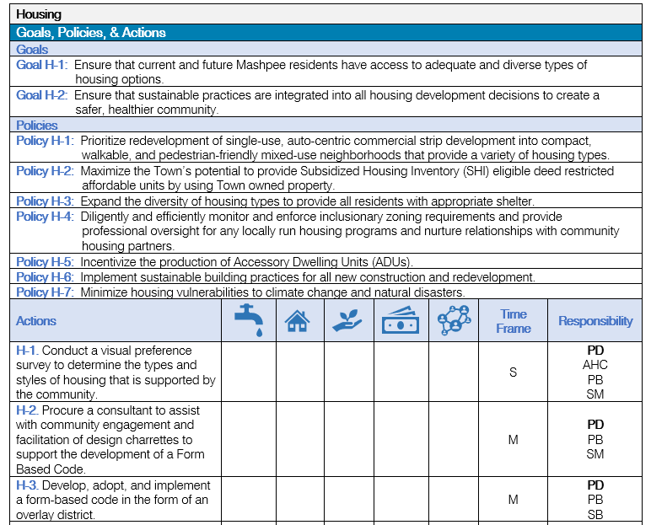
Implementation Table Format

Slide 15
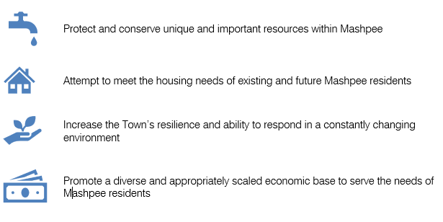
Action Themes

Slide 16
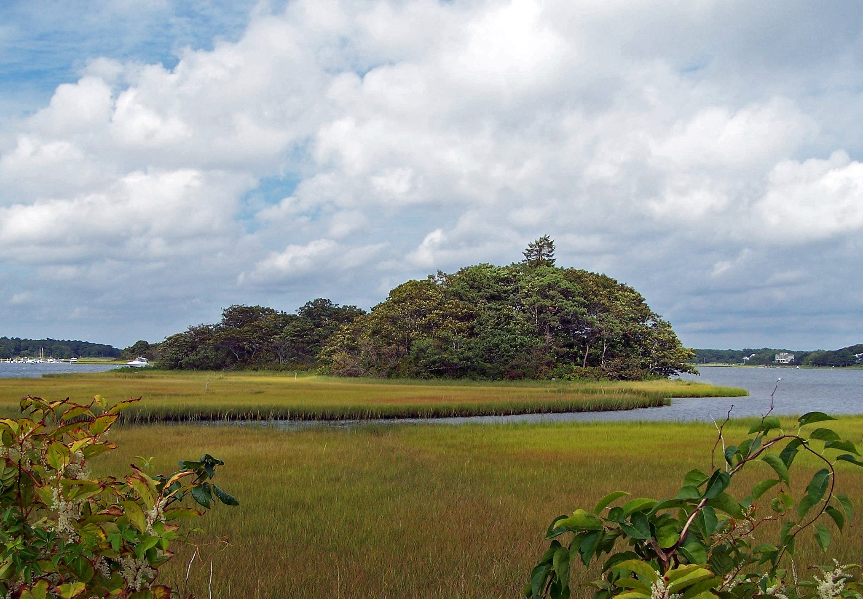
thank you
Photo by U.S. Fish and Wildlife Service.

