Slide 1
MASHPEE LOCAL COMPREHENSIVE PLAN Planning Board Meeting
Photo by Christopher Ryan on Unsplash

Slide 2
Meet The Team
Caroline Wells
Senior Project Manager
Ashley Sweet
Project Manger
Susan Mara
Senior Project Planner
Aqsa Butt
Planner
Jeffrey Maxtutis
Transportation Planning Director
BETA Group Inc.
Emily Slotnick
Community Engagement & Climate Resilience
BETA Group Inc.

Slide 3
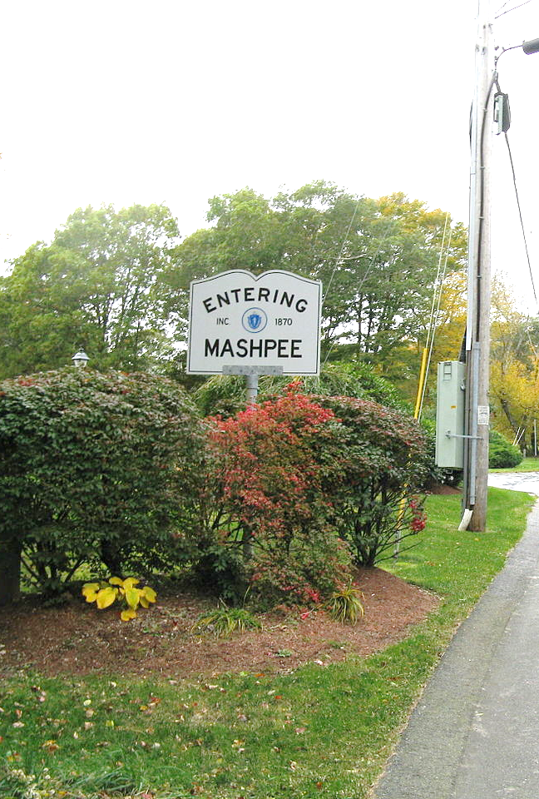
Agenda
Comprehensive Plan Overview
What is a Comprehensive Plan
Comprehensive Plan Process
Project Goals & Objectives
Committee Roles
Cape Cod Commission
Planning Systems
Community Engagement
Community Profile
Photo by John Phelan - Own work, CC BY-SA 3.0, Wikimedia Commons

Slide 4
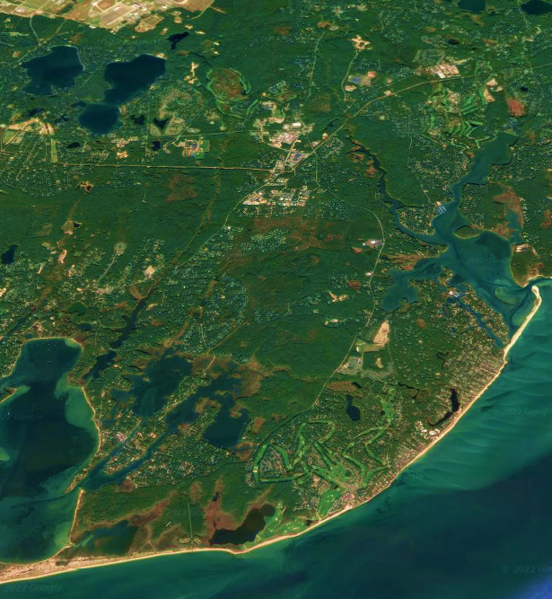
COMPREHENSIVE PLAN OVERVIEW
Photo from Google Earth.

Slide 5
What is a Comprehensive Plan?
…a statement, through text, maps, illustrations or other forms of communication, that is designed to provide a basis for decision making regarding the long-term physical development of the municipality (MGL, Ch. 41, Section 81D).
Framework for Future Development
Clear Actions/Steps for Decision Making
Protect & Manage Natural Resources

Slide 6
What does it do?
Coordinates updated data on the town
Creates a forum to think about the future in local terms
Avoids reactive decision-making
Clarifies priorities so rational financial decisions can be made
Promotes the appropriate use and conservation of land
Identifies ways to improve coordination among municipal entities
Serves as a resource for residents to understand government
Communicates town priorities to federal and state agencies, funders, private investors, etc.

Slide 7
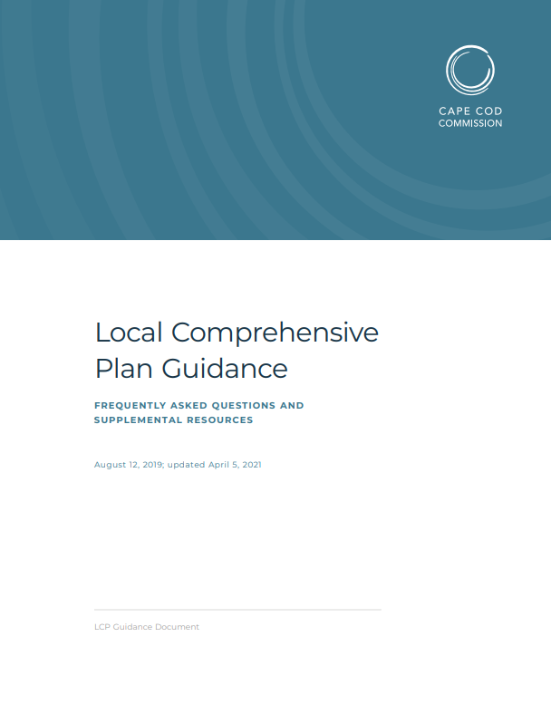
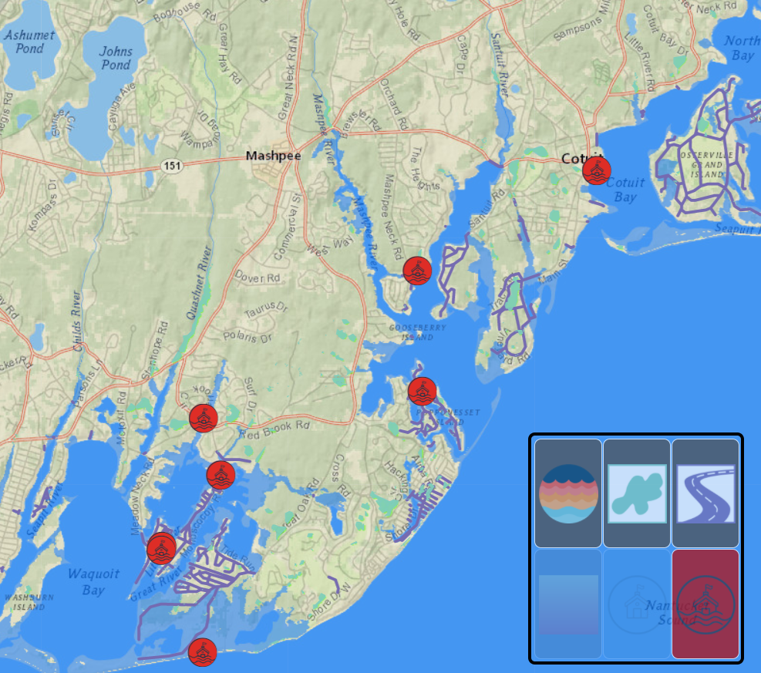
Cape Cod Commission
Regional planning is the Cape Cod Commission’s central role. The Cape Cod Commission assists communities in regional planning efforts to guide development in the region in a sustainable way.

Slide 8
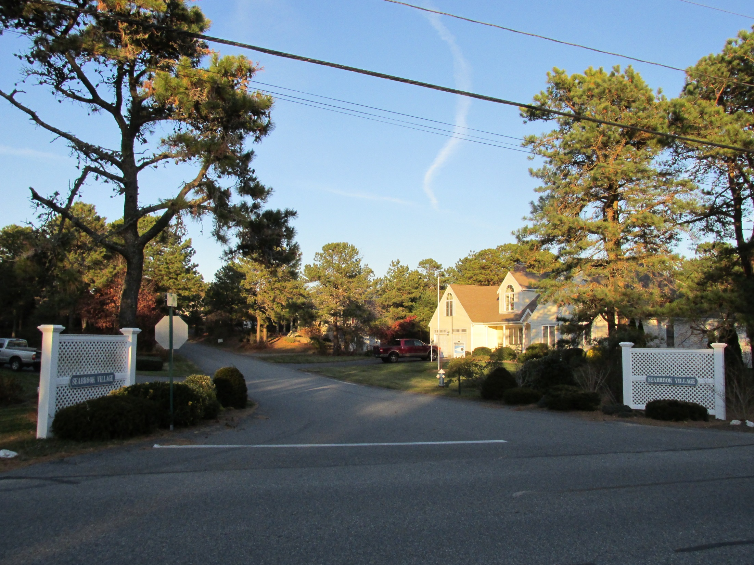
HOW WILL WE GET THERE
Photo by John Phelan - Own work, CC BY-SA 3.0, Wikimedia Commons

Slide 9
Comprehensive Plan Process
Assemble Full Plan Draft
Incorporate Public Comments
Refine Public Engagement Plan
Public Kickoff Meeting with Staff and Team
Prepare Plan
Finalize Plan
Nov-Dec 2021
Jan-Feb 2022
June-Aug 2022
Sep 2022
NOV
DEC
JAN
FEB
MAR
APR
MAY
JUNE
JUL
AUG
SEP
2021
2022
Jan-Feb 2022
Jan-July 2022
July-Aug 2022
Gather and Analyze Data
Launch Public Engagement Activities
Implementation Plan
Data Collection & Analysis
Data Request to the Town
Staff and Stakeholder Interviews
Prepare Draft GIS Maps
Public Event
Establish Project Website
Public Input on Draft
Public Review of Draft
Develop Draft Implementation Plan
Incorporate Public Comments

Slide 10
Community Engagement Workplan
Build Awareness & Participation
Public Workshops
Specific Public Input
Surveys
Expert Interviews
Specific Stakeholders
Website
Flyers
Mailers
Kick Off Meeting
Public Meeting 2

Slide 11
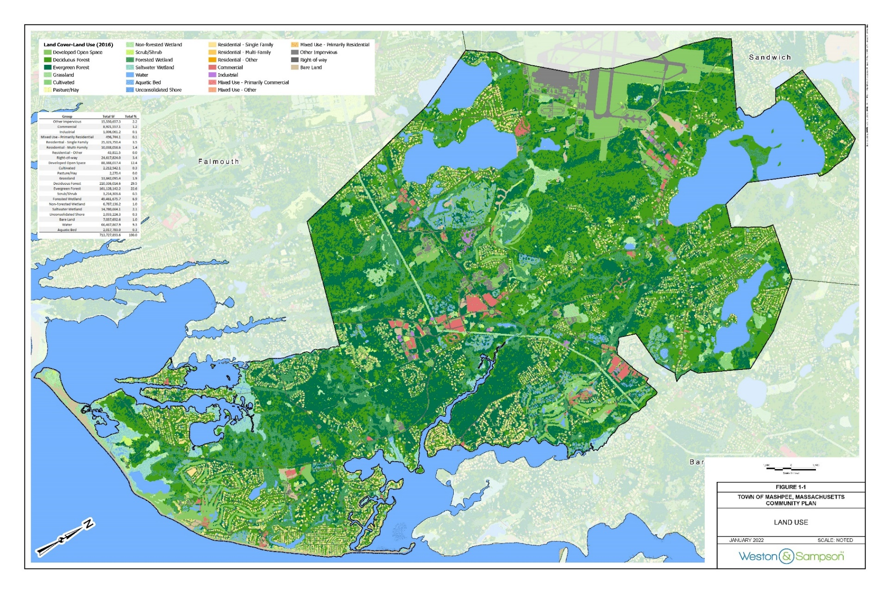
Data and Analysis

Slide 12
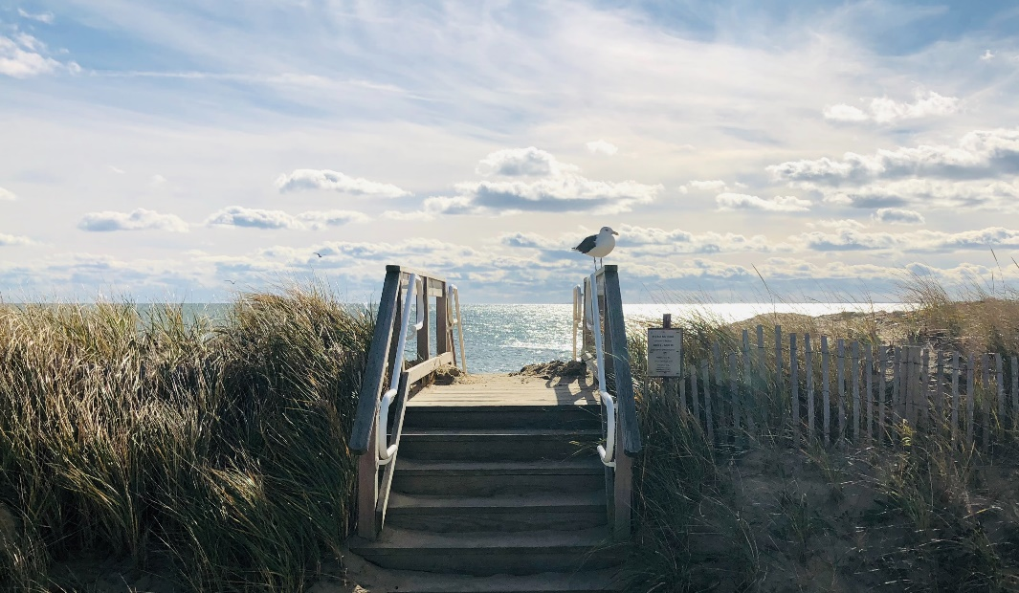
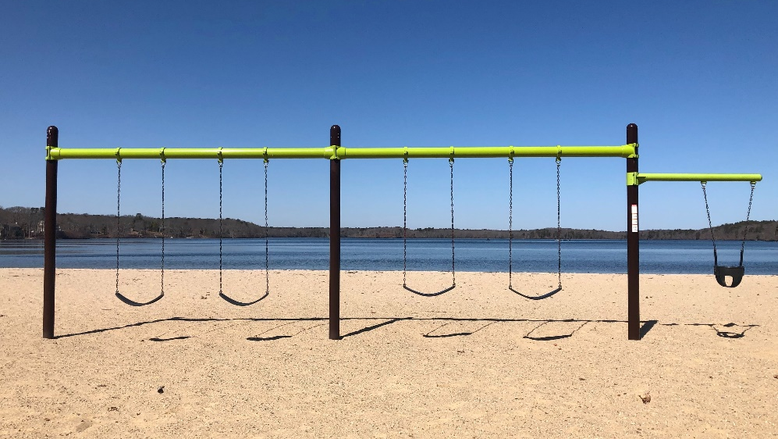
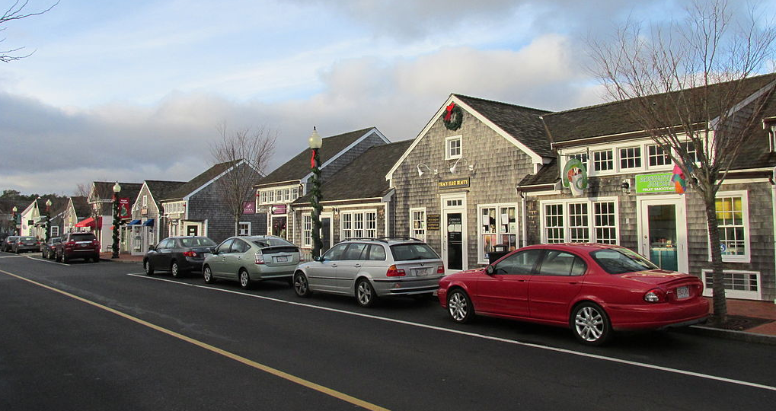
Planning Systems
Natural Systems
Community Systems
Built Systems

Slide 13
Community Placetypes
Natural Areas
Rural Development Areas
Suburban Development Areas
Historic Areas
Maritime Areas
Community Activity Centers
Industrial Activity Centers
Military/
Transportation Areas

Slide 14
Planning Board Roles
Advise
Review
Recommend

Slide 15
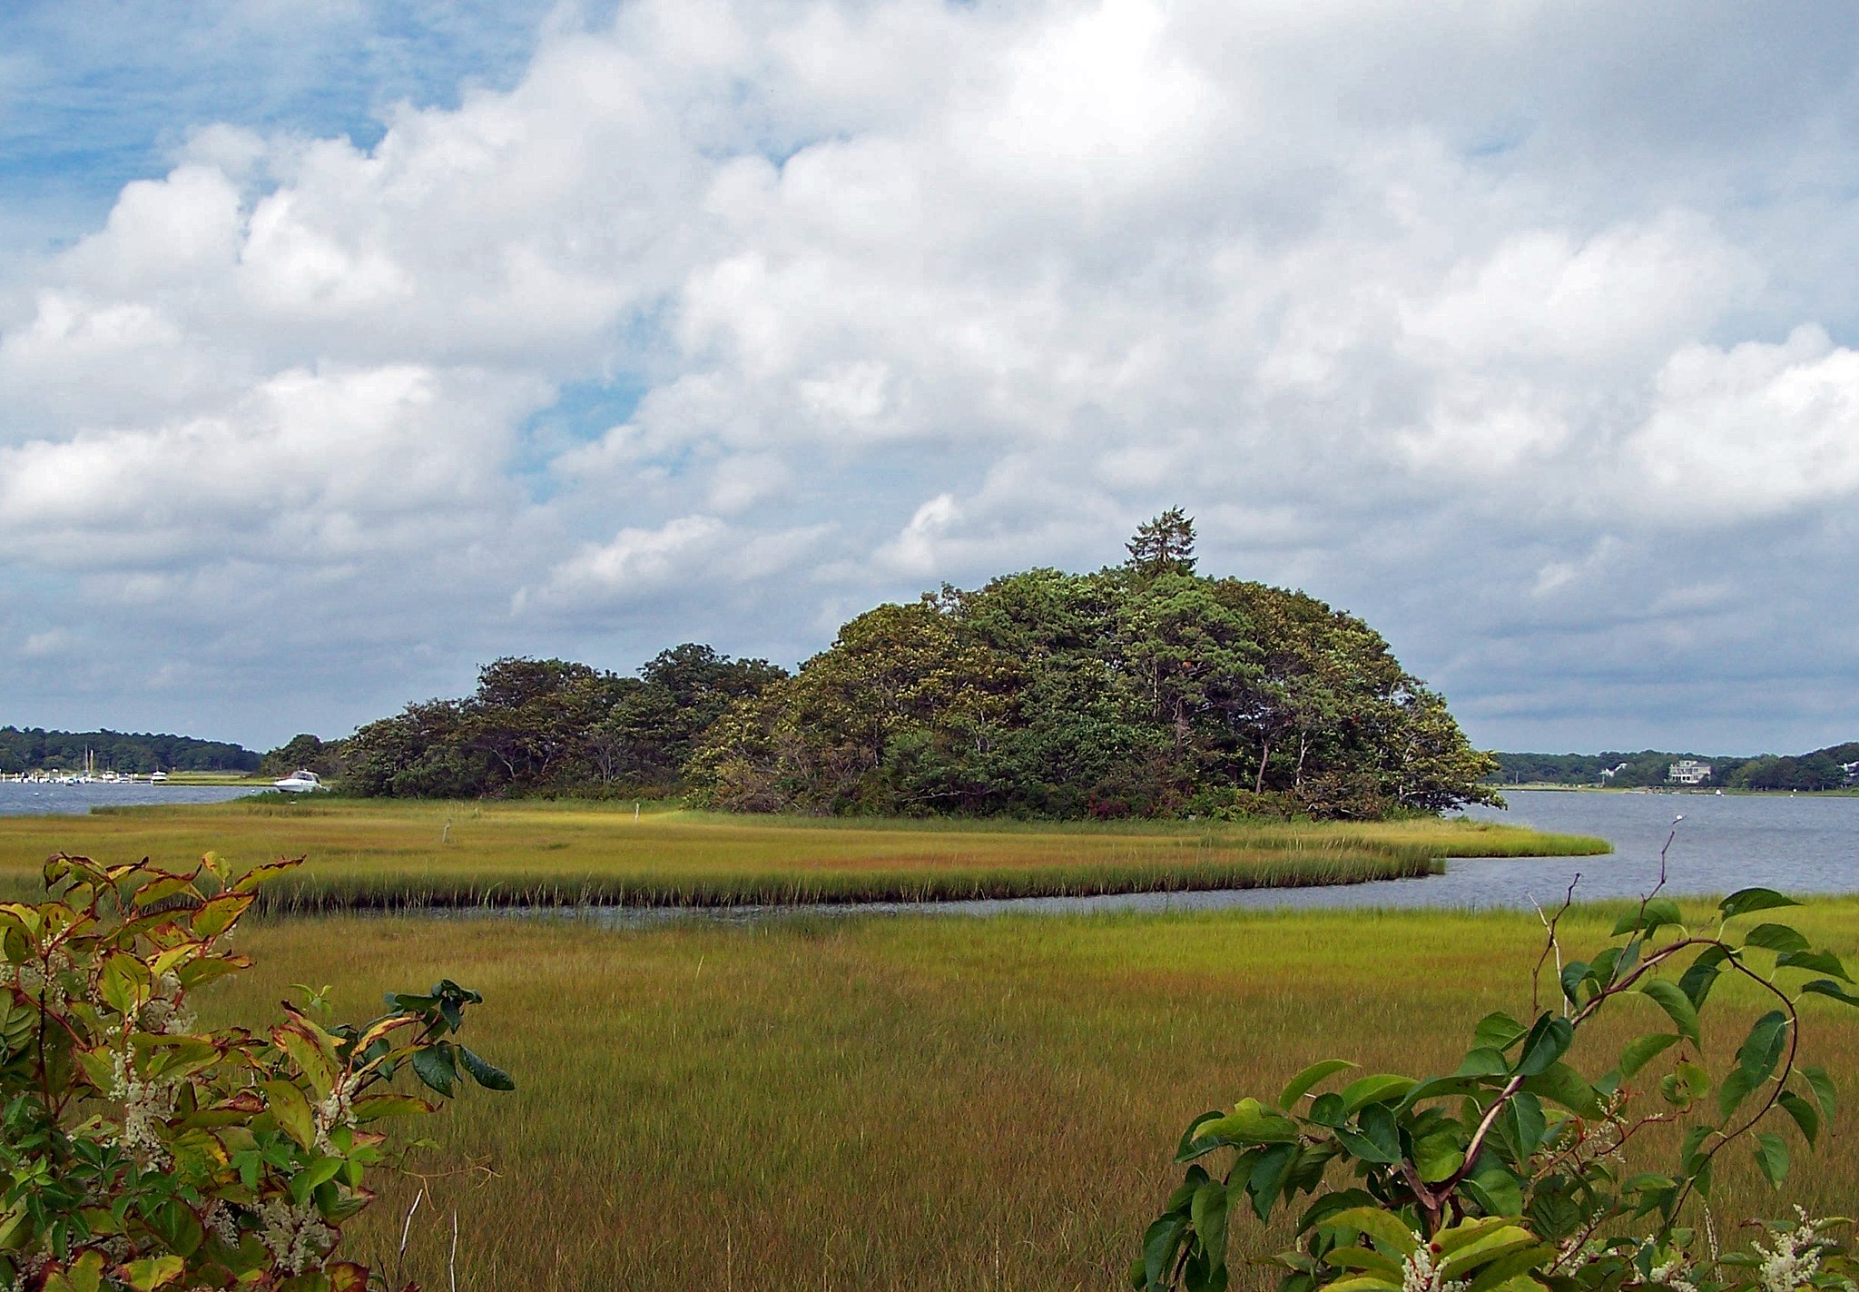
thank you
Photo by U.S. Fish and Wildlife Service.

