Slide 1
Studies on Pollution to Estuaries Regarding Ponds
Meredith H Harris
Sewer Commission 8/10/2023

Slide 2
Studies and Reports Timeline 1948 - 2012
1948 Federal Water Pollution Control Act
1972 Federal Clean Water Act (CWA)
1987 Sewer Commission Formed
1999 Watershed Nitrogen Management Plan
1978, 2013, 2015 Cape Cod Commission 208 Planning Effort
2004 - 2011 Mass Estuaries Project Popponesset Bay
2006 Final Popponesset Bay Report TMDL (Data Collected 1997-2003)
2008 Watershed Nitrogen Management Plan
TOWN OF MASHPEE, POPPONESSET BAY & WAQUOIT BAY EAST WATERSHEDS (Sterns & Wheeler)
2012 Scenarios Results Popponesset Bay & Waquoit Bay, Brian Howes, UMASS Dartmouth SMAST

Slide 3
Studies and Report Timeline 2013 - 2024
2013 Mass Estuaries Project Waquoit Bay
2013 Simulated Effects of Wastewater Management Popponesset Bay Watershed (DA Walter, US Dept of Interior, US Geological Survey)
2015 Comprehensive Watershed Nitrogen Management Plan 2015 Final – Plan Implemented 2022
2017 Town of Mashpee Existing WWTF Evaluation Final Report GHD – more high level WWTF needed
2017 & 2019 Shared Wastewater Management Study Bourne, Falmouth, Mashpee, Sandwich, JBCC– there is need for shared cooperative solutions to nitrogen removal
2001-2022 Santuit Pond Diagnostic Study – severely impaired
2022 Mashpee Pond Water Quality Report Mashpee Dept Natural Resources & Fuss & O’Neil – all ponds internally degraded – different reasons & solutions, milfoil, cyanobacteria, clarity, dissolved O2
2022- 2024 Mashpee Wakeby Pond Study UMA Dartmouth SMAST & Mashpee Dept Natural Resources – Wakeby more impaired than Mashpee but both impaired with nitrogen & phosphorous

Slide 4
Total Daily Maximum Load (TMDL) Studies
September 2004 “Linked Watershed-Embayment Model to Determine Critical Nitrogen Loading Thresholds for Popponesset Bay, Mashpee and Barnstable, Massachusetts” Final Report
January 2005 “Linked Watershed-Embayment Model to Determine Critical Nitrogen Loading Thresholds for the Quashnet River, Hamblin Pond, and Jehu Pond, in the Waquoit Bay System of the Towns of Mashpee and Falmouth, MA” Final Report
October 14, 2005 “FINAL DRAFT: Quashnet River, Hamblin Pond, Little River, Jehu Pond, and Great River in the Waquoit Bay System Total Maximum Daily Loads for Total Nitrogen”
April 10, 2006 “FINAL: Popponesset Bay total Maximum Daily Loads for Total Nitrogen”
RECOMMENDED TMDL .37 - >.50 TN L, actual in Mashpee watershed waters >.67

Slide 5
Mashpee Ponds

Slide 6
Pond Studies Report A Fisher 2022, Mashpee Dept Nat Resources
Santuit 2001, 2009,2010, 2022
Ashumet
Johns
Mashpee Wakeby 2022-2024 – ongoing
All Ponds are impaired: fish survival, invasive mollusks, milfoil, phytoplankton, clarity, low dissolved O2
Studies conducted 1978 - 1980

Slide 7
Mashpee Pond Water Quality & Low Impact Development
Mashpee Ponds: Ashumet, Johns, Mashpee Wakeby, Santuit
Moody, Mill, Amos, Coombs, Martha’s, Trout, FishHook, Dean’s, Deborah Bottles, Witch, Fells, Great Flat, Lily
Ashley Fisher, Mashpee Department of Natural Resources 2022 Report
Cape Cod Commission 2023 Mashpee Ponds Profiles

Slide 8
CC Commission pond & Lake Studies
Cape Cod’s ponds and lakes are fragile. The Commission’s 2003 Pond and Lake Atlas, as well as town-wide and pond specific assessments, identified that most Cape ponds were impaired and not meeting state regulatory surface water standards. The most recent State of the Waters Report from the Association to Preserve Cape Cod concluded that while data are limited, ponds remain impacted, with over one-third of ponds graded as having “unacceptable” water quality in 2019, 2020, and 2021.

Slide 9
Ponds Data CC Commission
On Cape Cod, excess nutrients originate largely from human sources and activities. Excess nitrogen comes from poorly treated wastewater (e.g., Title 5 septic systems) as well as fertilizers used on lawns, gardens, golf courses and farms. Some nitrogen also falls out from the atmosphere in precipitation, and this atmospheric nitrogen largely originates from burning fossil fuels. Excess phosphorus also comes from septic systems that discharge phosphorus into groundwater that enters ponds and lakes, as well as fertilizers used on lawns, gardens, golf courses and farms that is carried into ponds and lakes in stormwater runoff.
Mashpee Profile: 69 PONDS 12 10+ Acre, 21 Named, 25 ACRES Average Pond Size, 35 FEET Average Pond Depth

Slide 11
Findings
Excessive nitrogen (N) originating primarily from on-site wastewater disposal has led to significant decreases in the environmental quality of coastal rivers, ponds, and harbors. In the Towns of Mashpee and Barnstable the problems in coastal waters include:
Loss of eelgrass beds, which are critical habitats for macroinvertebrates and fish
Undesirable increases in macro algae, which are much less beneficial than eelgrass
Periodic extreme decreases in dissolved oxygen concentrations that threaten aquatic life
Reductions in the diversity of benthic animal populations
Periodic algae blooms

Slide 12
Solutions & Cautions
CLEAN UP THE CAPE COD WATERS
With proper management of nitrogen inputs these trends can be reversed
Without proper management more severe problems might develop:
Periodic fish kills
Unpleasant odors and scum
Benthic communities reduced to the most stress-tolerant species
In the worst cases, near loss of the benthic animal communities

Slide 13
Board of Health Regulation 2008
Water quality in certain areas of the Town of Mashpee is degraded.
Excessive nitrogen loading in our watersheds has been identified as a major cause of this degradation.
The primary source of excess nitrogen is wastewater from the on-site septic systems.
This regulation is promulgated in an effort to decrease the amount of nitrogen contribution from septic systems.

Slide 14
Process to identify impaired waters 2008
Federal Clean Water Act (CWA) 1972
Comprehensive (Watershed) Wastewater Management Plan 1999
CWA 303(d) Requires States to Identify & List
Section 208
Impaired Waters
Watersheds all 2003
Pilot Project Case Studies 2004-2008
MassDEP Develops TMDL Report 2008
CWMP Implementation Water Quality Remedial Infrastructure (Sewers etc.) 2013

Slide 15
2023 WOTUS Rule
Written 1972 revised - Under the 2023 Rule, “waters of the United States” include:
(1) traditional navigable waters, the territorial seas, and interstate waters
(2) impoundments of qualifying waters
(3) tributaries to qualifying waters
(4) wetlands adjacent to qualifying waters
(5) certain intrastate lakes and ponds, streams, and wetlands.

Slide 16
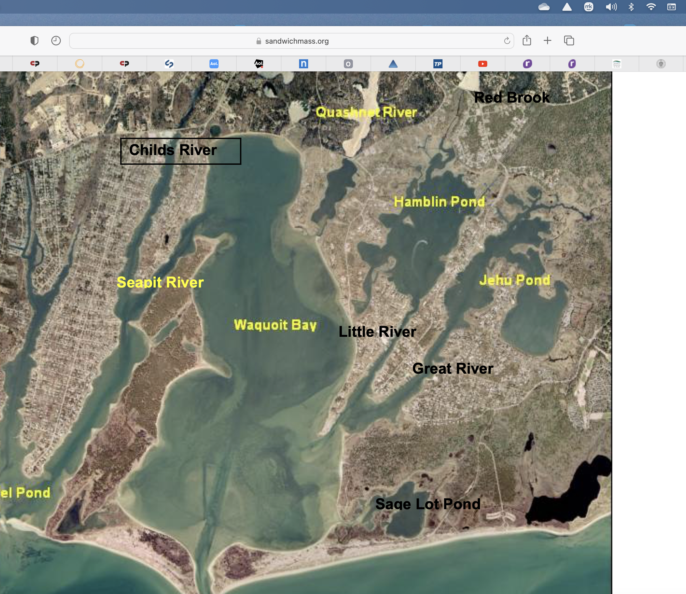
Waquoit Bay Estuarine System
Eel Pond, Childs River, Quashnet River, Hamblin Pond, Jehu Pond, Sage Lot Pond
Relationship of ponds and rivers to Bay
Towns of Falmouth, Mashpee

Slide 17
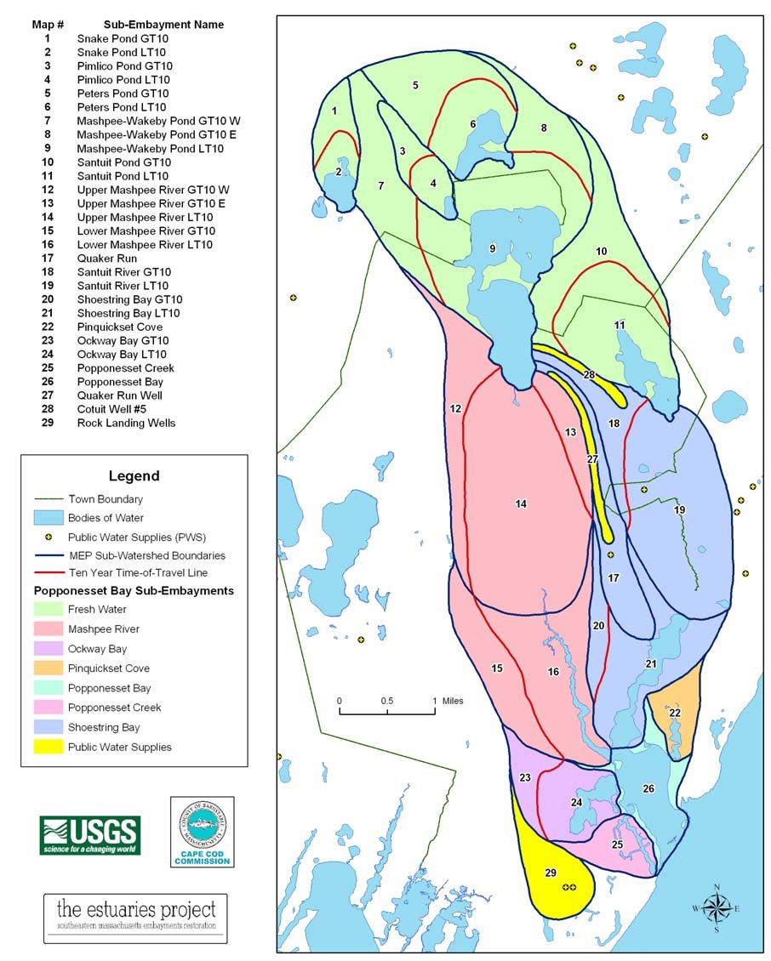
Popponesset Bay watershed
Sandwich Ponds – Snake, Pimlico, Peters
Mashpee Ponds- Mashpee Wakeby, Santuit
Mashpee River
Quaker Run
Santuit River
Shoestring Bay
Pinquickset Cove
Ockway Bay
Popponesset Creek & Bay
Quaker Run Well, Cotuit Well #5, Rock landing Wells

Slide 18
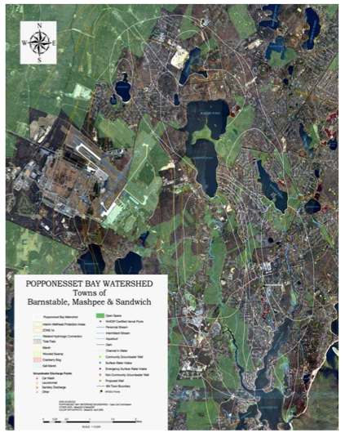
Popponesset Bay Watershed
Towns of
Sandwich
Mashpee
Barnstable

Slide 19
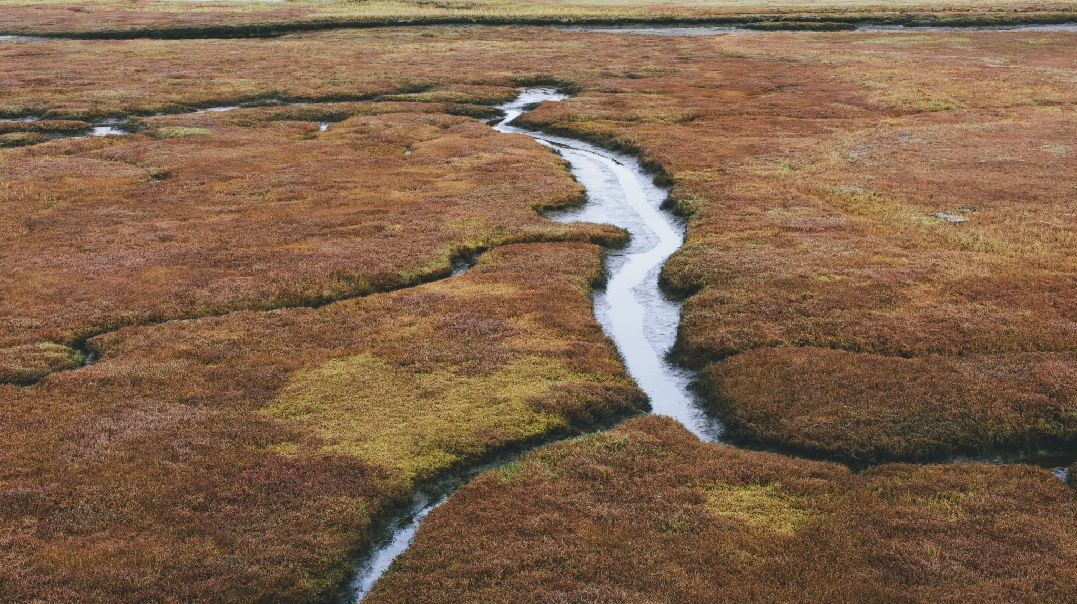
Popponesset Bay Impairment 2008 EPA
the Mashpee River, Shoestring Bay, and Popponesset Bay sub-embayments are listed as impaired waters on the Massachusetts 2006 Integrated List of Waters (http://www.mass.gov/dep/water/resources/2006cmt2.pdf) that require TMDLs (Category 5) to comply with the Clean Water Act under Section 303(d)
The environmental damage affecting the Popponesset, Mashpee River and Shoestring Bay embayments include pollutant loadings from nutrients and pathogens, periodic decreases of dissolved oxygen, decreased diversity of benthic animals, and periodic algal blooms.

Slide 20
Connections: Bay to Nantucket Sound
The Popponesset Bay Watershed & 5 Embayments
Popponesset Bay, Pinquicket Cove, Ockway Bay, Mashpee River, and Shoestring Bay) lie along the southern shores of the Cape Cod Basin.
Three estuarine river systems (Mashpee River, Santuit River, and Quaker Run) discharge directly to the Bay
ultimately discharges to Nantucket Sound through a single outlet

Slide 21
Study Contributors
University of Massachusetts Dartmouth Marine (SMAST) Brian Howes, Ed Eichner
Coastal Studies, UMASS Dartmouth
Massachusetts Environmental Protection Agency (MEP)
Cape Cod Commission
Mashpee Wampanoag Tribe
Department of Environmental Protection (DEP)
Mashpee Department of Natural Resources (Ashley Fisher)
Association to Preserve Cape Cod (APCC)

