Slide 1


Mashpee Water Quality Monitoring Program
Summary of Nutrient Related Health of
Mashpee’s Estuaries (summer 2018)
Town of Mashpee
Mashpee Wampanoag Tribe
SMAST-UMASSD Collaboration
For Estuarine Restoration
Brian L. Howes, Director
Coastal Systems Program
School of Marine Science & Technology
University of Massachusetts – Dartmouth
July 22, 2019

Slide 2
Major Anthropogenic Problem Facing Estuaries Globally
Habitat Degradation:
increased nitrogen loading is the major threat to estuaries, world-wide;
Nitrogen enrichment is causing impairments to estuarine resources in portions of most Cape Cod Estuaries.

Slide 3
Status: Mashpee Waquoit Bay
Upper regions of each estuary showing the greatest level of nutrient related water quality decline. Eelgrass lost from both systems.

Slide 4
Status: Mashpee Popponesset Bay
Upper regions of each estuary showing the greatest level of nutrient related water quality decline. Eelgrass lost from both systems.

Slide 5
Nitrogen management is the only way to restore degraded estuarine habitat, primarily through:
→ Increased tidal exchange
→ Control of watershed nitrogen sources
→ Increased Nitrogen removal in transport
How do we restore and protect
our estuaries?

Slide 6
Mashpee Water Quality Monitoring Program
Goals:
-- to assess the current nutrient related water quality of each estuary within the Town of Mashpee
-- to track short & long-term changes in embayment health
-- to yield site specific validation of the effectiveness of Nitrogen Management Alternatives and for TMDL compliance

Slide 7
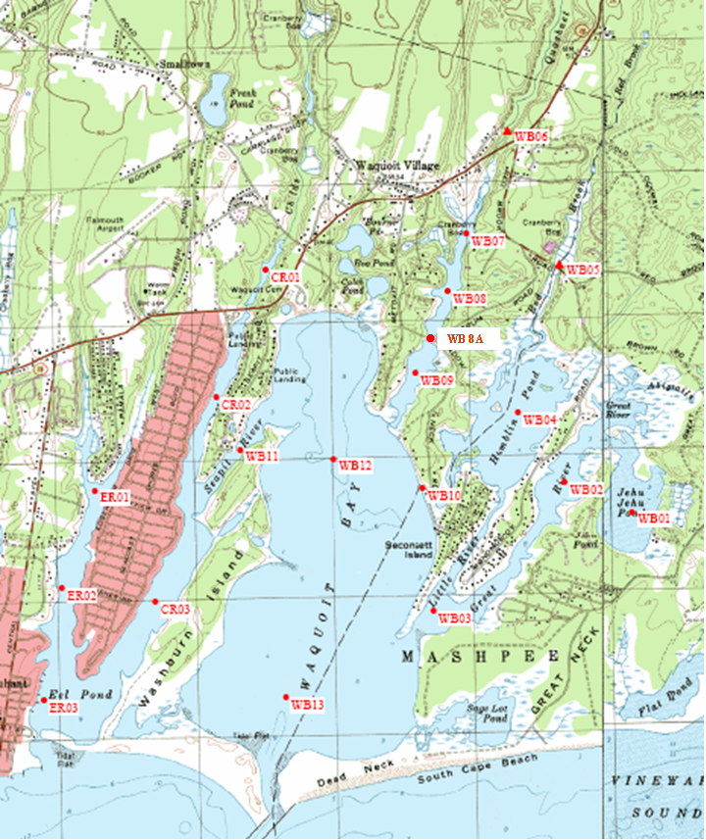
Estuarine Monitoring: Town of Mashpee
Waquoit Bay Water Quality Stations
2010-2018
18 estuarine stations monitored
4 sampling events

Slide 8
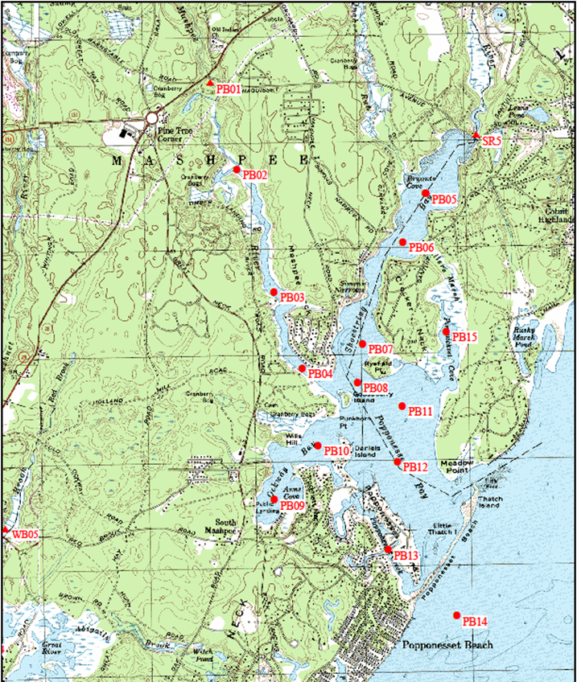
Estuarine Monitoring: Town of Mashpee
Popponesset Bay Water Quality Stations
2010-2018
16 estuarine stations
4 sampling events

Slide 9
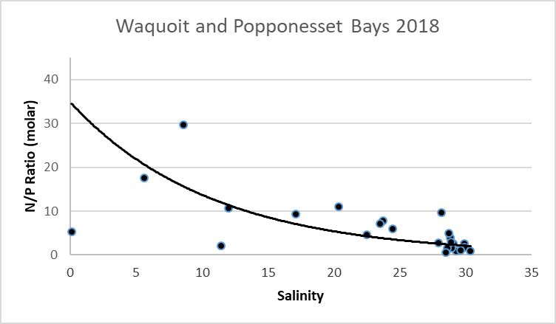
Estuarine Monitoring 2018
Systems Need to be Managed for Nitrogen
N/P Ratio (molar)
P - Fertilizes
N - Fertilizes
Salinity (ppt)

Slide 10
Estuarine Monitoring
Nitrogen Responsible for Phytoplankton Blooms

Slide 11
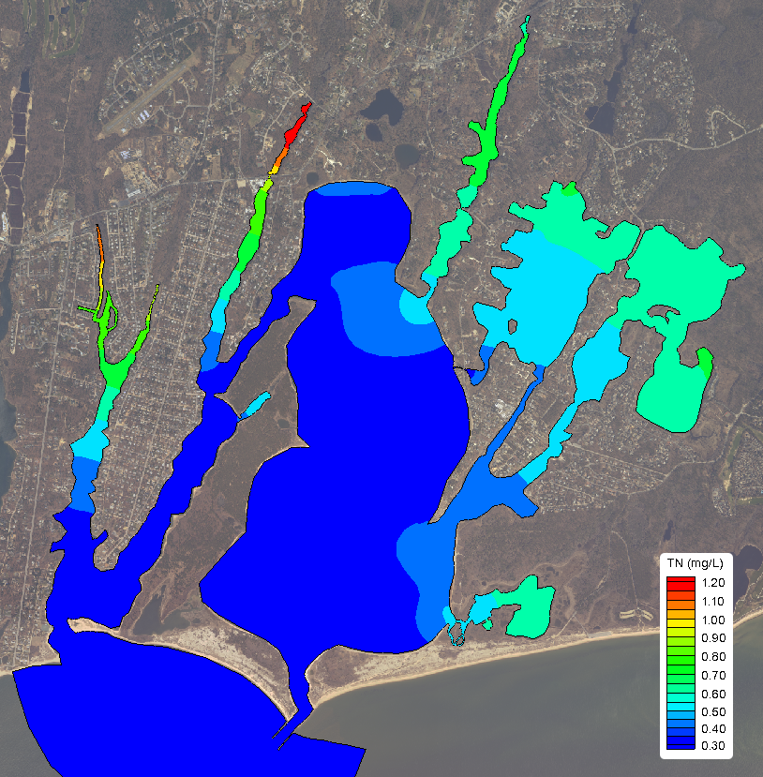
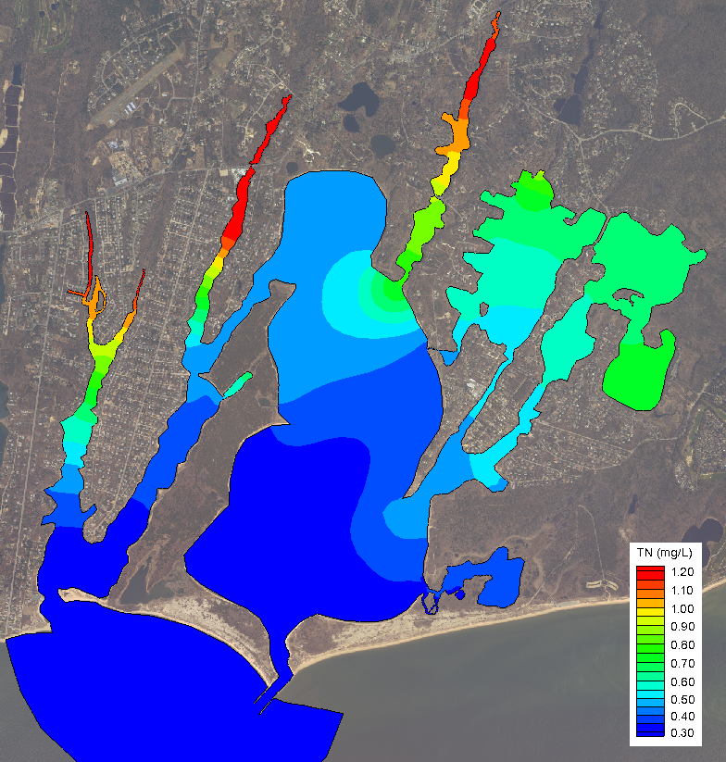
2010 N Loading
Build-out Loading
Tidally Averaged Total Nitrogen (mg/L) Gradient

Slide 12
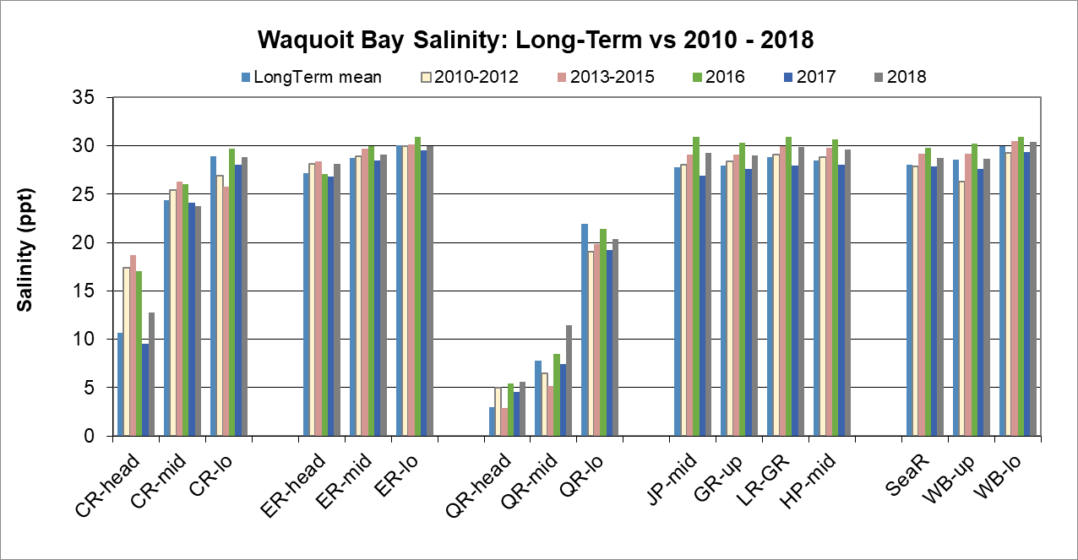
Estuarine Monitoring Waquoit Bay Salinity
CR: Childs River, ER: Eel River, QR: Quashnet River, JP: Jehu Pond, HP: Hamblin Pond, WB: Waquoit Bay main basin

Slide 13
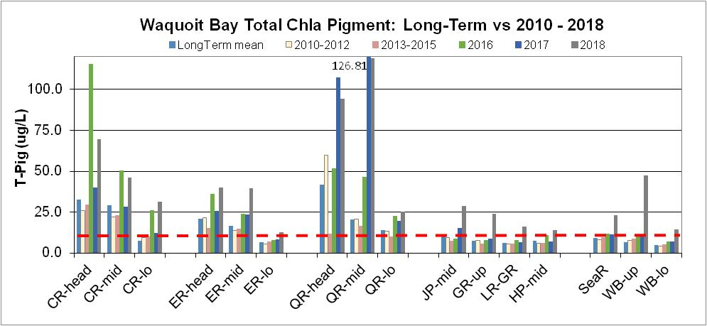
Waquoit Bay Monitoring Results: Phytoplankton Biomass (Chlorophyll-a)
Highest in least flushed basins
Sound
CR: Childs River, ER: Eel River, QR: Quashnet River, JP: Jehu Pond, HP: Hamblin Pond, WB: Waquoit Bay main basin

Slide 14
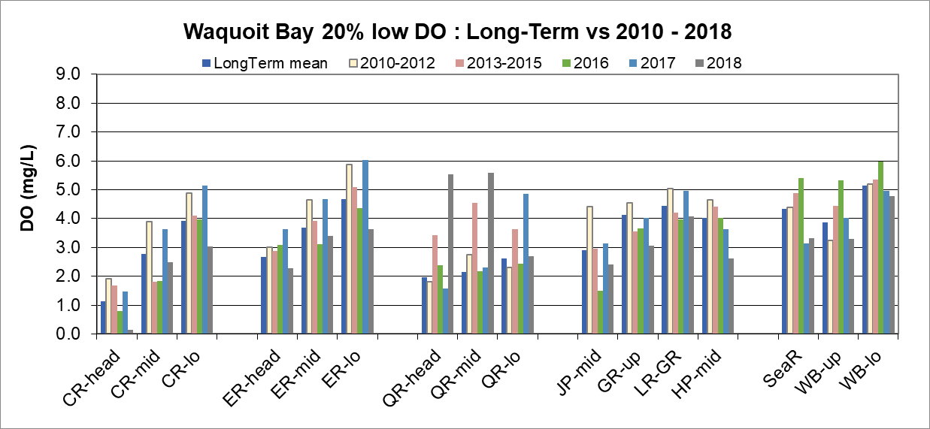
Waquoit Bay Monitoring Results: 20% Lowest D.O.
All Stations Showed Stress in 2018
Water Quality Classification: SA
Stress
CR: Childs River, ER: Eel River, QR: Quashnet River, JP: Jehu Pond, HP: Hamblin Pond, WB: Waquoit Bay main basin

Slide 15
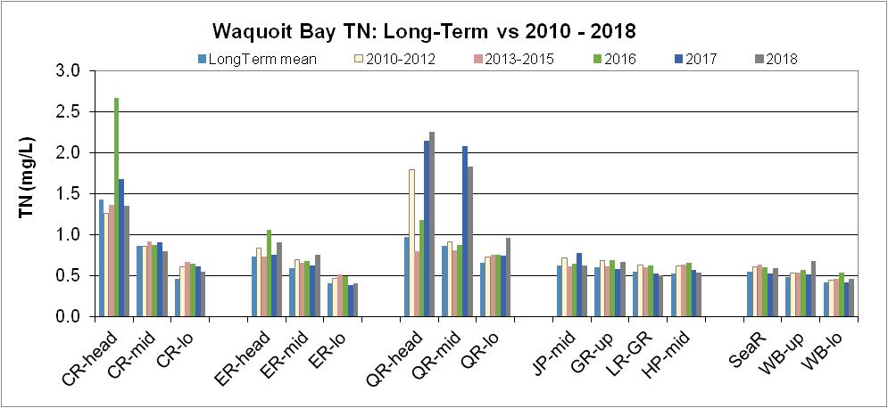
Waquoit Bay Monitoring Results: Total N
Threshold TN 0.5 mg/L
All Sites Over TMDL Nitrogen Threshold in All Years
Threshold TN 0.38 mg/L
CR: Childs River, ER: Eel River, QR: Quashnet River, JP: Jehu Pond, HP: Hamblin Pond, WB: Waquoit Bay main basin

Slide 16
Waquoit Bay Shellfish Sites: Total N
TN Lowered at Seeding Sites 2017-18
Seed
Seed
Great+Little River = Hamblin Pond: Quahog Seeding = 10 Mill in 2014-2016, pre-2018 season 11 Mill seed
WB: Waquoit Bay main basin, SeaR: Seapit River

Slide 17
Estuarine Quality Index
Red = Poor
Yellow = Moderate
Blue = High
Estuarine Quality Index
Red = Poor
Yellow = Moderate
Blue = High
Long-term -
2018 only -
Long-term -
2016 only -
Waquoit Bay Water Quality
2001-2018
Significant N enrichment in upper tributaries
Eastern embayments moderately N enriched
Quashnet continues to have poor water quality
2018 water quality, increased in terminal ponds (Hamblin, Jehu).
WB07
CR01
WB08
CR02
WB09
WB04
WB11
WB12
ER01
WB10
WB02
WB01
ER02
CR03
WB03
ER03
WB13

Slide 18
Status: Mashpee Waquoit Bay
Upper regions of each estuary showing the greatest level of nutrient related water quality decline. Eelgrass lost from both systems.

Slide 19
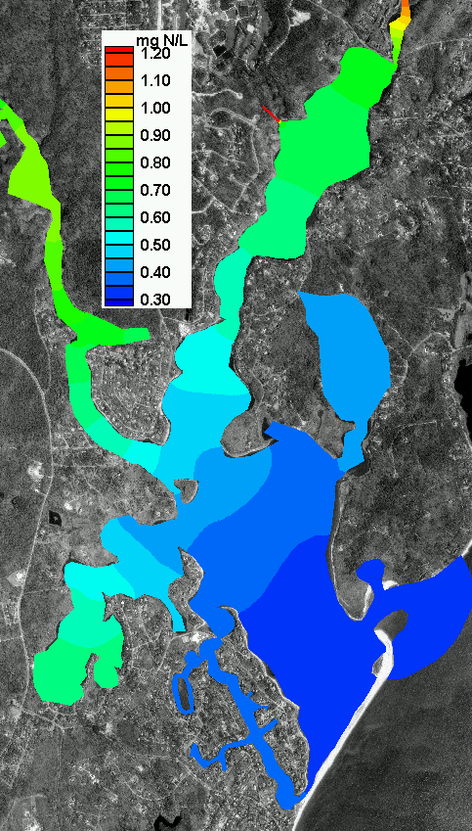
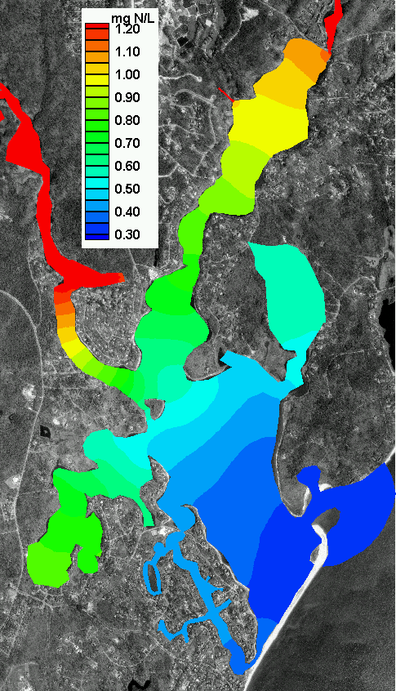
Nitrogen Levels: 2008
Nitrogen Levels: Build-Out

Slide 20
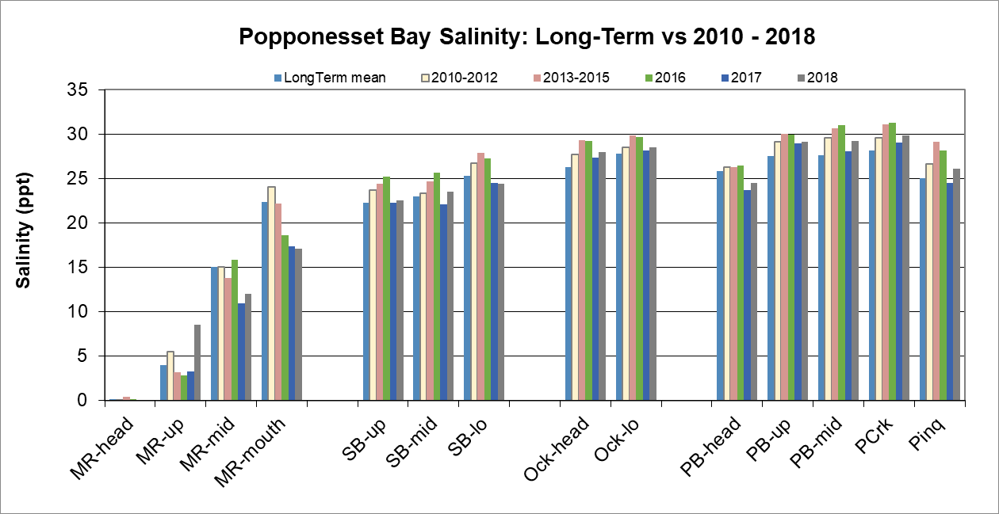
Monitoring Results: Popponesset Bay Salinity
MR: Mashpee River, SB: Shoestring Bay, Ock: Ockway Bay, Pinq: Pinquickset Cove, PCrk: Popponesset Creek, PB: Popponesset Bay

Slide 21
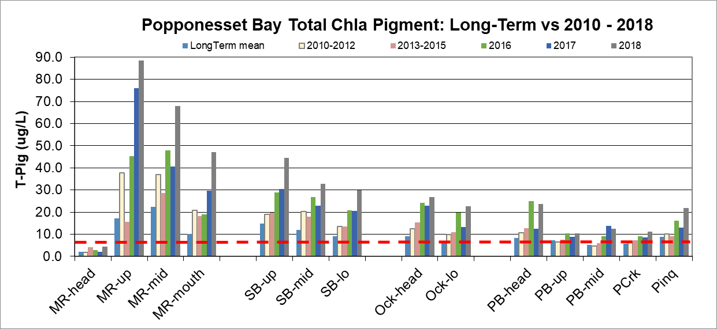
Popponesset Bay Monitoring Results: Phytoplankton Biomass (Chlorophyll-a)
Major Blooms in Each of Past 3 years
Nantucket Sound
MR: Mashpee River, SB: Shoestring Bay, Ock: Ockway Bay, Pinq: Pinquickset Cove, PCrk: Popponesset Creek, PB: Popponesset Bay

Slide 22
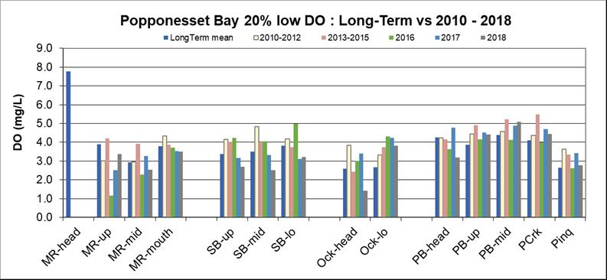
Popponesset Bay 20% Lowest D.O.
Water Quality Classification: SA
Oxygen Stress in ALL Tributary Basin over past 3 Summers
Stress
MR: Mashpee River, SB: Shoestring Bay, Ock: Ockway Bay, Pinq: Pinquickset Cove, PCrk: Popponesset Creek, PB: Popponesset Bay

Slide 23
Estuarine Monitoring Results: TN
TN at ALL Stations Exceed TMDL TN Threshold
MR: Mashpee River, SB: Shoestring Bay, Ock: Ockway Bay, Pinq: Pinquickset Cove, PCrk: Popponesset Creek, PB: Popponesset Bay

Slide 24
Estuarine Quality Index
Red = Poor
Yellow = Moderate
Blue = High
Long-term -
2018 only -
Popponesset Bay Water Quality
Large and Significant N enrichment in upper tributaries; nutrient impairments throughout
Large phytoplankton blooms each summer
Slight TN decline associated with oyster culture in Mashpee River, but still impaired by N
SR5
PB02
PB05
PB06
PB03
PB07
PB15
PB04
PB08
PB11
PB10
PB09
PB12
PB13
PB14

Slide 25
Status: Mashpee Popponesset Bay
Upper regions of each estuary showing the greatest level of nutrient related water quality decline. Eelgrass lost from both systems.

Slide 26
Popponesset and Waquoit Bays
Findings:
Bays are showing little improvement in shellfish areas, are stable or declining in other areas. Almost all estuarine basins now showing impaired Habitat Quality.
The historically highest quality areas are now showing slow declines in habitat quality (e.g. Upper/Lower Main Basin of Popponesset Bay and Waquoit Bay)
Data indicate organic enrichment due to N inputs. Indicating that lowering N levels will reduce phytoplankton biomass and improve water clarity and oxygen conditions resulting in restored animal and plant habitats.
Results indicate that Monitoring Program is able to detect changes in response to implementation of management alternatives.
26

Slide 27
Estuarine Monitoring:
Popponesset Bay and Waquoit Bay
Findings:
Upper reaches of all estuarine basins are significantly impaired by excess nitrogen
Results indicate that Monitoring Program is able to detect changes in response to implementation of management alternatives.
Tracking water quality versus TMDL targets will be used to support adaptive management & reduce infrastructure costs as N removals start.
27

Slide 28
Estuarine Monitoring: Popponesset Bay and Waquoit Bay
THANK YOU !
Mark Weissman Colin Grant, Bert Crothers, D. Sergio M Granville, Hurwitz, Jane & Rick Troubreidge, P. Zamrhitto, C Stringer

Slide 29
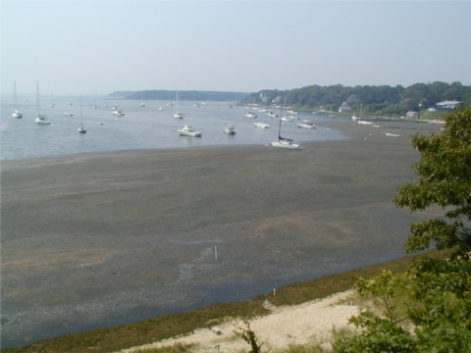
“Knowledge and Need are the Basis of Innovation”
Questions & Discussion

